Slide 1
Exploring the Charm of Paris
Uncover the Allure of the City of Love

Slide 2
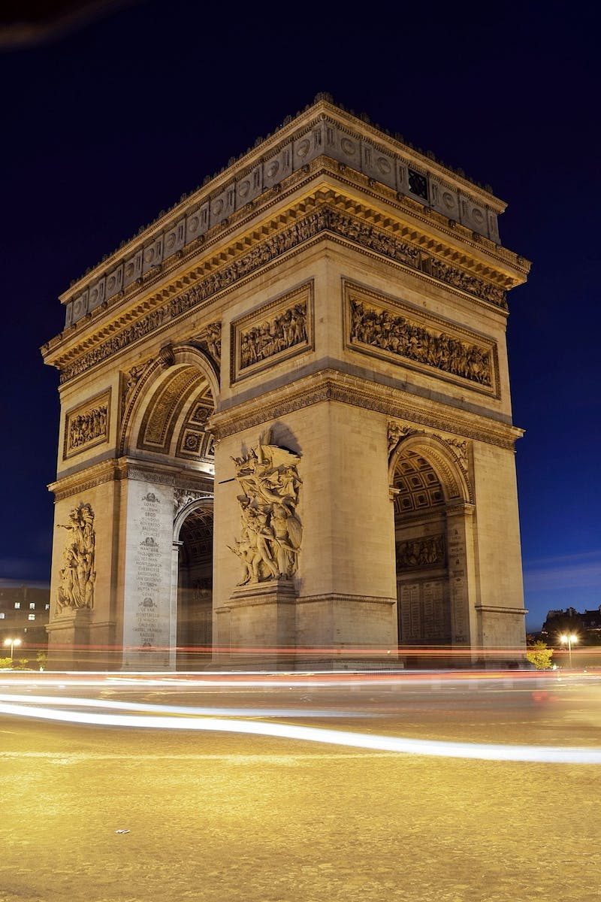
Introduction to Paris
• Sun dress and Paris
• Little Paris with a big heart
• Discover the charm of the city
• Replica of the real Paris
Photo by Pexels

Slide 3
Tres Simplest Paris
• Unveiling the simplicity of Paris
• Cherish the simplicity and elegance
• Experience the essence of Parisian lifestyle
• Discover the joy in the little things
Photo by Pexels

Slide 4
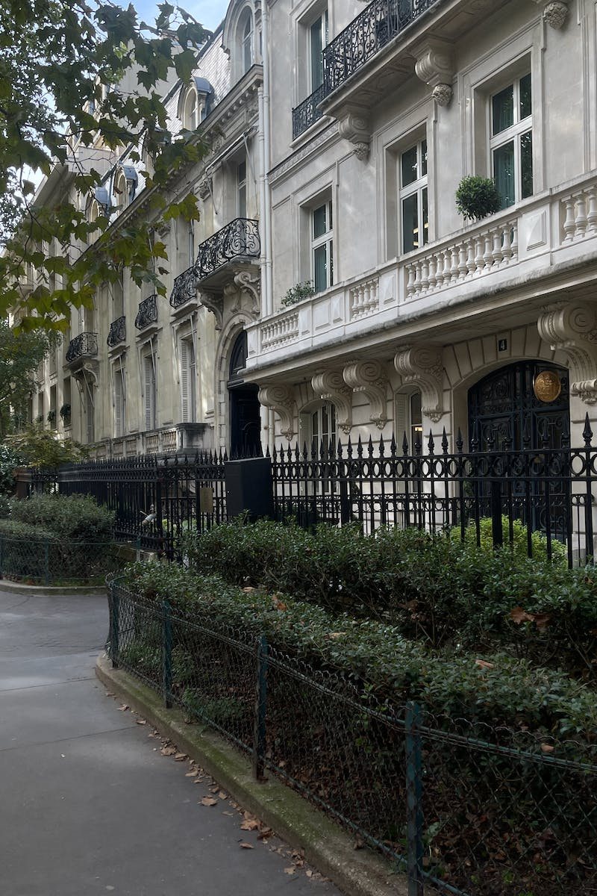
The Allure of Replica Paris
• Uncovering the magic of replica Paris
• Exploring the replicated landmarks
• Understand the significance of replicas
• Experience Paris in a unique way
Photo by Pexels

Slide 5
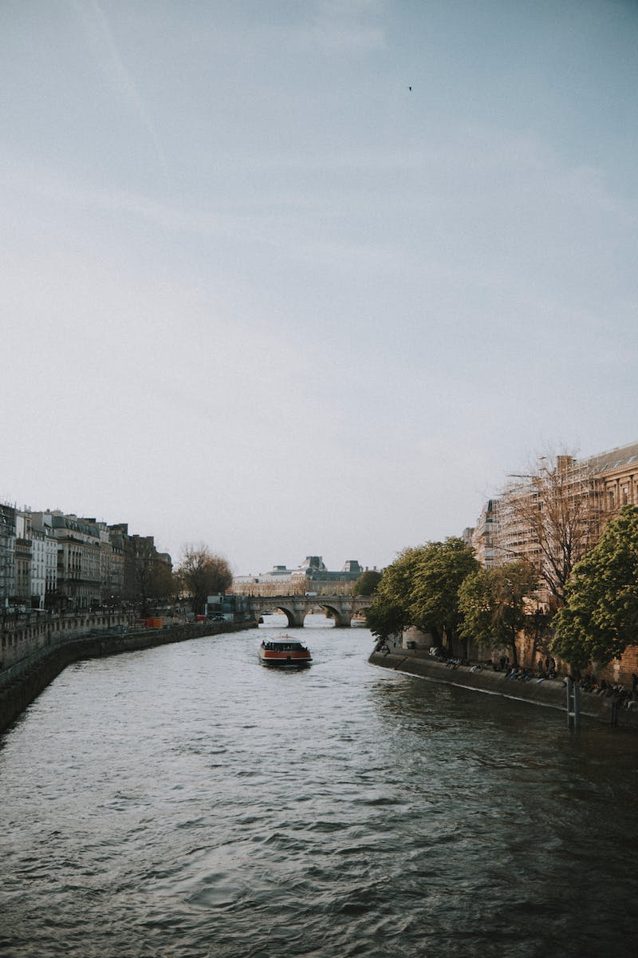
The Parisian Vessels
• Unveiling the vessels of Paris
• Discover the charm of Parisian boats
• Cruise along the Seine River
• Experience the heart of Paris
Photo by Pexels

Slide 6
Cuisine and Culture of Paris
• Indulge in Parisian cuisine
• Experience the culinary delights
• Immerse in Parisian art and culture
• Explore iconic museums and attractions
Photo by Pexels

