Slide 1
The Power of Artificial Intelligence
Exploring the Impact and Potential of AI

Slide 2
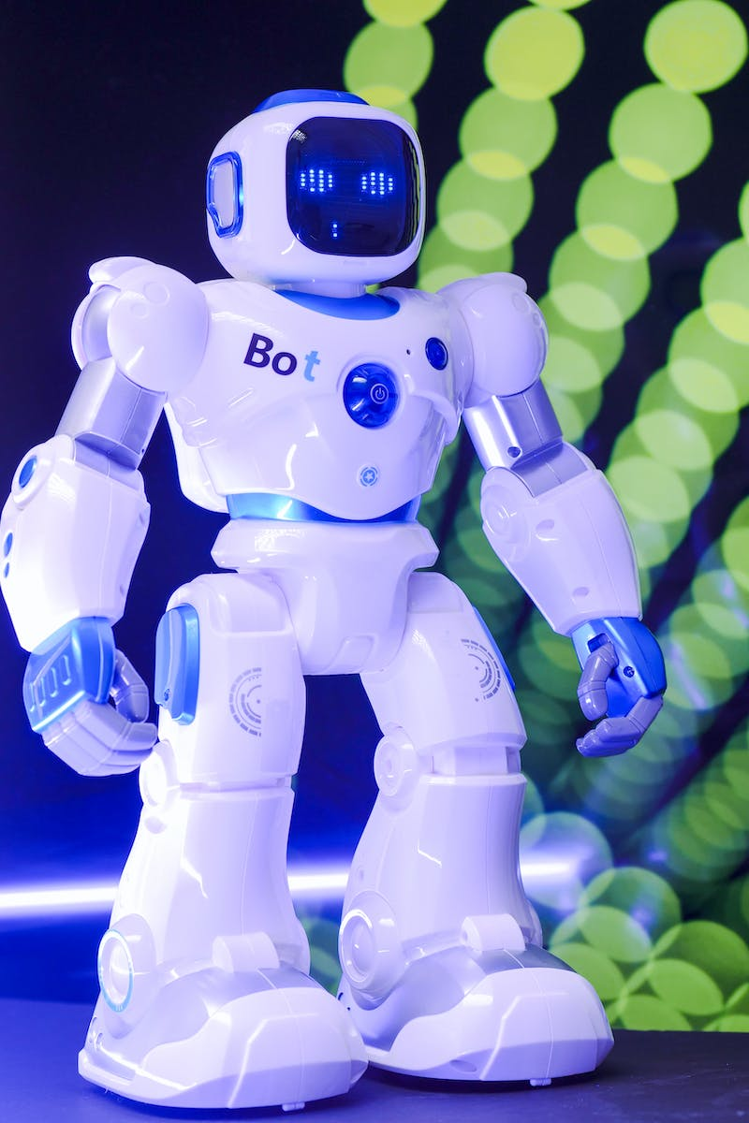
Introduction to AI
• AI is a branch of computer science that aims to create intelligent machines
• Machine learning is a key component of AI, enabling machines to learn and improve from data
• AI has the potential to revolutionize various industries and improve people's lives
• AI can be categorized into narrow AI and general AI, with different capabilities
Photo by Pexels

Slide 3
Machine Learning Algorithms
• Supervised learning enables machines to learn from labeled training data
• Unsupervised learning allows machines to find patterns and relationships in unlabeled data
• Reinforcement learning uses a reward system to train machines through trial and error
• Deep learning involves neural networks with multiple layers for complex learning tasks
Photo by Pexels

Slide 4
Applications of AI
• AI is used in healthcare for diagnosis, treatment, and drug discovery
• Autonomous vehicles use AI for navigation, perception, and decision-making
• AI-powered chatbots improve customer service and support
• AI is transforming the finance industry with fraud detection and risk assessment
Photo by Pexels

Slide 5
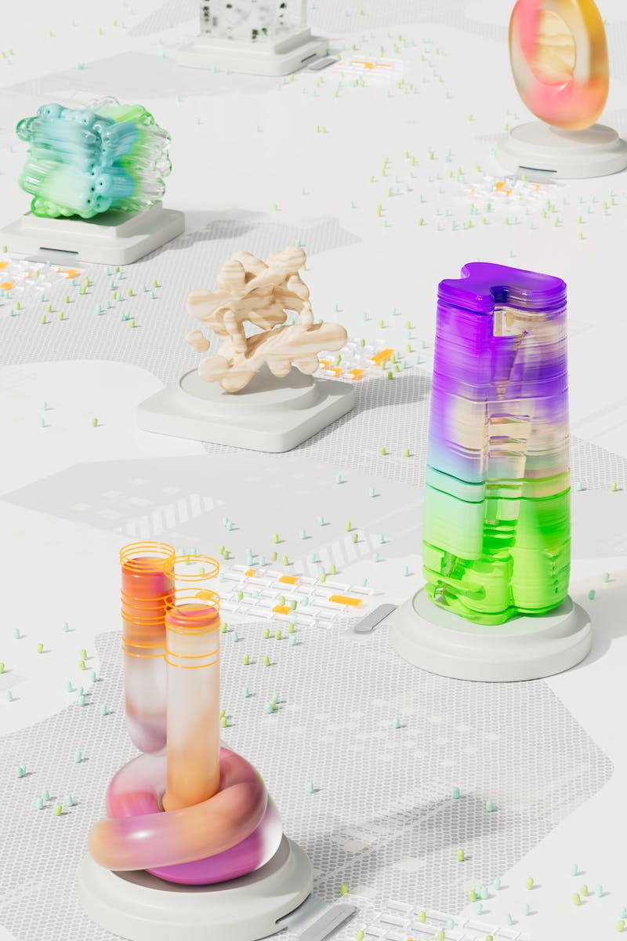
Ethical Considerations
• AI raises ethical concerns such as privacy, bias, and job displacement
• Algorithmic bias can result in discrimination and unfair treatment
• Transparency and accountability are essential to address ethical challenges
• Governments and organizations are developing guidelines and regulations for AI
Photo by Pexels

Slide 6
Future of AI
• AI is expected to continue advancing and becoming more integrated into daily life
• The development of AGI (artificial general intelligence) raises both excitement and concerns
• AI has the potential to solve complex global problems and drive innovation
• Collaboration between humans and machines will be crucial for a successful AI future
Photo by Pexels

