Slide 1
Adaptation Concepts: Tools and Resources
A Comprehensive Overview of the Climate Change Response Framework Project and the Adaptation Workbook

Slide 2
Introduction
• Welcome to the overview of adaptation concepts, tools, and resources
• Explore the Climate Change Response Framework and the Adaptation Workbook
• Learn how to respond to climate change through mitigation and adaptation
• Understand the importance of connecting adaptation actions to your specific goals and objectives
Photo by Pexels

Slide 3
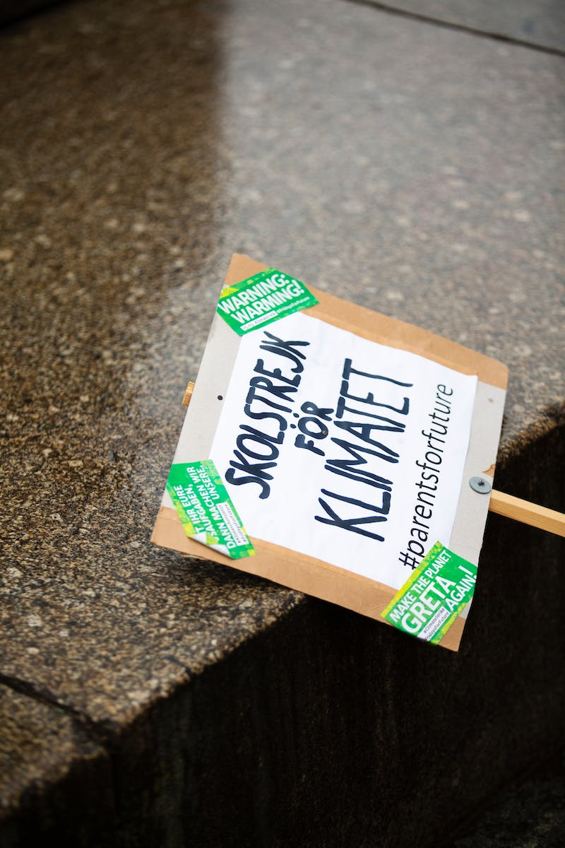
Mitigation and Adaptation
• Mitigation: Reducing greenhouse gas emissions and promoting carbon sequestration
• Adaptation: Addressing the physical manifestations of climate change in current and future actions
• Mitigation focuses on global cycles and works on a longer time frame
• Adaptation addresses observed or anticipated effects of climate change in the present
Photo by Pexels

Slide 4
Defining Adaptation
• Adaptation: Actions taken to address climate change impacts and vulnerabilities
• Adaptation is complementary to existing sustainable forest management practices
• Recognize the need to consider multiple threats and stressors in adaptation planning
• Climate change can impact other threats and stressors, affecting forest management strategies
Photo by Pexels

Slide 5
The Adaptation Workbook
• The Adaptation Workbook: A logical stepwise process for addressing climate change
• Define management goals, objectives, and timeline
• Assess climate change impacts and vulnerabilities
• Evaluate challenges and opportunities for meeting management objectives
• Select adaptation strategies and approaches
• Devise specific tactics and actions
• Monitor and evaluate effectiveness
Photo by Pexels

Slide 6
Adaptation Strategies and Approaches
• Adaptation strategies: Ways to respond to climate change impacts
• Approaches: Specific actions under each strategy to address the impacts
• Strategies range from resistance to resilience to transition
• Resistance: Improving defenses to prevent significant disturbances
• Resilience: Accommodating gradual change and rebounding from disturbances
• Transition: Facilitating intentional change to adapt to new conditions
Photo by Pexels

Slide 7
Selecting Adaptation Tactics
• Tactics: Specific actions to implement adaptation strategies and approaches
• Crafted by the manager to suit their specific needs and objectives
• Consider benefits, drawbacks, practicability, and time frame
• Write down all feasible tactics and evaluate their relevance
• Match tactics to appropriate approaches and strategies
• Maintain a record of the decision-making process
Photo by Pexels

Slide 8
Connecting the Dots
• Connect adaptation actions to your goals and objectives
• Assess climate change impacts on your specific ecosystem
• Identify challenges and opportunities for management
• Select options, strategies, and approaches that align with your objectives
• Consider external factors and frameworks that may influence adaptation
• Ensure adaptation actions are feasible and practicable
• Maintain a record of the adaptation decision-making process
Photo by Pexels

Slide 9
Adaptation Demonstrations
• Over 250 examples of using the Adaptation Workbook
• Diverse range of adaptations across different regions and ecosystems
• Case studies available online for reference and inspiration
• Unique examples tailored to specific landowners' goals and objectives
Photo by Pexels

Slide 10
Conclusion
• Adaptation actions are crucial for addressing climate change impacts
• Adaptation complements existing land management practices
• Continued monitoring and evaluation improve adaptation effectiveness
• Connect adaptation actions to your specific goals and challenges
• Additional resources available for assessing climate change impacts and responding to change
Photo by Pexels

