Slide 1
Introduction to Programming
A comprehensive guide to the basics of computer programming

Slide 2
Welcome to Introduction of Programming
• Presenters: Steven and Sean
• Duration: 90 minutes
• Overview of 21 different segments covering the basics of computer programming
• Focus on common features of computer science and programming languages
• No software required to follow along with the tutorial
Photo by Pexels

Slide 3
What is Programming?
• Definition of programming
• Getting a computer to complete tasks without errors
• Analogous to giving instructions to a less intelligent friend
• Computer's main functionality depends on how we manipulate it
• Overview of machine code and programming languages
Photo by Pexels

Slide 4
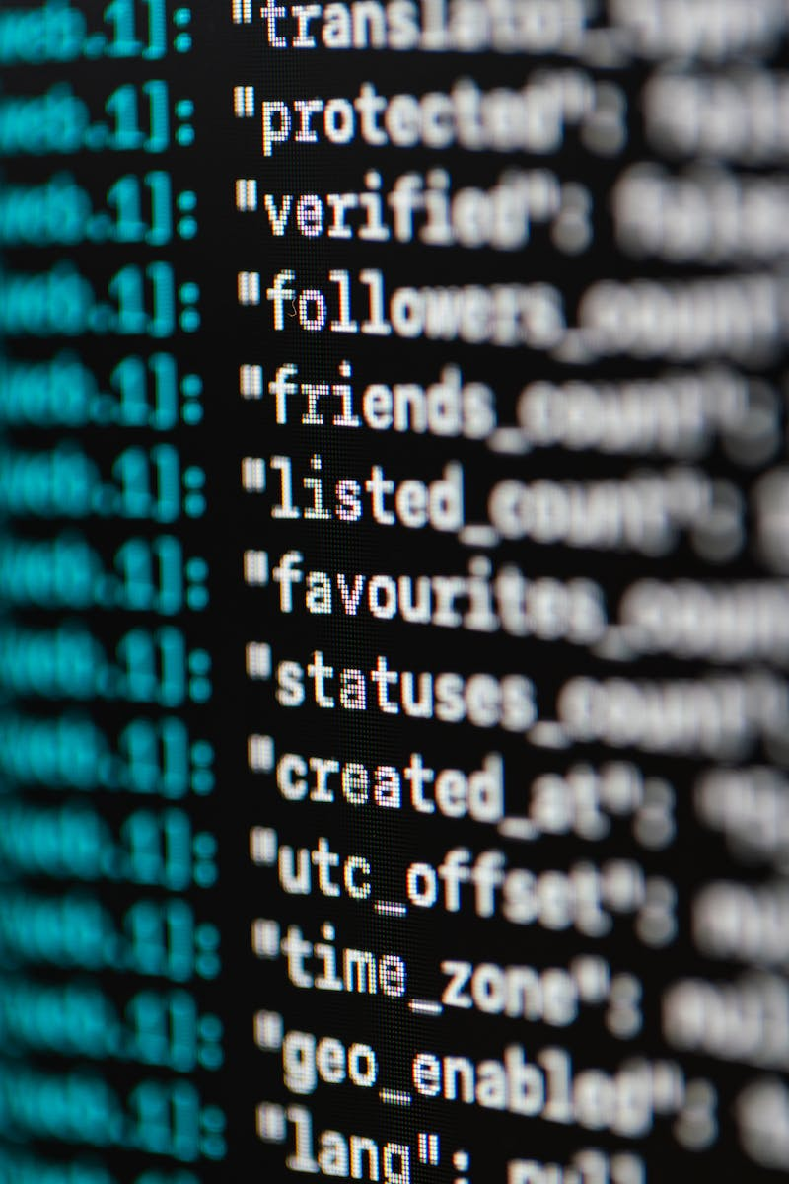
Introduction to Programming Languages
• Overview of programming languages
• Middleman for translating programming into machine code
• Different programming languages with unique uses
• Power and level of programming languages
• Choosing a language based on preference
Photo by Pexels

Slide 5
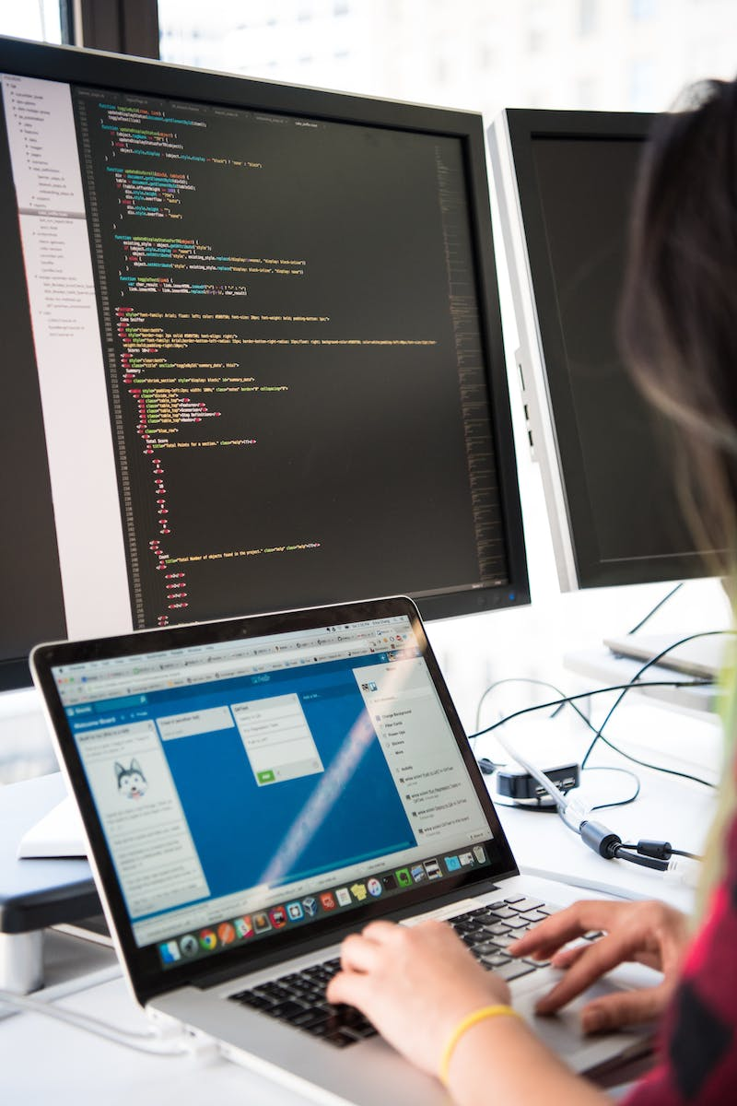
Using Integrated Development Environment (IDE)
• Definition and purpose of IDE
• Facilitates code development and debugging
• Features such as error checking, auto-filling, and project hierarchy
• Example of a specific IDE for Java programming
• Significance of IDE in writing and running code smoothly
Photo by Pexels

Slide 6
Understanding Syntax and Programming Rules
• Definition and importance of syntax in programming
• Syntax as programming grammar and rules
• Syntax differences between programming languages
• Importance of following syntax rules
• Syntax errors and error checking in IDE
Photo by Pexels

Slide 7
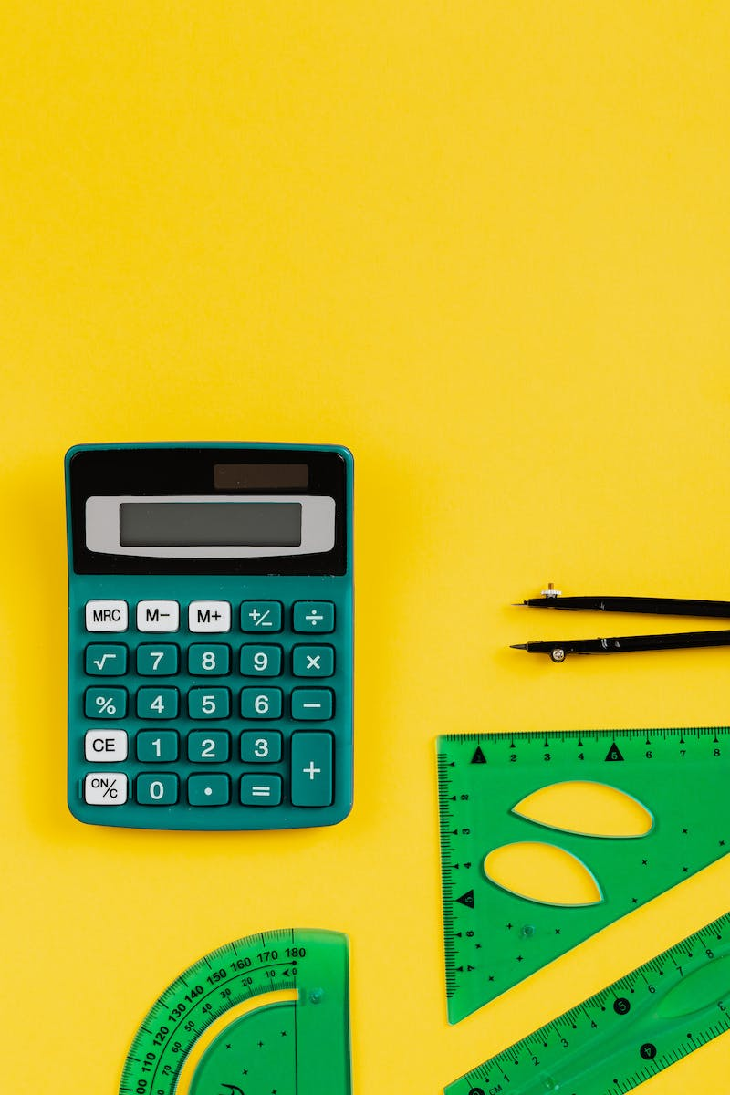
Basic Math and String Manipulation
• Computer's ability to perform arithmetic operations
• Using variables to store and manipulate numbers
• Example of adding, subtracting, multiplying, and dividing variables
• Concatenating strings and displaying output
• Power and versatility of variables
Photo by Pexels

Slide 8
Working with Variables
• Definition and purpose of variables
• Storing and referencing information
• Types of variables: integer, boolean, float, double, string, character
• Updating variables and manipulating data
• Naming conventions for variables
Photo by Pexels

Slide 9
Conditional Statements: If, Else, Elif
• Definition and purpose of conditional statements
• Executing code based on conditions
• Structure and syntax of if, else, and elif statements
• Evaluation of conditions and running code accordingly
• Common use cases and applications
Photo by Pexels

