Slide 1
A Day in the Life: My Daily Routine
Exploring the Daily Rituals that Shape my Life

Slide 2
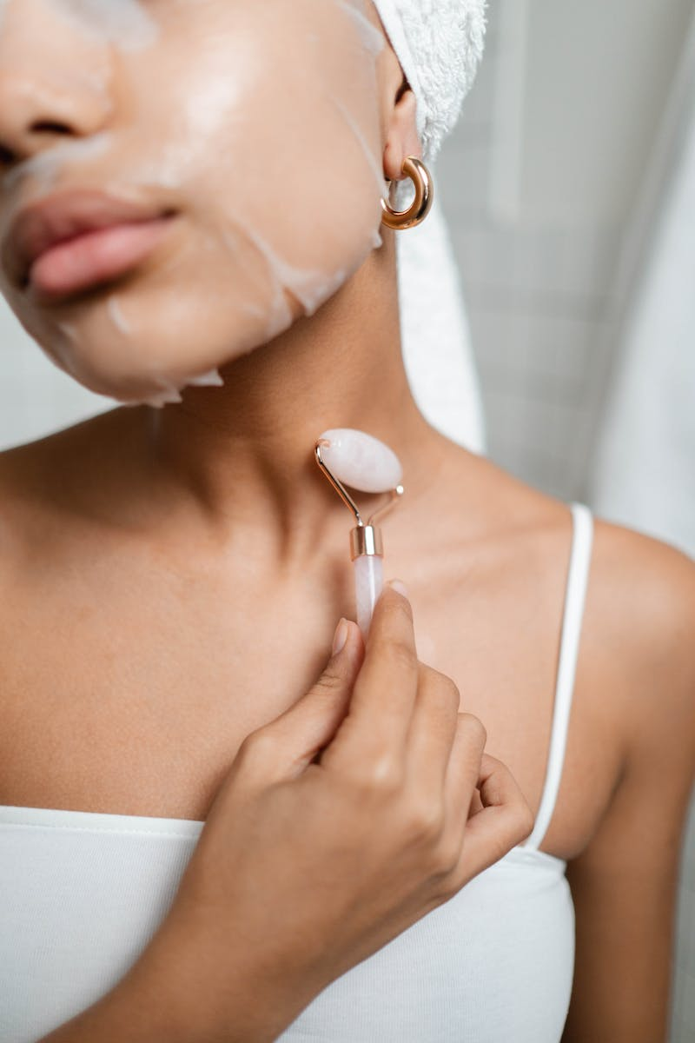
Morning Routine
• Wake up at seven o'clock
• Eat breakfast and feed my dog
• Brush my teeth
• Take a shower
• Dry my hair
• Do my makeup
• Leave home at eight thirty
Photo by Pexels

Slide 3
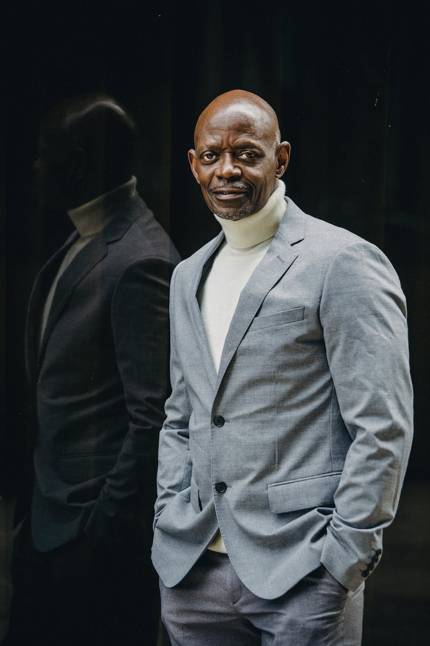
Commute to Work
• Drive my car downtown
• Start work at nine o'clock
• Arrive a few minutes early
• Have lunch with coworkers around Noon
Photo by Pexels

Slide 4
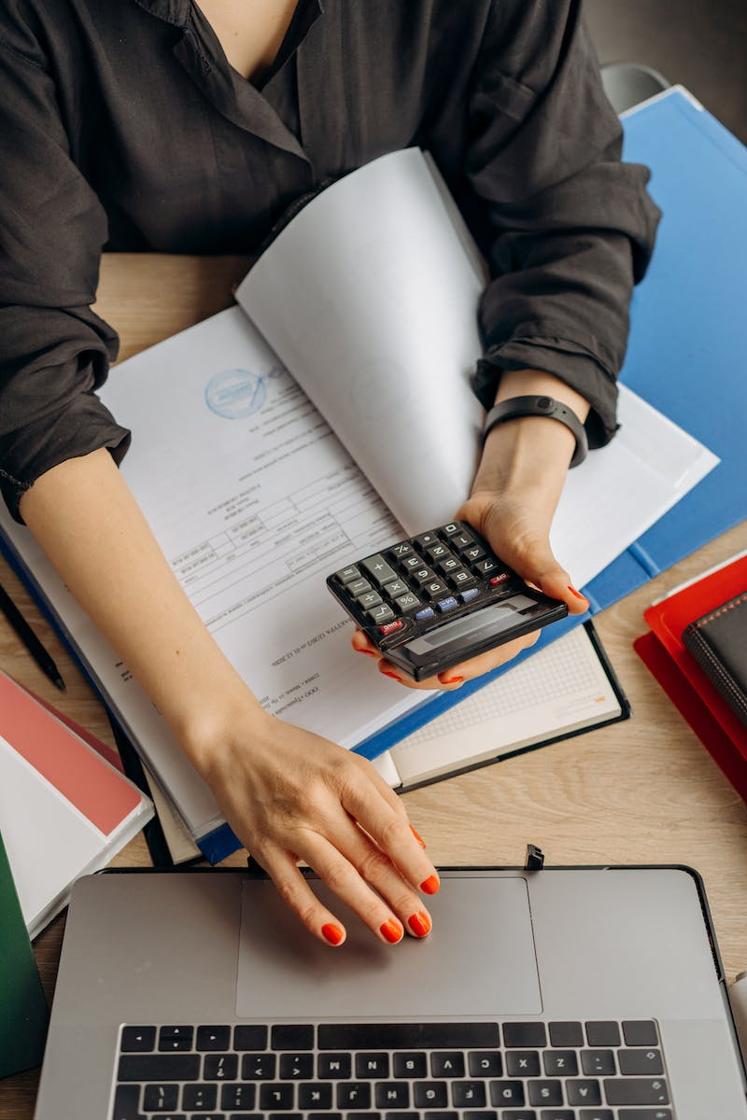
Work Routine
• Finish work at five o'clock
• Walk my dog
• Have dinner
Photo by Pexels

Slide 5
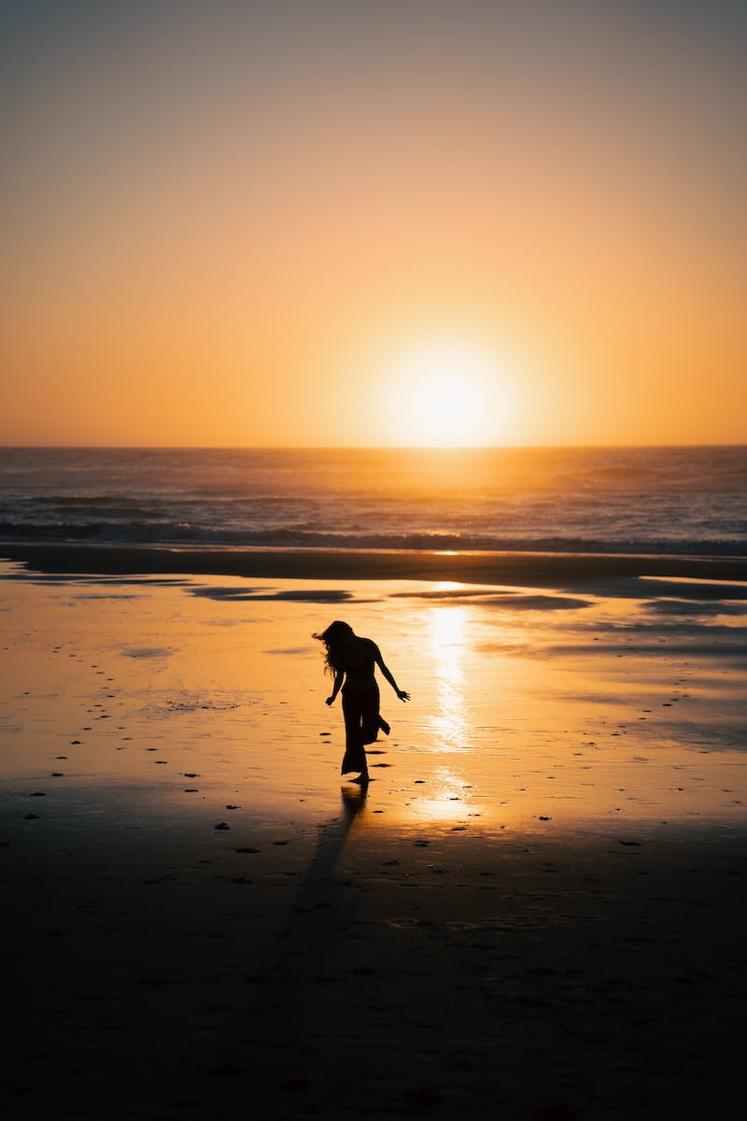
Evening Routine
• Take another shower
• Brush my teeth
• Go to bed at ten o'clock
Photo by Pexels

