Slide 1
How to Use Chat GPT to Write Killer Articles
Creating Persuasive Sales Letters with Chat GPT 3

Slide 2
Introduction
• Chat GPT can help you write compelling articles
• Learn the best way to use Chat GPT 3 for sales letters
• Generate persuasive sales letters for affiliate products
• Successful sales letters can generate income online
Photo by Pexels

Slide 3
Using AIpm Chat GPT Prompts
• AIpm Chat GPT prompts extension offers thousands of prompts
• Access over 4,400 prompts for various tasks
• Use the extension to generate 100% human SEO optimized articles
• Prompts can assist in writing fully optimized articles and FAQs
• Explore the Mid-Journey prompt generator for specific tasks
Photo by Pexels

Slide 4
Writing a Sales Letter
• Use famous copywriters as inspiration
• Research famous copywriters on Google
• Ask Chat GPT to write sales copy in their style
• Select a product to promote, such as the Ultimate Keto Meal Plan
• Request sales copy in the style of David Ogliv, Joseph Sugarman, or Leo Burnett
Photo by Pexels

Slide 5
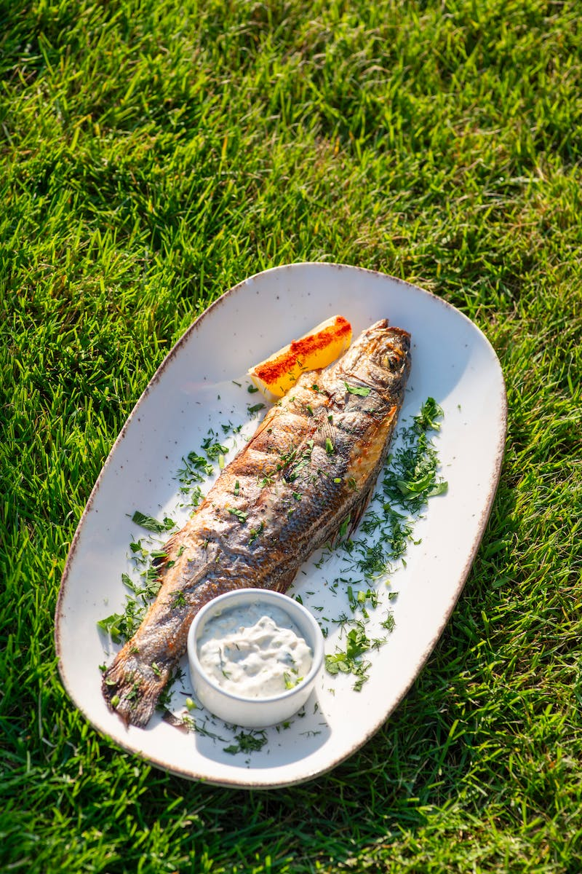
Example: Sales Copy in David Ogliv Style
• Introduce the Ultimate Keto Meal Plan
• Highlight the benefits of weight loss and increased energy
• Create a sense of indulgence and enjoyment with culinary perfection
• List reasons why the Ultimate Keto Meal Plan is the best choice
• Include a section for personalization and mention the founder
Photo by Pexels

Slide 6
Example: Sales Copy in Joseph Sugarman Style
• Revolutionize health with the Ultimate Keto Meal Plan
• Address health enthusiasts and wellness seekers
• Create a vision of a healthier, happier future
• Highlight the unique selling points of the meal plan
• End with a strong commitment to customer satisfaction
Photo by Pexels

Slide 7
Example: Sales Copy in Leo Burnett Style
• Discover a healthier you with the Ultimate Keto Meal Plan
• Tap into the desire for a healthier and happier life
• Emphasize harmony of health and taste
• Appeal to personalized energy and community support
• End with a promise and call to action
Photo by Pexels

Slide 8
Writing Articles and Stories with Famous Authors
• Utilize famous authors' writing styles for articles and stories
• Research famous authors such as Leo Tolstoy, JK Rowling, and Stephen King
• Request Chat GPT to write in the style of famous authors for various genres
• Explore book writing prompts for easy book generation
• Sell the generated books on platforms like Amazon
Photo by Pexels

Slide 9
Example: Horror Story in Stephen King Style
• Set the stage with a quiet town and ominous structure
• Build suspense with whispers of haunted history
• Create engaging chapters and suspenseful storyline
• Leave readers wanting more with a cliffhanger ending
• Continue the story based on Chat GPT's prompts
Photo by Pexels

Slide 10
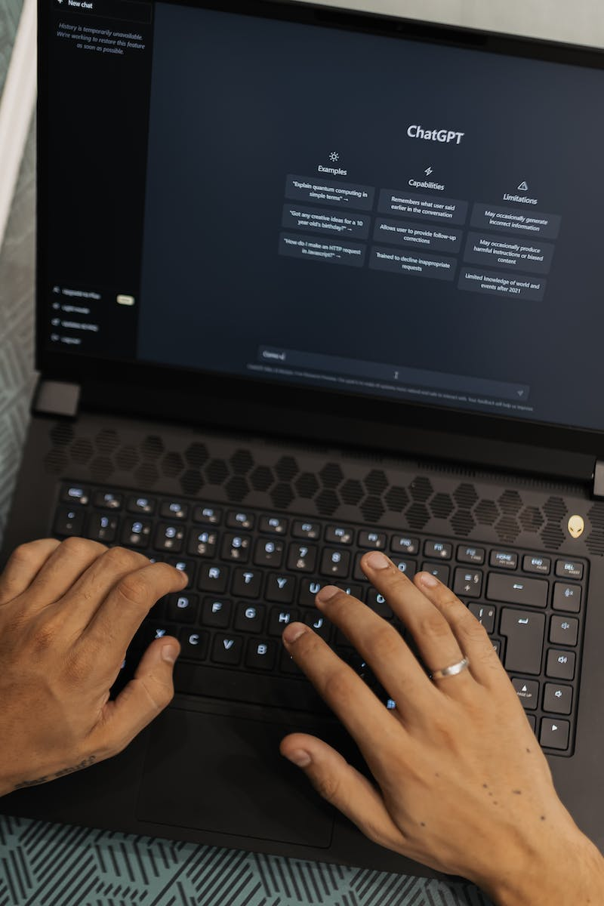
Conclusion
• Explore the wide range of possibilities with Chat GPT
• Install the AIpm Chat GPT prompts extension for easy access
• Use prompts for various professions like artists, chefs, and more
• Follow the provided examples for persuasive writing
• Unleash your creativity and generate compelling content
Photo by Pexels

