Slide 1
Mastering Major Scales: Unlocking the Key to Music Theory
A comprehensive guide to understanding and applying major scales in music

Slide 2
Introduction to Major Scales
• A major scale is a set of ordered notes in Western classical music
• It is a cornerstone of music theory and essential for understanding many other concepts
• There are 15 major scales, but they all follow the same simple rules
• The easiest one to start with is the C major scale
Photo by Pexels

Slide 3
The Simple Rules of Major Scales
• Every major scale has 8 notes
• The scale starts and ends on the same note
• Each letter name appears once in the scale
• The pattern of tones and semitones between notes creates a major scale sound
Photo by Pexels

Slide 4
The Interval Pattern of Major Scales
• The interval pattern of a major scale is: tone, tone, semitone, tone, tone, tone, semitone
• A semitone is the smallest interval on the piano, equivalent to a half step
• A tone is two semitones, also known as a whole step
• This pattern applies to all major scales
Photo by Pexels

Slide 5
Building Major Scales and Understanding Sharps and Flats
• Major scales are built using the interval pattern and starting note
• Sharps (#) and flats (♭) modify the notes in a scale
• The specific sharp or flat used depends on the relationship between notes
• The piano keyboard provides a visual representation of the major scale
Photo by Pexels

Slide 6
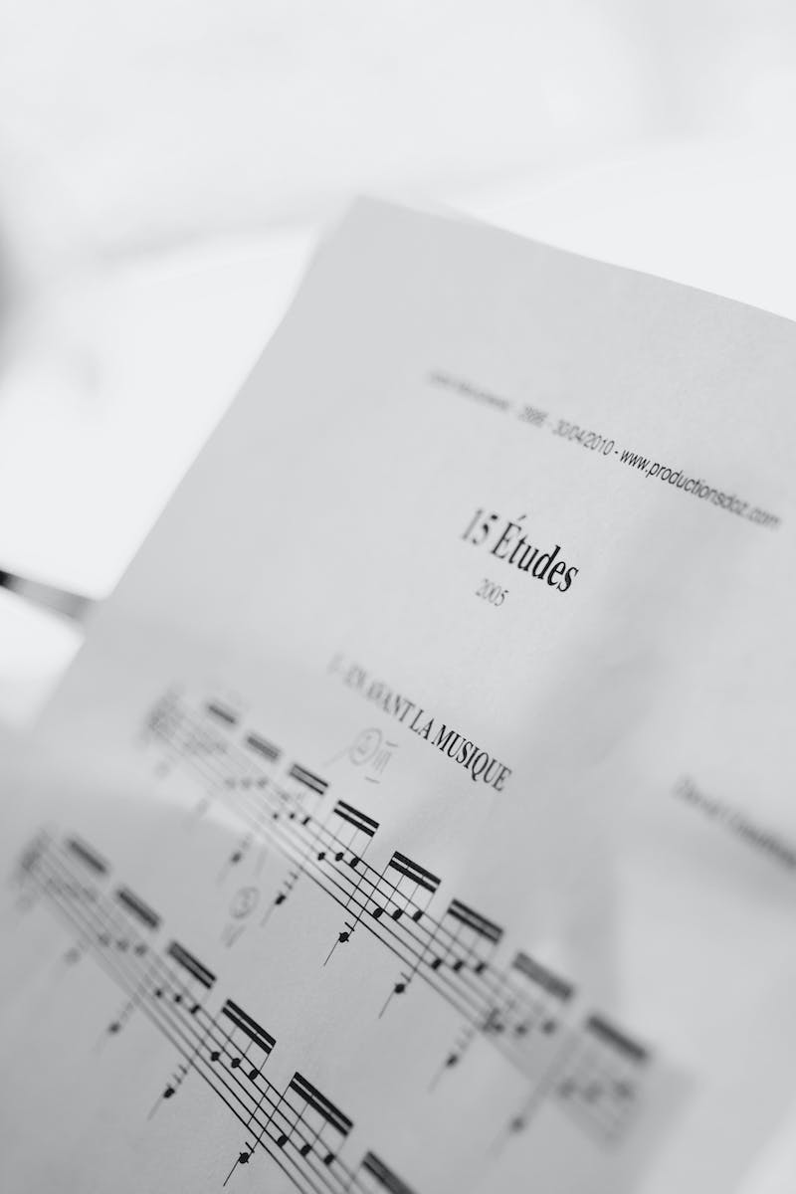
Writing Major Scales and Dealing with Enharmonic Equivalents
• Writing major scales involves writing the notes and their interval pattern
• Some notes have more than one name, known as enharmonic equivalents
• Enharmonic equivalents sound the same but are spelled differently
• Properly identifying enharmonic equivalents is crucial for accurate scale representation
Photo by Pexels

Slide 7
Answering Common Questions About Major Scales
• Chromatic and whole tone scales have different interval patterns
• C major and D flat major are enharmonic equivalents
• There is no G sharp major scale due to the lack of natural notes
• Double sharps and flats are not used in major scales
Photo by Pexels

Slide 8
Key Concepts: Chords and Music Theory
• Major scales are fundamental to understanding chords and other music theory concepts
• Knowledge of major scales enhances comprehension of key signatures, triads, cadences, and more
• Major scales form the basis for further exploration of music theory topics
• Mastering major scales is crucial for success in music theory studies
Photo by Pexels

Slide 9
Conclusion
• Major scales are integral to Western classical music theory
• By following a simple set of rules, major scales can be constructed and understood
• Understanding major scales opens the door to exploring other music theory concepts
• Continued practice and application of major scales will enhance musical abilities
Photo by Pexels

