Slide 1
Creating a Culture of Inclusion: Stage One - Inclusion Safety
Building a Foundation of Acceptance and Belonging

Slide 2
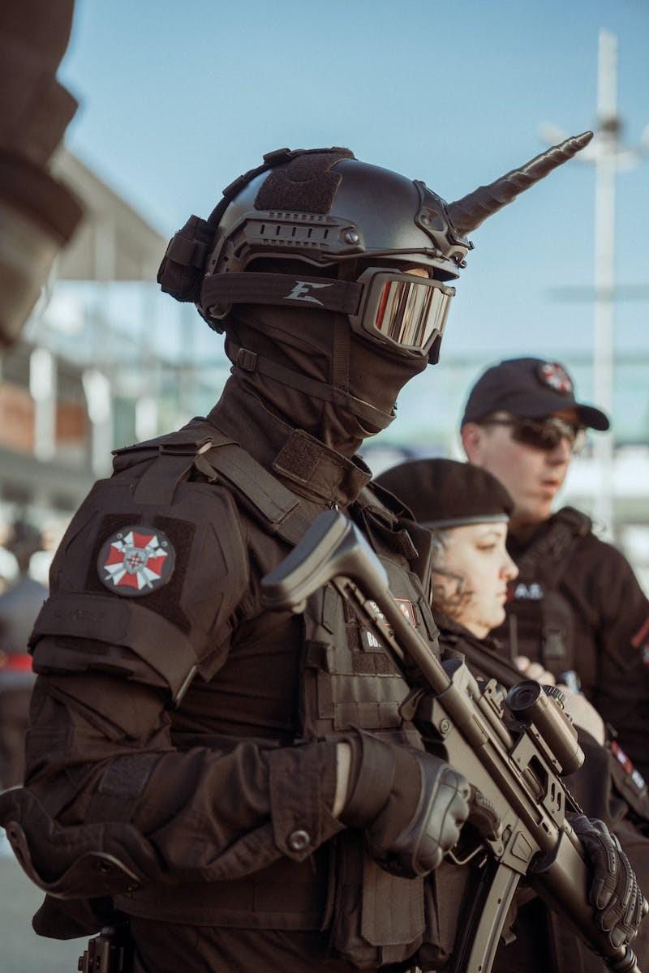
Introduction
• Psychological Safety: Understanding the Four Stages
• Stage One: Inclusion Safety
• Central Question: Do you feel included?
• Inclusion Safety satisfies the basic human need to be accepted and valued
Photo by Pexels

Slide 3
Defining Inclusion Safety
• Inclusion Safety means being accepted for who you are
• Accepting unique attributes and defining characteristics
• Creating a safe environment where individuals can be themselves
• Not excluding based on personal attributes or characteristics
Photo by Pexels

Slide 4
Increasing Inclusion Safety
• Assess the current level of inclusion safety
• Consider the experiences of team members
• Work towards increasing the level of inclusion safety
• Sustain inclusion safety through ongoing efforts
Photo by Pexels

Slide 5
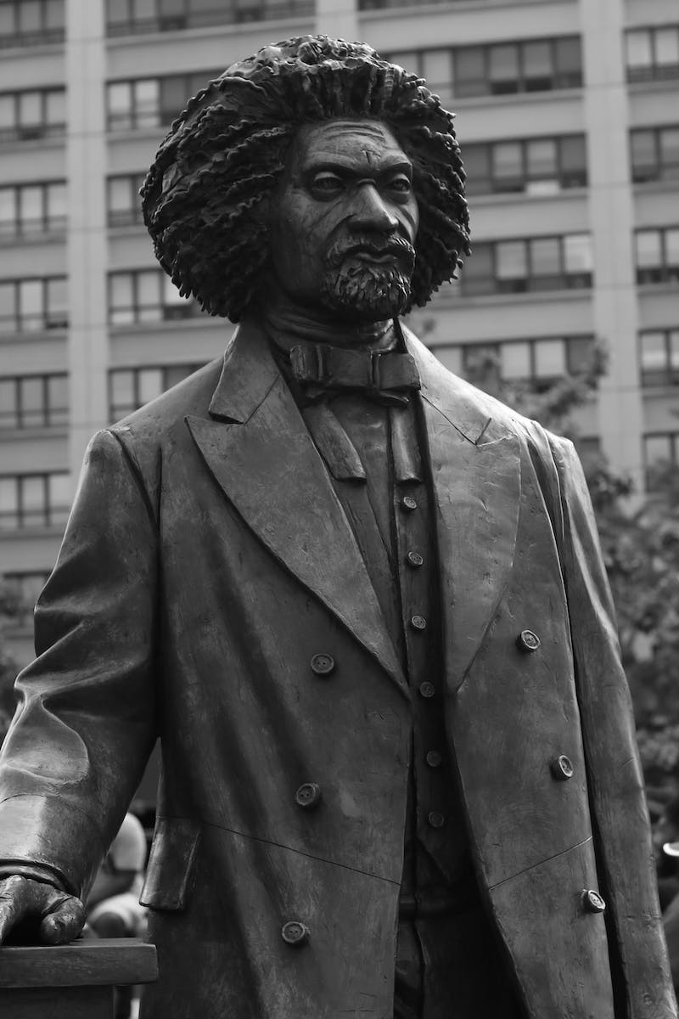
Lessons from History
• Frederick Douglass and the Composite Nation speech
• Loyalty to humanity over race
• Elevating inherent worth as the basis for inclusion
• Avoiding the division caused by applying worthiness tests
Photo by Pexels

Slide 6
Personal Experiences: Inclusion Safety in Action
• Growing up among the Navajo
• Acknowledging and appreciating differences
• Maintaining inclusion safety despite cultural disparities
• Being injured in a football game
• Inclusion safety revoked based on worthiness test
• Car dealership experience and soc-economic status
Photo by Pexels

Slide 7
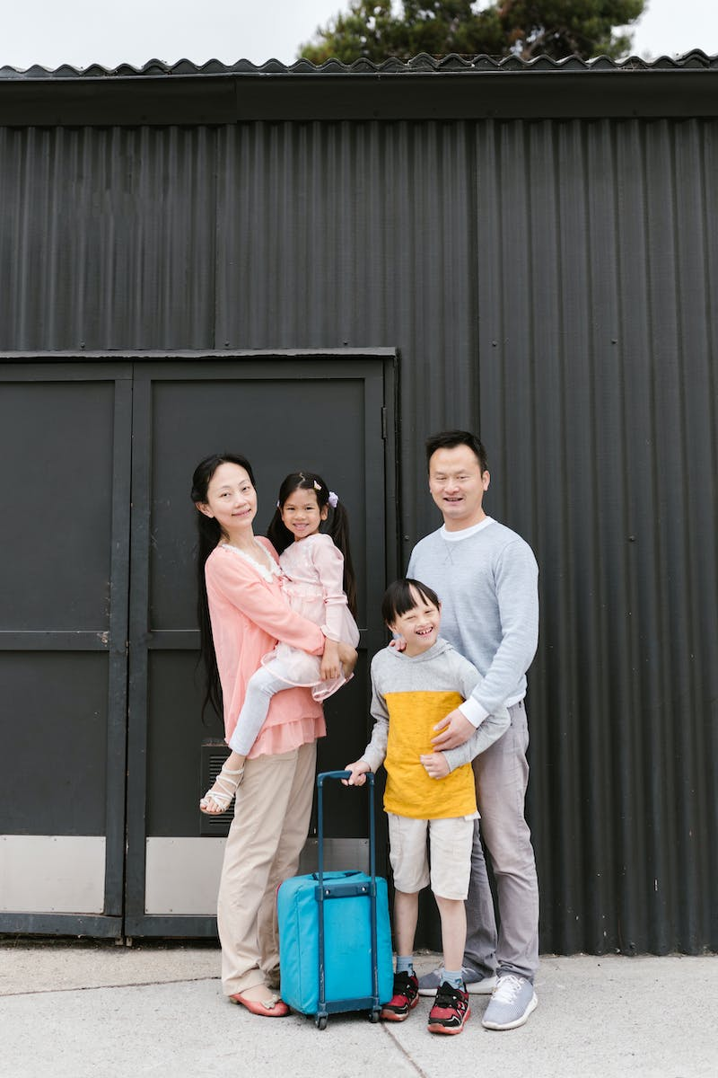
Creating a Culture of Inclusion
• Comparison and competition hinder connection
• Applying a worth test to promote inclusion
• Subordinating other human differences to the human family
• Exclusion only justified when harm is threatened
Photo by Pexels

Slide 8
Installing Inclusion Safety
• Modeling and rewarding inclusive behaviors
• Applying a worth test to team members
• Including individuals as part of the human family
• Inclusion safety as an entitlement and human right
Photo by Pexels

