Slide 1
The Business of Flu
Debunking Myths and Analyzing Data

Slide 2
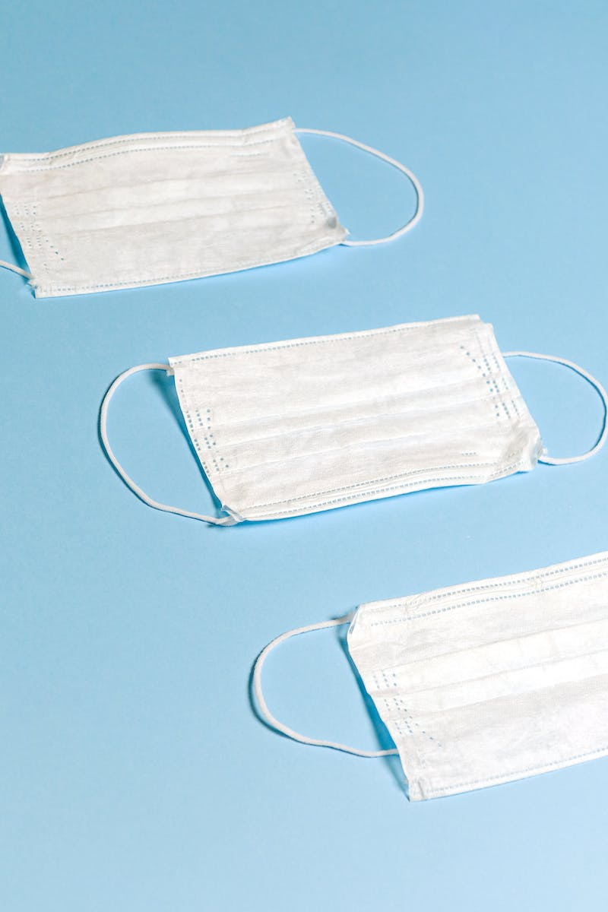
Introduction
• Natural flu cases are on the rise
• Pneumonia is often misunderstood
• Subway's impact on the flu crisis
• White-collar flu management
Photo by Pexels

Slide 3
The Subway Effect
• Subway's promotion leads to increased flu cases
• The connection between fast food and illness
• Flu prevention at Subway
• The impact on business
Photo by Pexels

Slide 4
White-Collar Flu Management
• Addressing flu in the workplace
• The importance of sick leave policies
• Flu vaccine promotion at businesses
• The impact on employee productivity
Photo by Pexels

Slide 5
Debunking Flu Myths
• Common misconceptions about the flu
• The effectiveness of flu shots
• Distinguishing flu from the common cold
• The impact of misinformation on public health
Photo by Pexels

Slide 6
Analyzing Flu Data
• Understanding flu trends
• Analyzing the economic impact of flu
• Tracking vaccine uptake
• Data-driven flu prevention strategies
Photo by Pexels

