Slide 1
Comparing Cameras: Sony, Canon, and Fuji
A deep dive into the specifications and features of the latest camera releases

Slide 2
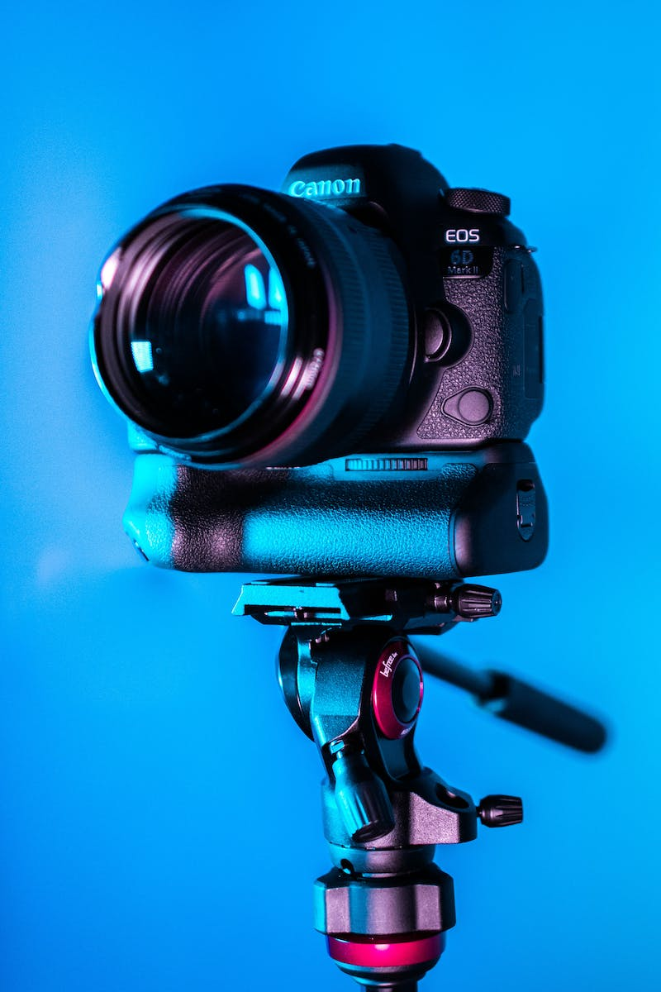
Introduction
• Overview of the latest camera releases
• Focus on Sony a7c Mark II, Canon R8, and Fuji xs20
• Exploring their features, specifications, and price points
Photo by Pexels

Slide 3
Sony a7c Mark II vs. zve E1
• Similar price point: a7c Mark II and zve E1
• Zve E1 is lighter and has better video capabilities
• Sony offers a viewfinder but not a very good one
Photo by Pexels

Slide 4
Fuji xs20 Features and Price
• Fuji xs20 is even cheaper than the previous cameras
• Great vlogging lens with zoom capabilities
• Heavier than other cameras mentioned
Photo by Pexels

Slide 5
Comparing Canon R8 and zve E1
• Canon R8 is slightly lighter and cheaper than zve E1
• Canon offers 4K 60 video capability with no crop
• Advantage of zve E1 is its superior video capabilities
Photo by Pexels

Slide 6
The Appeal of Fuji xs20
• Fuji xs20 offers great value for money
• Suitable for vlogging with a versatile zoom lens
• Packs impressive specs, including 6K open gate
Photo by Pexels

Slide 7
Panasonic S5 II: The Old Guard
• Panasonic S5 II is a heavier and older camera
• Not in the same category as the others mentioned
• Worth considering for its lower price
Photo by Pexels

Slide 8
Conclusion: Choosing the Right Camera
• Different cameras suit different needs
• Sony a7c and a74 may not be recommended
• Canon R8 and zve E1 are comparable options
• Fuji xs20 offers impressive features and value
Photo by Pexels

Slide 9
Acknowledgements

