Slide 1
Effortless Ways to Make a Positive Impact
Simple actions for a better world

Slide 2
Introduction
• Effortless ways to make a positive impact
• Small actions with big results
• Creating a better world without much effort
Photo by Pexels

Slide 3
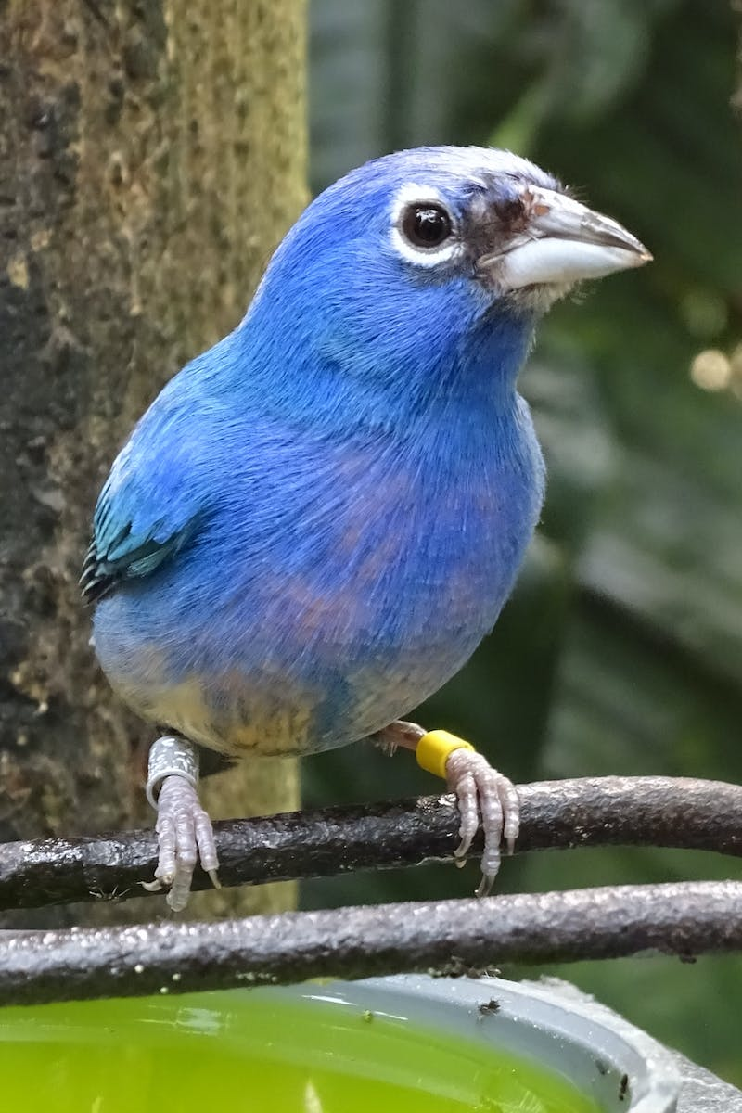
Conserving Water
• Xixi in the shower
• Saving water through simple everyday habits
• The potential impact of water conservation
• Encouraging others to adopt water-saving practices
Photo by Pexels

Slide 4
Organ Donation
• Importance of being an organ donor
• Dispelling myths and misconceptions
• The impact of organ donation on saving lives
• Encouraging others to discuss their wishes with family
Photo by Pexels

Slide 5
Petitions for Change
• The power of online petitions
• Effectively advocating for causes
• Promoting positive change through collective action
• Encouraging participation and sharing petitions
Photo by Pexels

Slide 6
Supporting Artists
• Recognizing and praising artists
• The impact of positive feedback and support
• Sharing and promoting lesser-known artists
• Fostering a supportive and inclusive arts community
Photo by Pexels

Slide 7
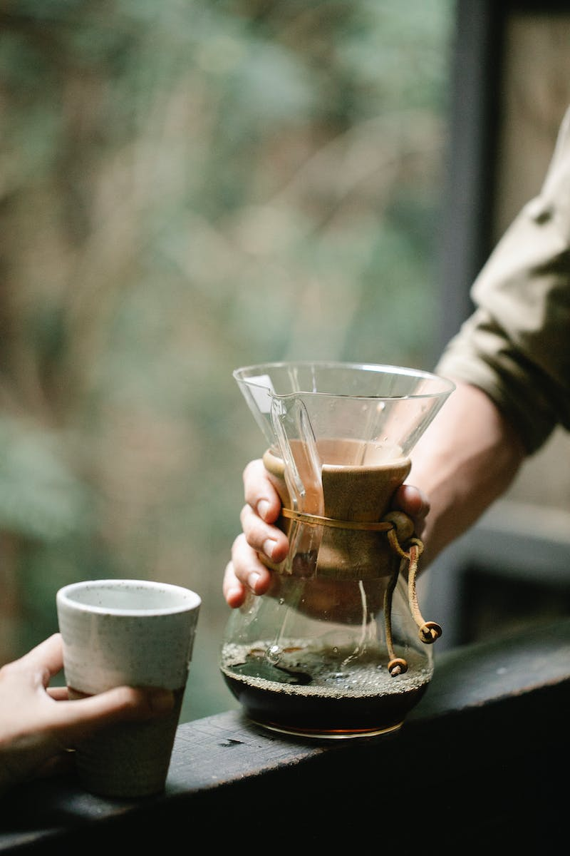
Planting Trees
• Environmental benefits of trees
• Combatting pollution and climate change
• Effortlessly contributing to reforestation
• Creating greener and healthier communities
Photo by Pexels

Slide 8
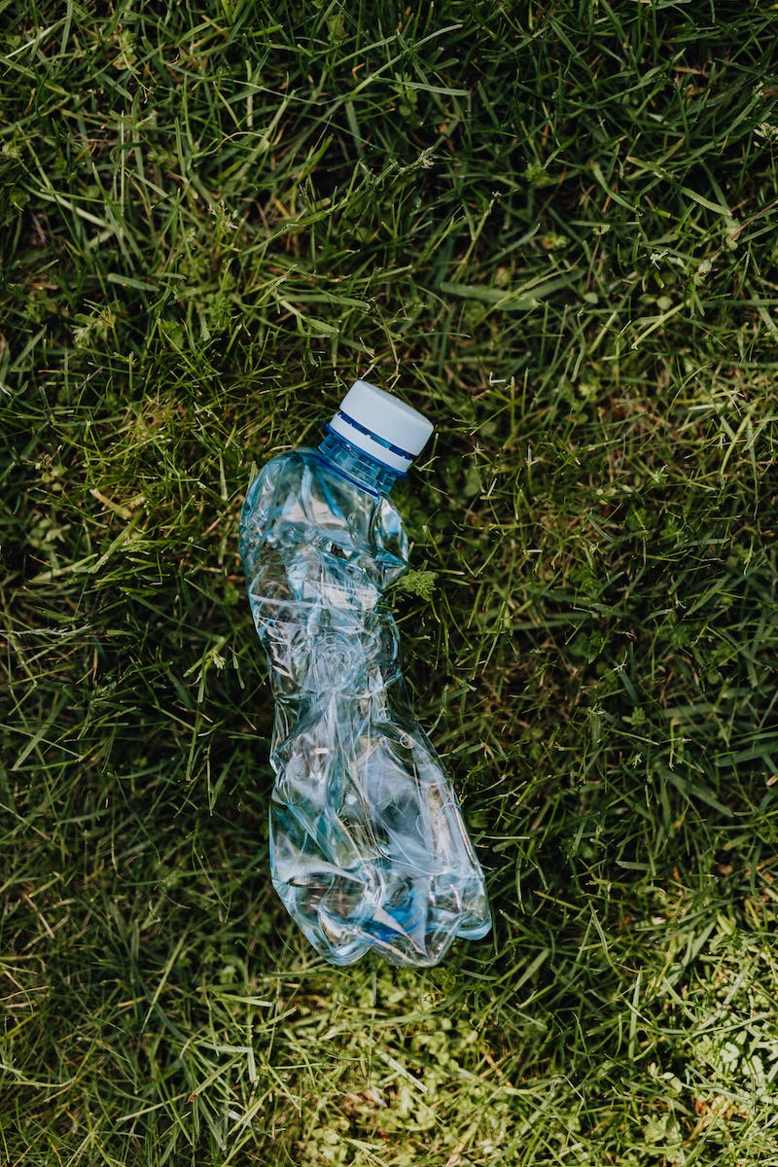
Proper Waste Disposal
• The importance of responsible waste management
• Keeping the environment clean and safe
• Carrying trash until a proper disposal point
• Encouraging others to adopt responsible waste practices
Photo by Pexels

Slide 9
Wearing Jeans Less Frequently
• Reducing the frequency of jeans washing
• Environmental impact of excessive laundry
• Extending the lifespan of clothing
• Promoting sustainable fashion habits
Photo by Pexels

Slide 10
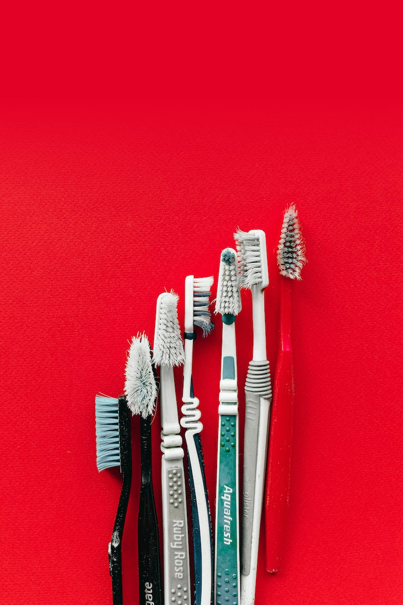
Improving Dental Hygiene
• Outsourcing dental hygiene advice
• The importance of oral health
• Referring others to dental hygiene resources
• Promoting good dental habits for overall well-being
Photo by Pexels

Slide 11
Conclusion
• Highlighting the importance of individual actions
• Creating a collective impact
• Inspiring others to take small steps towards positive change
Photo by Pexels

