Slide 1
The Role of Wealth in Pastoral Ministry
Examining the Relationship between Prosperity and Ministry

Slide 2

Introduction
• Pastoral ministry and wealth
• The question of pastors owning luxury items
• Exploring the issue biblically
• Reacting to a podcast clip
Photo by Pexels

Slide 3
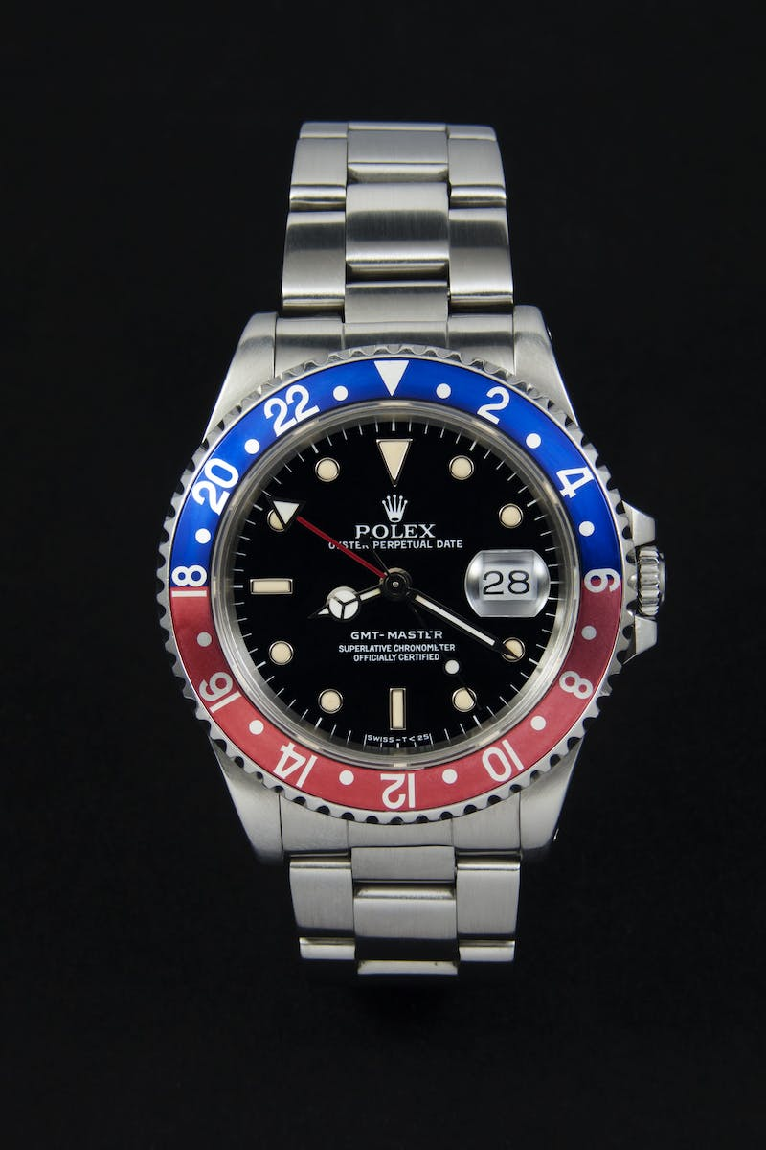
Rolex Inquiry
• Pastor asked about wearing a Rolex
• Controversy around pastors having expensive items
• Exploring the biblical perspective
• Reacting to the podcast clip
Photo by Pexels

Slide 4

Wealth and Ministry
• Does wealth hinder ministry purity?
• Teaching of liberation theology
• Associating wealth with the purity of ministry
• Examining the fallacies
Photo by Pexels

Slide 5

The Love of Money
• Biblical perspective on money
• The love of money as the root of evil
• Wealth not inherently sinful
• The danger of idolizing wealth
Photo by Pexels

Slide 6
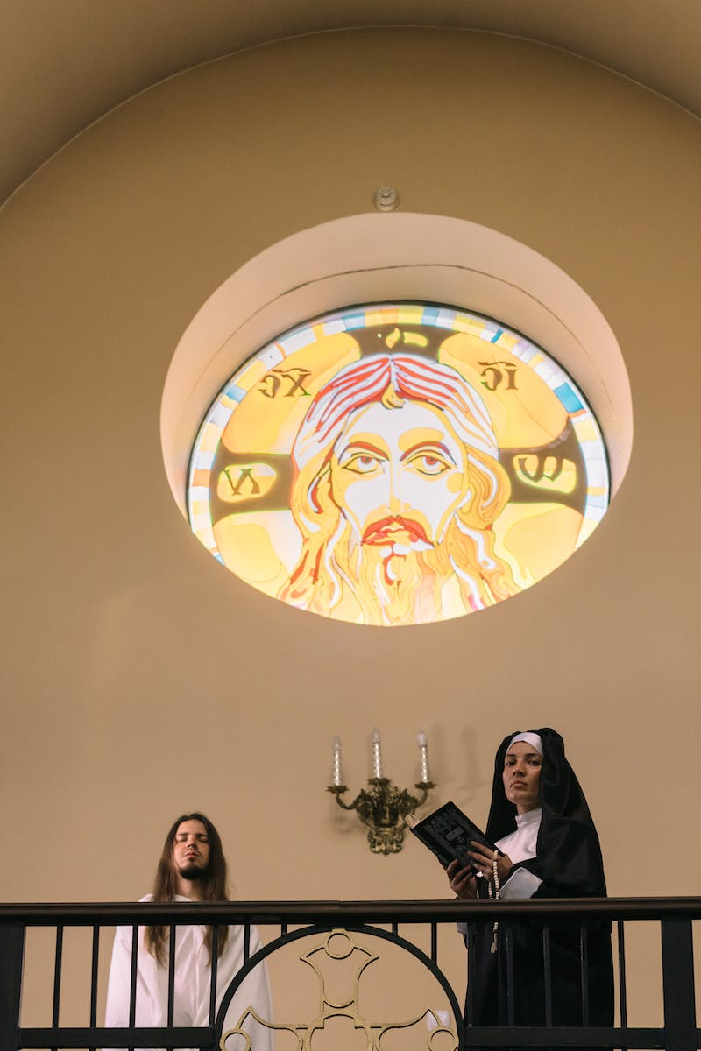
Misusing Biblical Examples
• Interpreting biblical examples incorrectly
• The story of the woman anointing Jesus
• Misunderstanding the message
• Importance of intention over material possessions
Photo by Pexels

Slide 7

The Definition of Pure Ministry
• Wealth and ministry purity
• Defining the purity of ministry
• Pure ministry not defined by possessions
• Root of ministry purity
Photo by Pexels

Slide 8

Misconceptions about Pastors
• Not all pastors are wealthy
• Wealthy pastors and ministry purity
• Unfortunate cases of dishonest pastors
• Wealth not an indicator of ministry purity
Photo by Pexels

Slide 9

The Way Forward
• Balancing wealth and ministry
• Working for the good of others
• Avoiding ostentation and idolatry
• Using resources to glorify God
Photo by Pexels

Slide 10
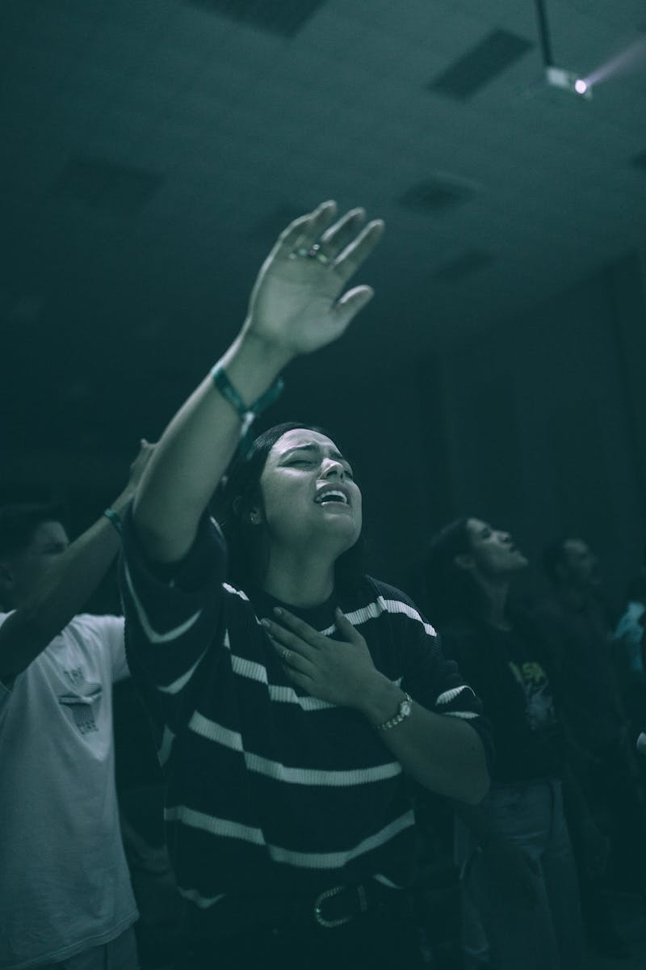
Conclusion
• Importance of appropriate use of resources
• Being mindful of ostentation
• Focusing on the message of the Gospel
• Striving for ministry purity
Photo by Pexels

