Slide 1
The Future of Artificial Intelligence
Exploring the potential and challenges of AI in the modern world

Slide 2
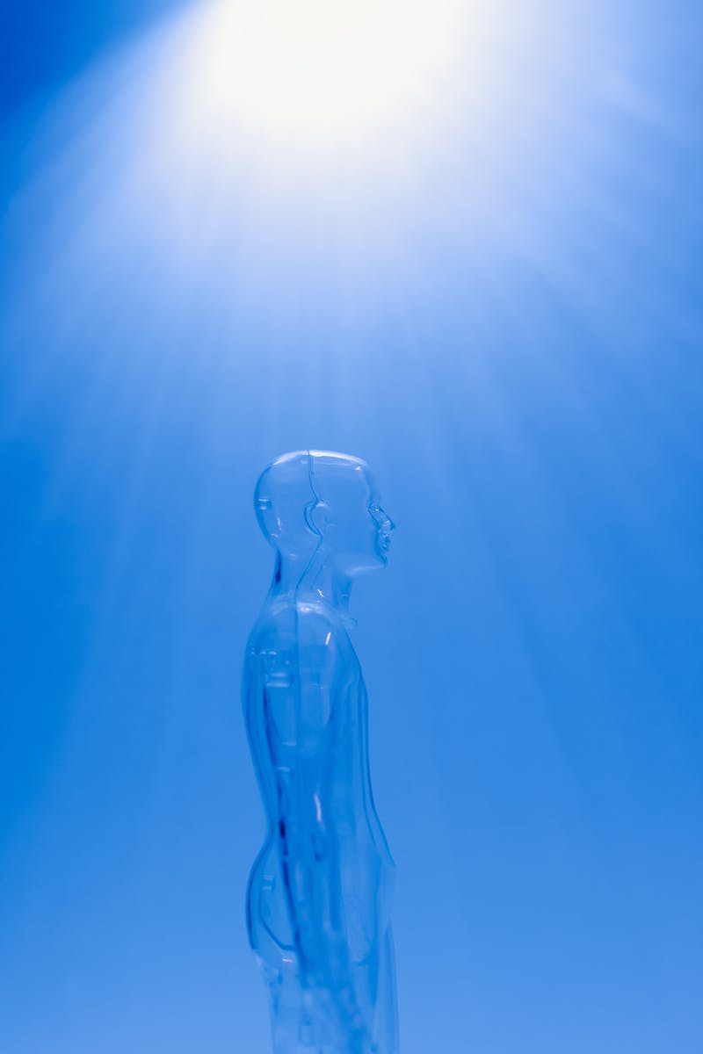
Introduction
• Definition and brief history of Artificial Intelligence
• AI's impact on various industries
• Current limitations and challenges
• Importance of ethical considerations
Photo by Pexels

Slide 3
Applications of AI
• AI in healthcare
• AI in finance
• AI in transportation
• AI in customer service
• AI in education
Photo by Pexels

Slide 4
Advancements in Machine Learning
• Deep learning algorithms
• Natural language processing
• Computer vision
• Reinforcement learning
• Transfer learning
Photo by Pexels

Slide 5
Challenges and Risks of AI
• Ethical considerations
• Job displacement
• Bias and fairness
• Privacy and security
• Malicious use of AI
Photo by Pexels

Slide 6
Future Possibilities
• Enhanced automation
• Improved healthcare outcomes
• Efficient resource allocation
• Personalized services
• AI-human collaboration
Photo by Pexels

