Slide 1
Qualities and Functions of a Sports Official
Exploring the key attributes and roles of sports officials

Slide 2
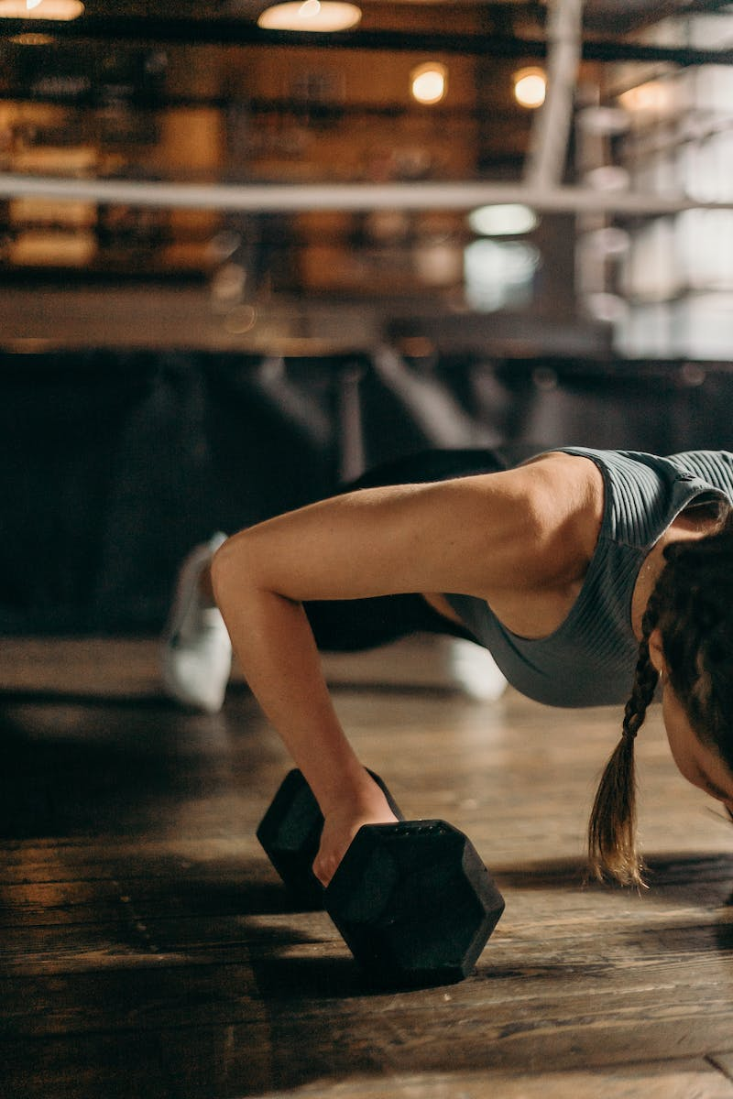
Introduction to Sports Officiating
• Sports officials are responsible for maintaining order and fairness in sporting events.
• They supervise competitions according to established rules.
• Knowledge of the sport's rules is crucial for effective officiating.
• Unbiased judgment and accuracy are essential qualities.
• Officials play a critical role in ensuring a satisfying experience for both teams and spectators.
Photo by Pexels

Slide 3
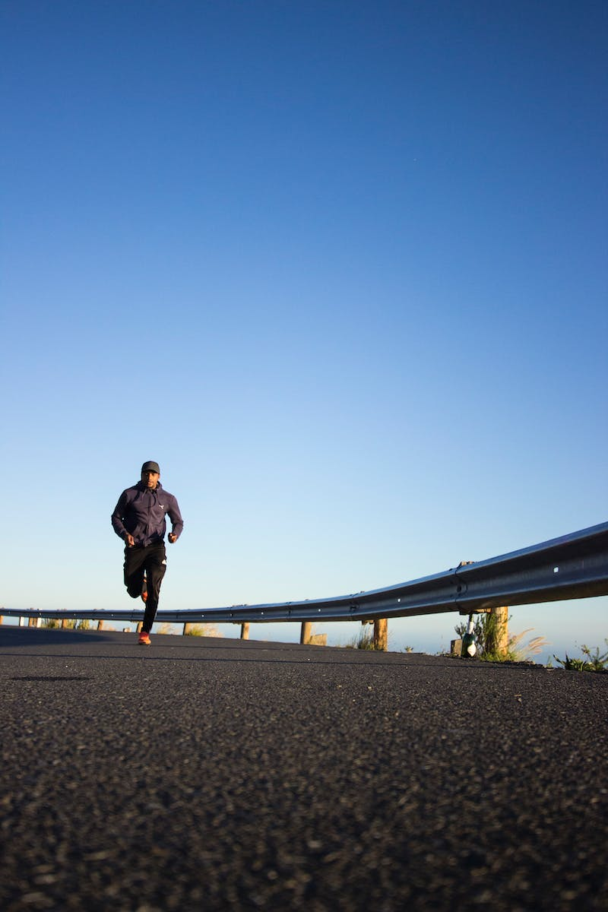
Physical Qualities
• Physical attributes are critical for sports officials.
• They need to keep up with the athletes' actions on the court.
• Higher fitness levels are required to perform the job effectively.
Photo by Pexels

Slide 4
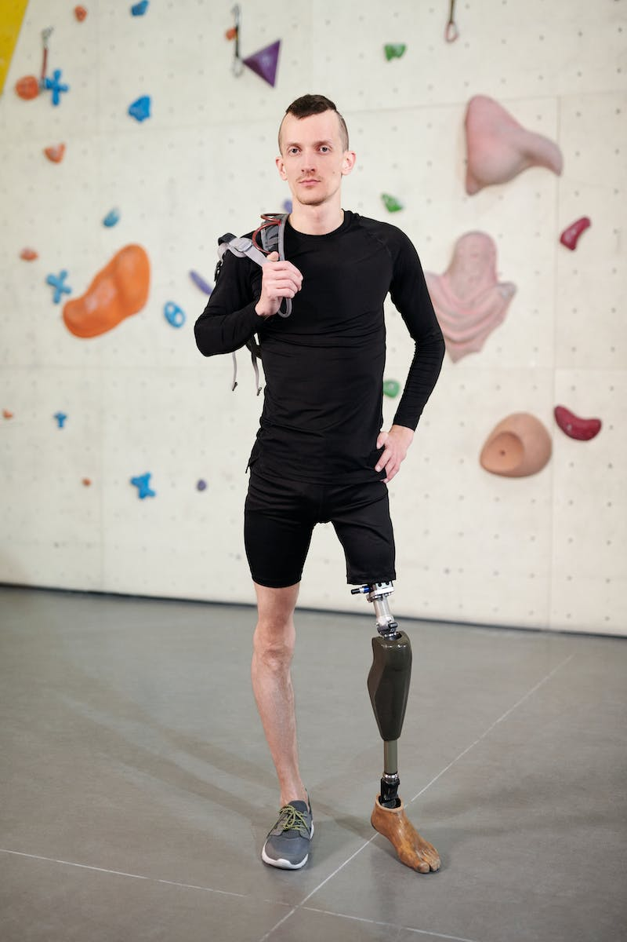
Emotional Qualities
• Emotional readiness is crucial for sports officials.
• Confidence is an essential emotional attribute.
• Practicing confidence through game observations can help improve it.
Photo by Pexels

Slide 5
Mental Qualities
• Mental characteristics are as important as physical and emotional qualities.
• Mental toughness involves staying focused, handling pressure, and controlling thoughts and feelings.
• Thorough knowledge of the game is necessary for mental toughness.
Photo by Pexels

Slide 6
Social Qualities
• Social qualities involve the ability to handle disputes and maintain the integrity of the game.
• Settling disputes without sacrificing fairness is crucial for sports officials.
• Developing social qualities requires practice and experience.
Photo by Pexels

Slide 7
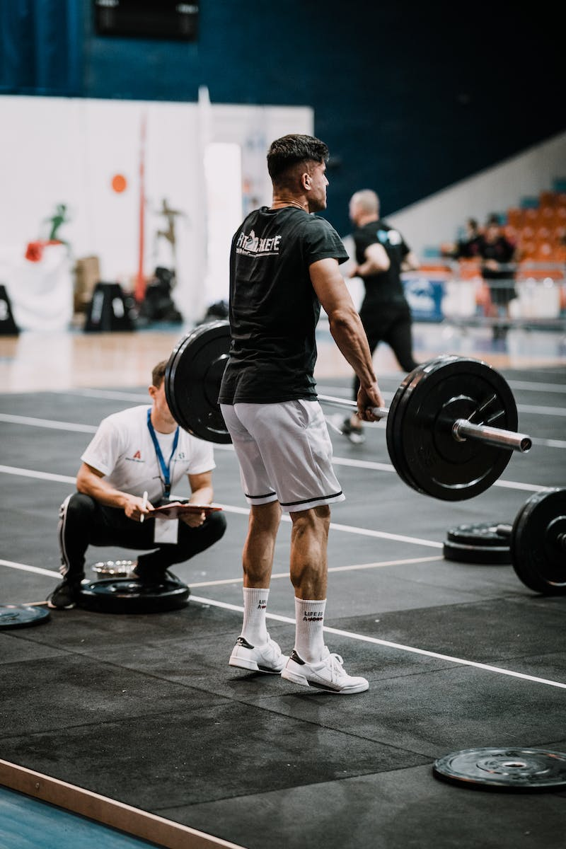
Functions of a Sports Official
• The first function is being a referee, responsible for ensuring compliance with rules and making decisions.
• The second function is being a timekeeper, keeping track of game time, timeouts, and substitutions.
• The third function is being a scholar, recording details such as player names, scores, and fouls.
Photo by Pexels

Slide 8
Conclusion
• Sports officials play a crucial role in maintaining order and fairness in games.
• They require a combination of physical, emotional, mental, and social qualities.
• The functions of a sports official include refereeing, timekeeping, and record-keeping.
• Improving these qualities and performing the functions effectively contribute to a satisfying experience for all involved.
Photo by Pexels

