Slide 1
Wisdom in Proverbs
Lessons to live by

Slide 2
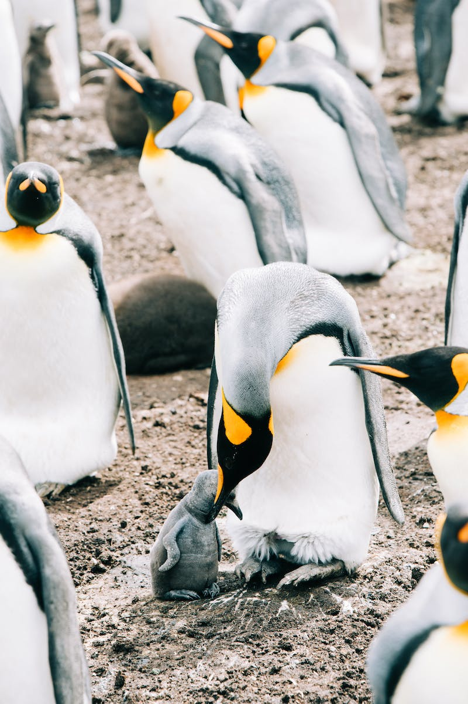
A Bird on the Ground
• A bird that lands on an ant hill is still on the ground.
• Appearances can be deceiving.
• External circumstances do not change the nature of a situation.
Photo by Pexels

Slide 3
The Drum and the Mad Man
• He who beats the drum for the mad man to dance is no better than the mad man himself.
• Enabling destructive behavior is just as harmful as the behavior itself.
• We have a responsibility to not support or encourage harmful actions.
Photo by Pexels

Slide 4
Water and Land
• Where water is the boss, where the land must obey.
• The power dynamics between water and land.
• Highlighting the forces of nature.
Photo by Pexels

Slide 5
The Illusion of Beauty
• No matter how beautiful and well-crafted a coffin might look, it will not make anyone wish for death.
• External appearances do not change internal desires.
• Material possessions do not bring true happiness.
Photo by Pexels

Slide 6
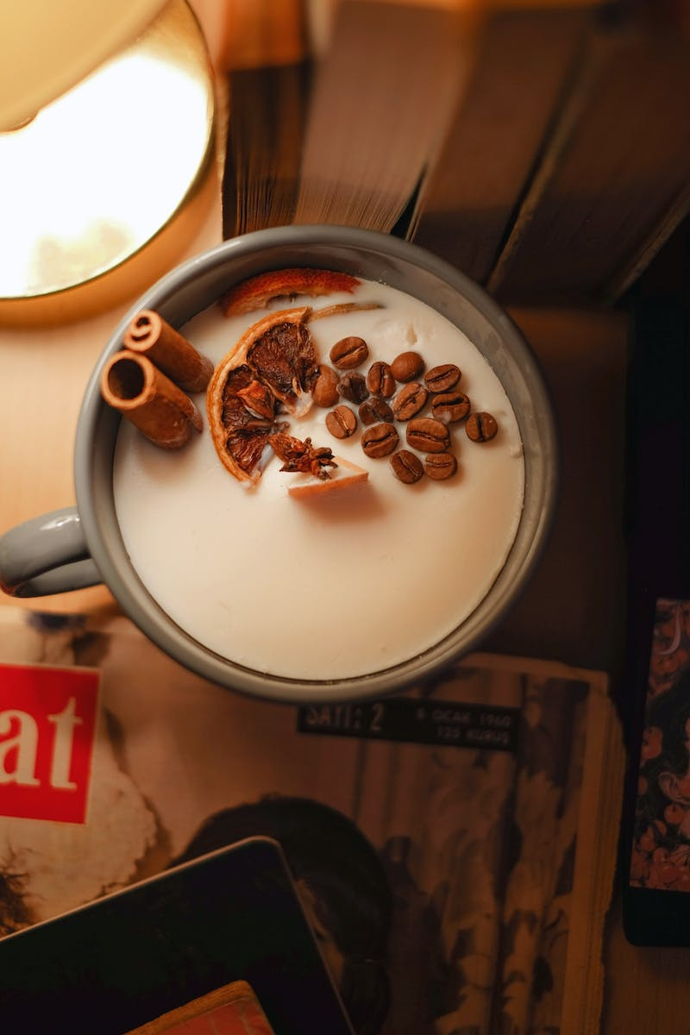
Shepherd's Return
• When the shepherd comes home in peace, the milk is sweet.
• Peaceful circumstances enhance enjoyment.
• Highlighting the influence of external factors on our experiences.
Photo by Pexels

Slide 7
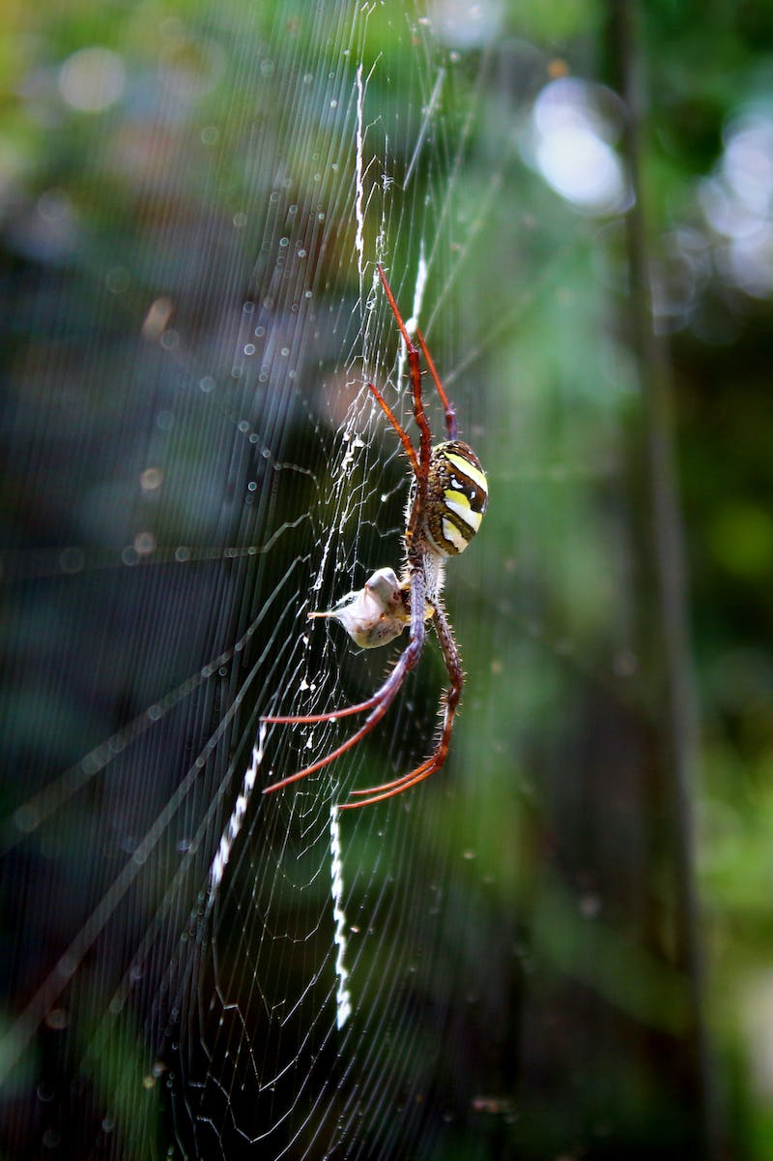
The Spider's Web
• A spider's cobweb is not only its sleeping spring but also its food trap.
• Highlighting the multi-functional nature of a spider's web.
• Emphasizing efficiency and adaptability.
Photo by Pexels

Slide 8
The Value of Patience
• If you do not have patience, you cannot make beer.
• Patience is a necessary virtue.
• Drawing parallels between patience and a brewing process.
Photo by Pexels

Slide 9
Fortune and Peace
• He who runs after good fortune runs away from peace.
• Balancing the pursuit of success and inner peace.
• Highlighting the potential trade-offs in life choices.
Photo by Pexels

Slide 10
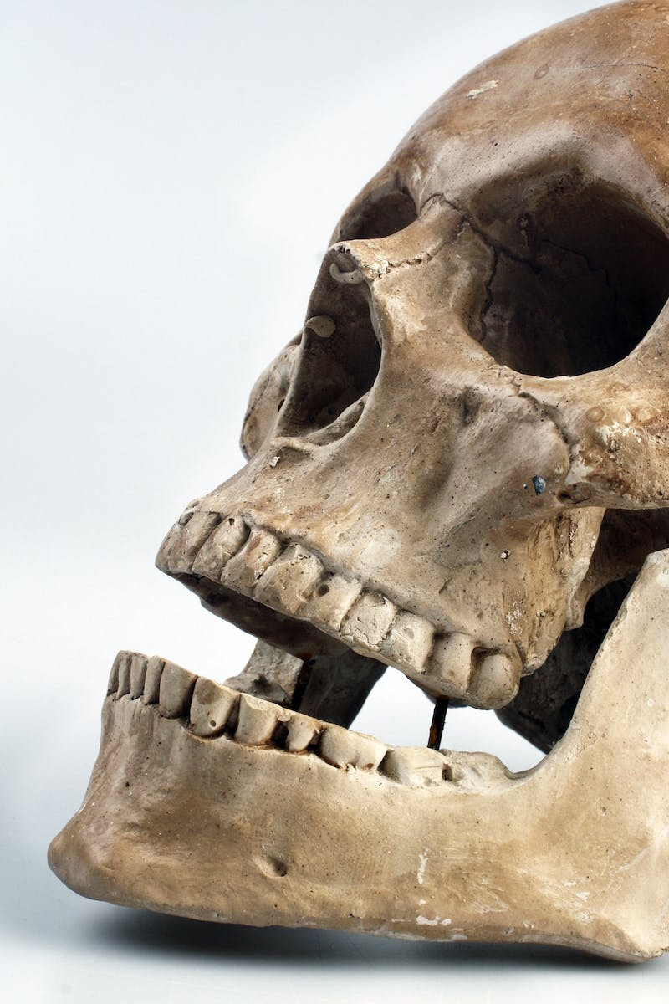
The Unbiased Observer
• Teeth do not see poverty.
• Removing bias and judgment.
• Highlighting the impartiality of natural objects.
Photo by Pexels

Slide 11
Power and Ownership
• You have little power over what's not yours.
• Emphasizing the limits of control and influence.
• Highlighting the importance of respecting boundaries.
Photo by Pexels

Slide 12
The Two Ends of a Stick
• If you pick up one end of a stick, you also pick up the other.
• Consequences and interconnectedness.
• Highlighting the ripple effects of actions.
Photo by Pexels

Slide 13
Finding Contentment
• Better little than too little.
• Embracing contentment over excess.
• Highlighting the value of simplicity.
Photo by Pexels

Slide 14
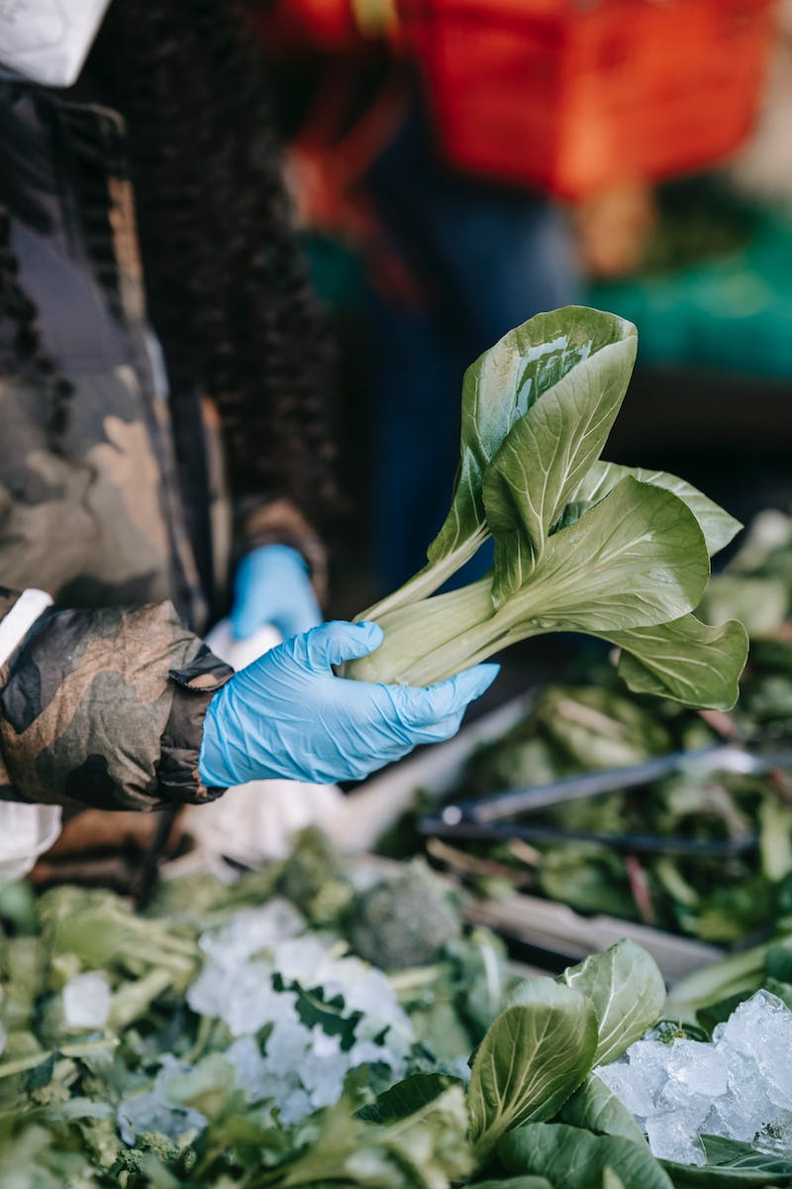
Attending to Business
• You must attend to your business with the vendor in the market.
• Focusing on priorities and responsibilities.
• Emphasizing the value of being present and engaged.
Photo by Pexels

Slide 15
The Night's Secrets
• The night has ears.
• Caution and awareness in darkness.
• Highlighting the unseen aspects of the night.
Photo by Pexels

Slide 16
Inspiration from Unexpected Sources
• The child you fired has inspired you.
• Finding inspiration in unexpected places.
• Highlighting the transformative power of unexpected experiences.
Photo by Pexels

Slide 17
Consequences of Actions
• A doctor who invoked a storm on his people cannot prevent his house from destruction.
• Consequences and accountability.
• Highlighting the impact of one's actions.
Photo by Pexels

Slide 18
Choosing Allies
• An intelligent enemy is better than a stupid friend.
• The value of intelligence in relationships.
• Highlighting the importance of compatibility in connections.
Photo by Pexels

Slide 19
Listening to the Elders
• The young bird does not grow until it hears the old ones.
• Learning from the wisdom of the elders.
• Emphasizing the value of experience.
Photo by Pexels

Slide 20
Appreciating Words of Wisdom
• If you carry the egg basket, do not thank.
• Gratitude for timely advice.
• Emphasizing the value of wise counsel.
Photo by Pexels

Slide 21
Seizing Opportunities
• One day, you will regret that you do not hear these quotes earlier. Do not lose the opportunity.
• Embracing opportunities for growth.
• Highlighting the importance of seizing the present moment.
Photo by Pexels

Slide 22
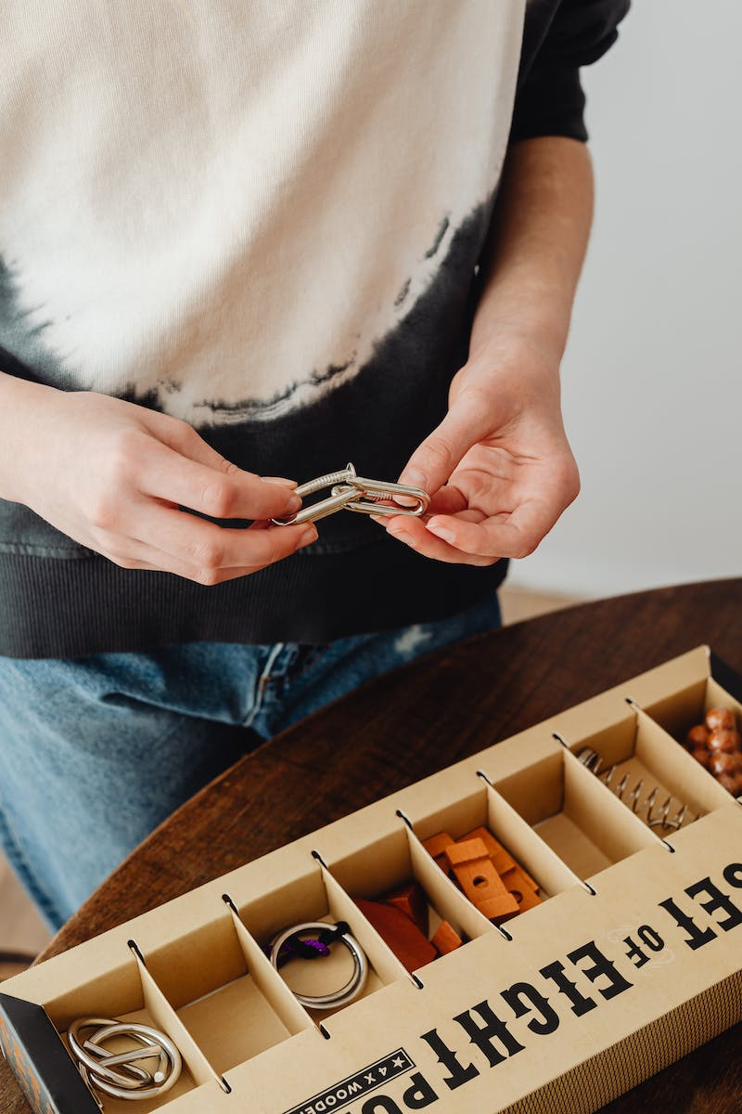
Teaser for the Next Presentation
• Watch our next---
• Building anticipation for the next presentation.
• Creating curiosity among the audience.
Photo by Pexels

