Slide 1
Unlocking the Potential of Zero
A Revolutionary Training System

Slide 2
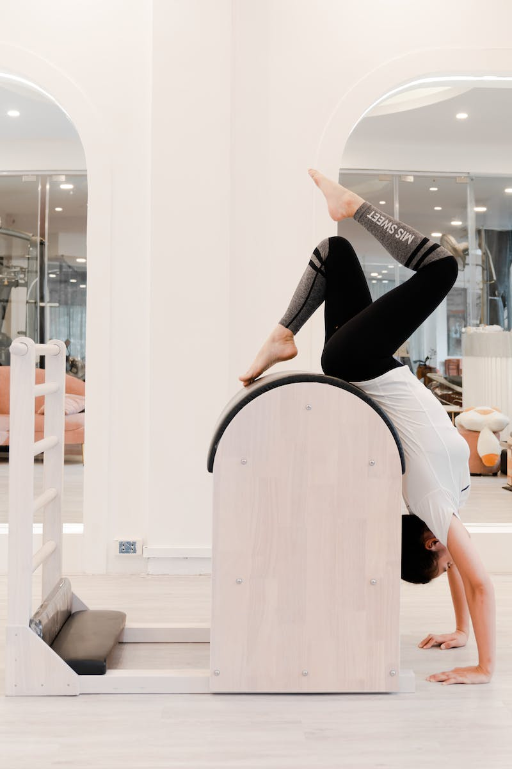
Introduction
• Zero: A groundbreaking system for maximum results
• Training that defies limitations
• Elevating performance to new heights
• Experience the power of zero
Photo by Pexels

Slide 3
The Problem with Traditional Methods
• No ground-breaking results with conventional training
• Limited scope hinders progress
• Struggling to reach the next level
• The need for a transformative approach
Photo by Pexels

Slide 4
Introducing Zero Training
• Zeroing in on unparalleled results
• Unlock hidden potential
• Unleash exponential growth
• A paradigm shift in training
Photo by Pexels

Slide 5
The Power of Zero
• Zero to hero: Accelerating progress
• Overcoming boundaries with zero resistance
• Breaking through plateaus effortlessly
• Achieving peak performance
Photo by Pexels

Slide 6
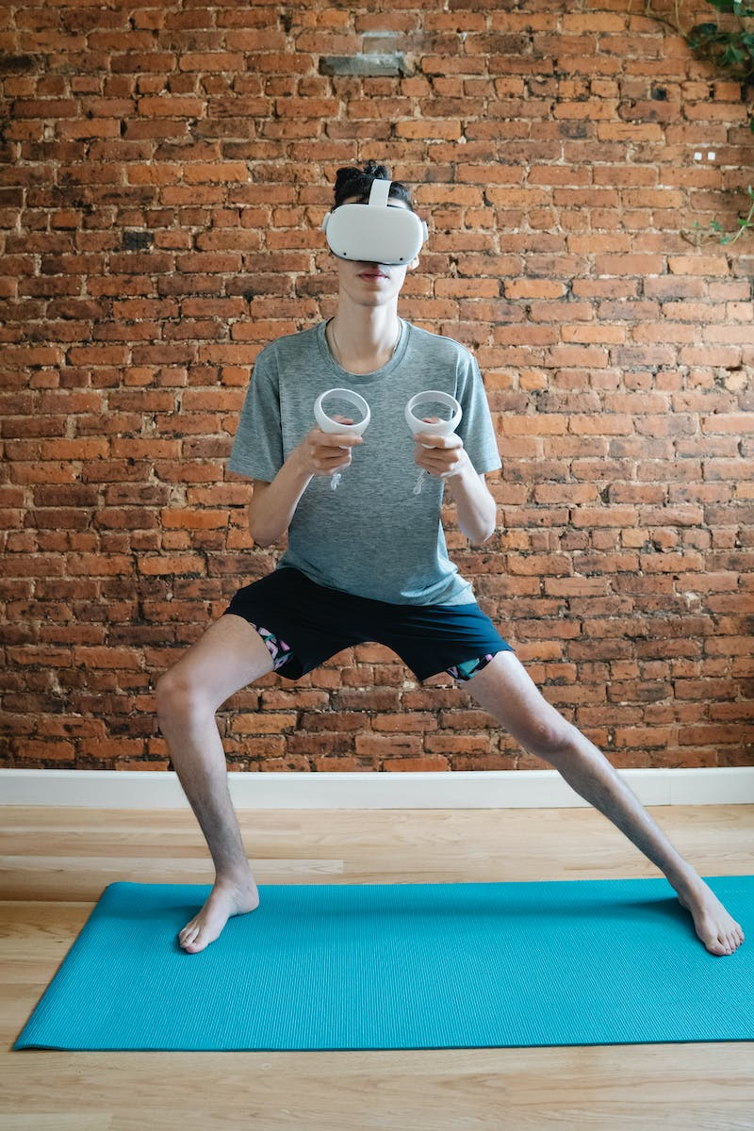
Experience the Zero Difference
• Witness the revolution in action
• Unleash your true potential
• A training experience like no other
• Take the first step towards greatness
Photo by Pexels

