Slide 1
Drone Technology in Energy Sector
Improving Efficiency and Safety

Slide 2
Introduction to DJI
• DJI is the world leader in drone technology
• DJI Enterprise department focuses on industrial clients
• Drones designed to meet industry needs
• Overview of industries where drones are used
Photo by Pexels

Slide 3
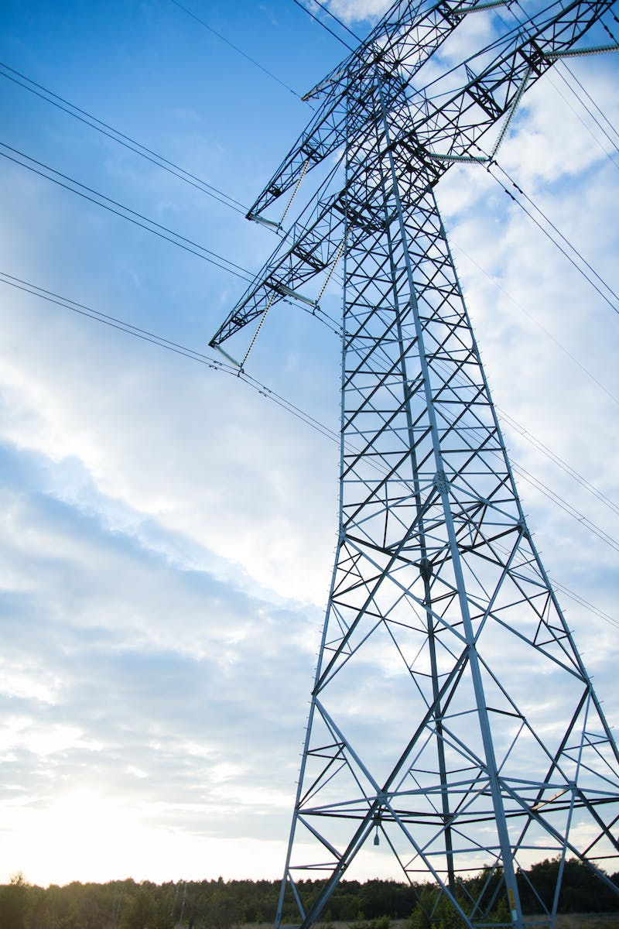
Benefits of Drones in Energy Sector
• Drones enable inspection of difficult-to-reach areas
• Faster inspections reduce costs
• Improved safety for workers
• Examples of drone usage in the energy sector
Photo by Pexels

Slide 4
Introducing DJI Matrice 300 RTK
• Features that make it unique for energy inspections
• Live mission recording and AI spot check
• Ability to fly specific routes automatically
• Design for safety with dual battery configuration and emergency landing
Photo by Pexels

Slide 5
H20 Camera for Energy Inspections
• Overview of H20 camera features
• Laser point rangefinder for precise measurements
• High-resolution grid photo for detailed inspections
• 20-megapixel zoom camera and 12-megapixel wide camera
Photo by Pexels

Slide 6
Power Line Inspection with M300 RTK
• Importance of power line inspection
• Specific areas to inspect, such as poles, metal rooftops, and isolators
• Improved safety for employees with drone inspections
• Ability to detect cracks, rust, and other damages
Photo by Pexels

Slide 7
Flying and Inspecting with M300 RTK
• Manual flight for initial inspection
• Mission flights for subsequent inspections
• Using high-resolution grid photo for detailed inspection
• Infrared and tracking functions for specialized inspections
Photo by Pexels

Slide 8
Safety and Regulations
• Flying within line of sight
• Importance of proper training and certifications
• Adhering to local drone regulations
• Ensuring safe flying conditions
Photo by Pexels

Slide 9
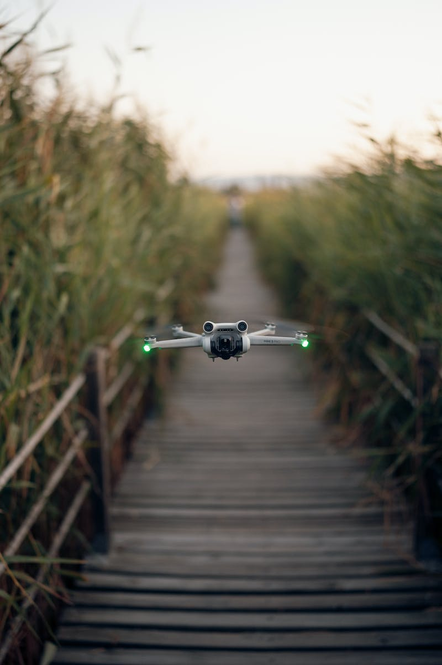
Conclusion
• Benefits of drone technology in the energy sector
• Improved efficiency and safety
• Future advancements in drone technology
• Continued integration of drones in various industries
Photo by Pexels

