Slide 1
The Wonderful World of Music Instruments
Unveiling the Rich and Diverse Universe of Musical Instruments

Slide 2
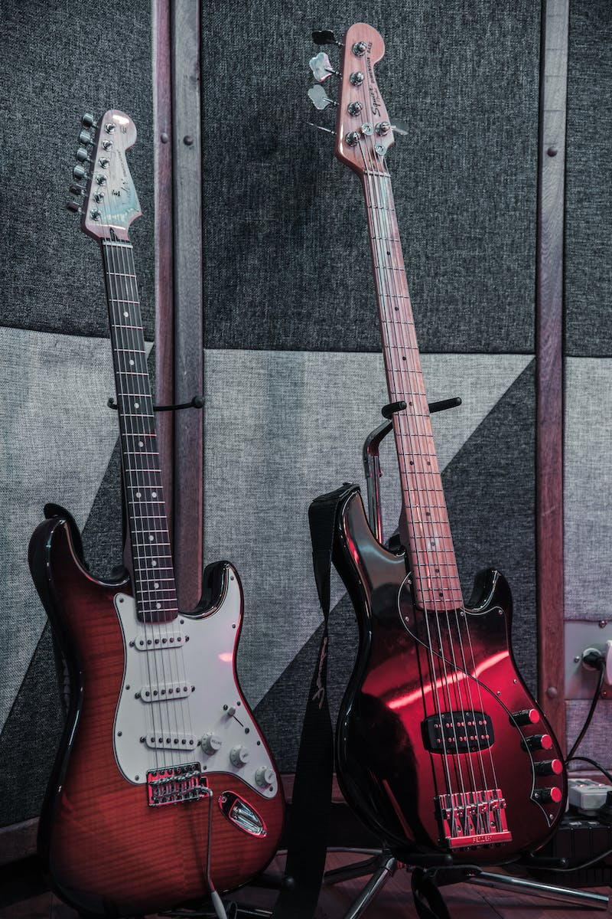
Introduction
• Music instruments play a vital role in the world of music
• They come in various sizes, shapes, and sound extraction methods
• Instruments are categorized into keyboard, wind, percussion, and string families
• Each instrument is unique and contributes its own special qualities to the music
Photo by Pexels

Slide 3
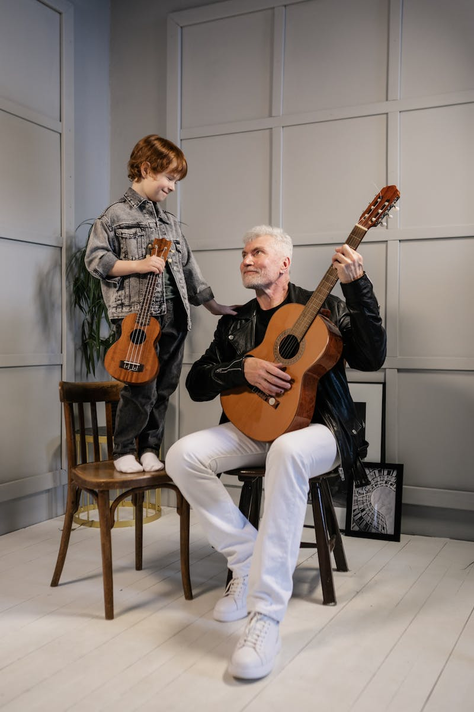
String Instruments
• String instruments are known for their rich and melodic sounds
• Famous examples of string instruments include violin, cello, guitar, and harp
• They can be classified as bowed or plucked string instruments
• String instruments offer a wide range of expressive possibilities
Photo by Pexels

Slide 4
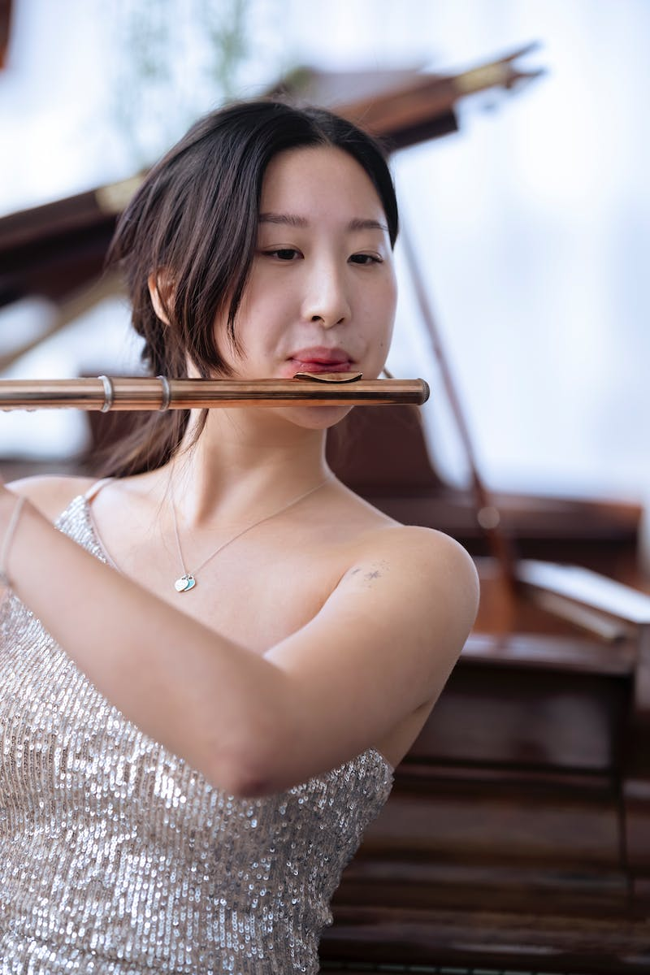
Wind Instruments
• Wind instruments produce sound by vibrating air columns
• Brass instruments like French horn, trumpet, and trombone belong to this category
• Woodwind instruments like oboe, clarinet, and flute are also part of the wind family
• The diverse range of wind instruments adds unique timbres to music
Photo by Pexels

Slide 5
Percussion Instruments
• Percussion instruments produce sound through impact or vibration
• Drums, cymbals, and tambourines are examples of percussion instruments
• They provide rhythmic support and dynamic accents in music
• Percussion instruments add energy and excitement to musical compositions
Photo by Pexels

Slide 6
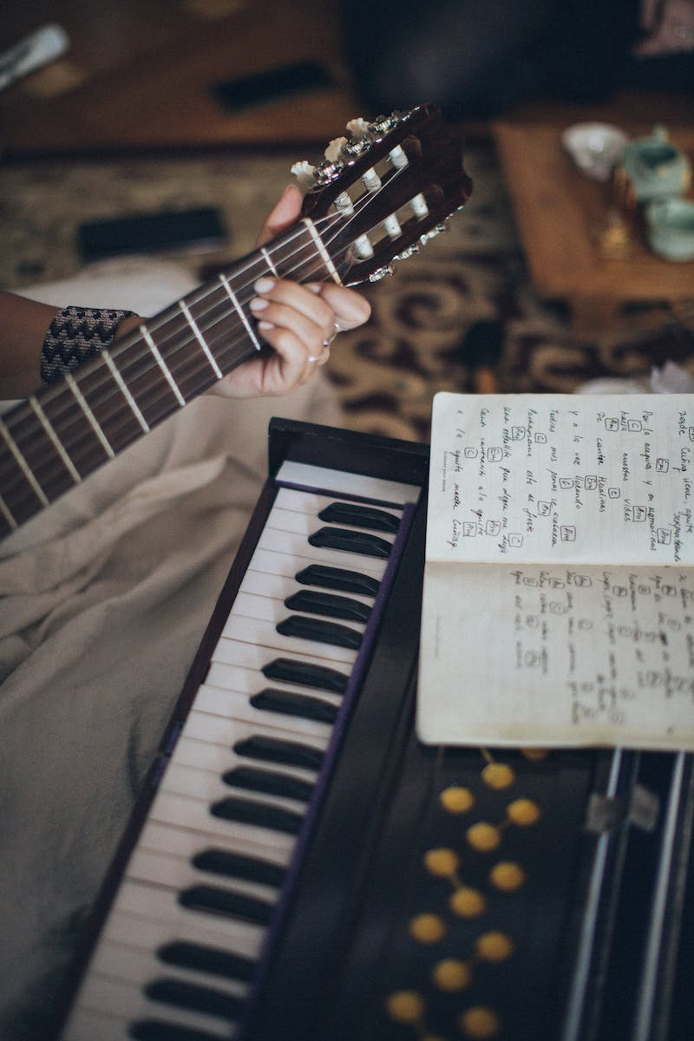
Keyboard Instruments
• Keyboard instruments produce sound through keys that control pitch
• The organ, piano, and harpsichord fall under this category
• The keyboard family offers a wide dynamic range and harmonic possibilities
• Keyboard instruments are known for their expressive and versatile nature
Photo by Pexels

Slide 7
The Majestic Organ
• The organ is an iconic symbol of beauty and grandeur in the music world
• Its captivating sound transports listeners to a realm of mystery and wonder
• The organ's powerful and multi-voiced texture evokes awe and inspiration
• It can mimic various instruments as well as natural sounds, like birdsong and wind
Photo by Pexels

Slide 8
The Grandeur of the Organ
• The organ offers vast tonal possibilities and wide dynamic range
• Its voice palette is incredibly diverse, ranging from gentle to thunderous
• It can imitate the sounds of numerous instruments, voices, and even nature
• The organ's tremendous size and weight make it a monumental musical instrument
Photo by Pexels

Slide 9
Organ in Concert Hall Bardak, Atlantic City
• The largest organ in the world resides in the Bardak concert hall in Atlantic City
• Built in 1932, it boasts an impressive 33,112 pipes and 455 registers
• This organ holds multiple records for size, musical instrument, and volume
• Its massive construction reflects the grandeur and uniqueness of the organ
Photo by Pexels

Slide 10
The Evolution of the Organ
• The organ has a long and rich history spanning thousands of years
• Its origins can be traced back before the common era
• The organ's development led to increased size, complexity, and quality
• It became an integral part of both religious and secular music
Photo by Pexels

Slide 11
The Pan Flute Legend
• The pan flute is a popular wind instrument with a rich history
• According to legend, it originated from a love story in ancient Greece
• A god named Pan fell in love with a beautiful nymph called Syrinx
• Pan, heartbroken, created the pan flute using reeds as a reminder of his lost love
Photo by Pexels

Slide 12
The Organ's Revolutionary Transformation
• In the 13th century, hydraulic organs were replaced by mechanical organs
• The invention of the 'positiv' and 'portativ' organs enabled portability
• These hand organs became popular in diverse musical settings
• The transformation allowed for greater accessibility and versatility
Photo by Pexels

Slide 13
The Renaissance of Organ Music
• From the 14th to the 17th century, organs underwent significant advancements
• Multiple manuals and pedals were added, expanding the instrument's capabilities
• Keyboards were reduced in size, enabling greater playing dexterity
• The organ's repertoire and popularity flourished during this period
Photo by Pexels

Slide 14
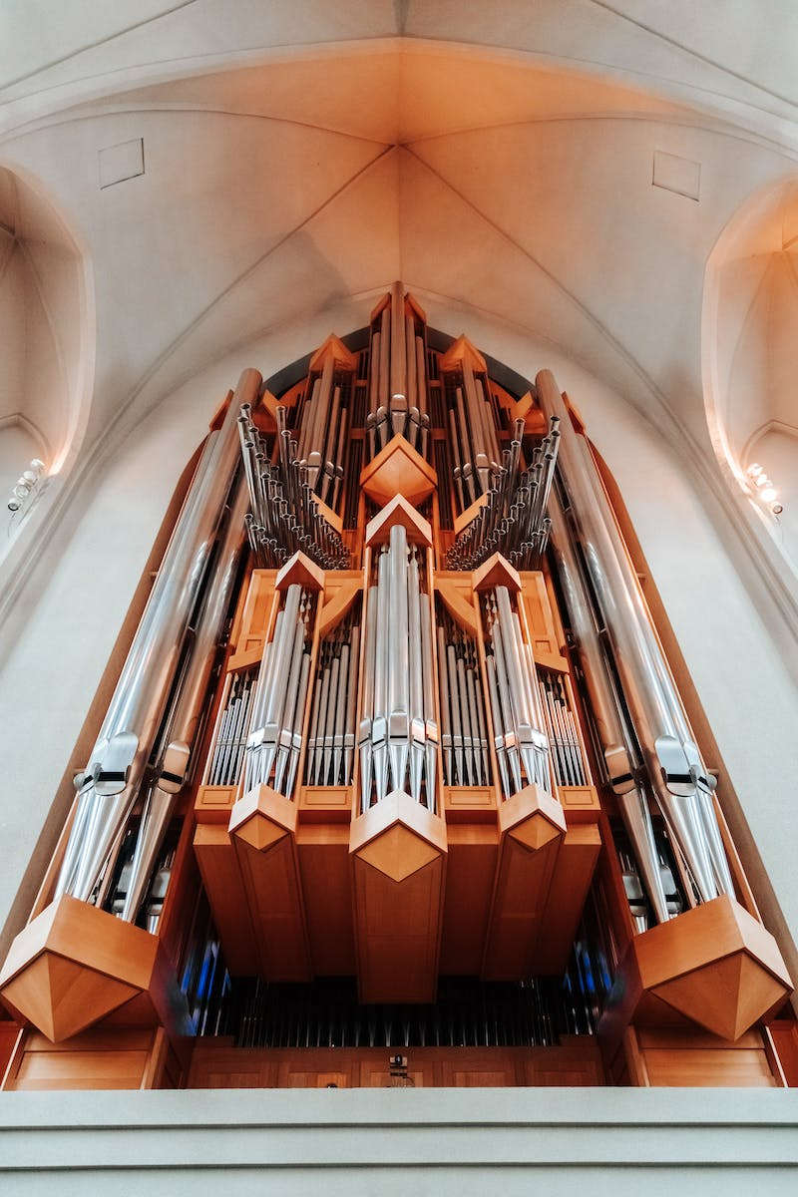
The Organ Today
• Modern organs continue to evolve in terms of structure and complexity
• They feature advanced mechanisms, intricate pipe systems, and precise control systems
• Organ builders now create instruments tailored to specific architectural spaces
• Contemporary organs push the boundaries of performance and tonal possibilities
Photo by Pexels

