Slide 1


April 2025
Unleash Your Inner Superhero: The Comics Art Creator!
Craft Thrilling Stories and Incredible Characters with AI Power!

Slide 2


Table of Contents
1
Comics Art Creator: Unleash Your Inner Hero!
5
Comic Style AI Power-Up
2
Comic Creation Unleashed
6
Unleash Your Creativity!
3
Crafting Memorable Characters
7
Benefits of Using Comics Art Creator
4
Unleash Your Inner Storyteller
8
Comics Art Creator: Unleash Your Vision

Slide 3
Table of Contents
9
Comic Creation: Unleash Heroes
10
Conclusion: Unleash Your Inner Hero!

Slide 4
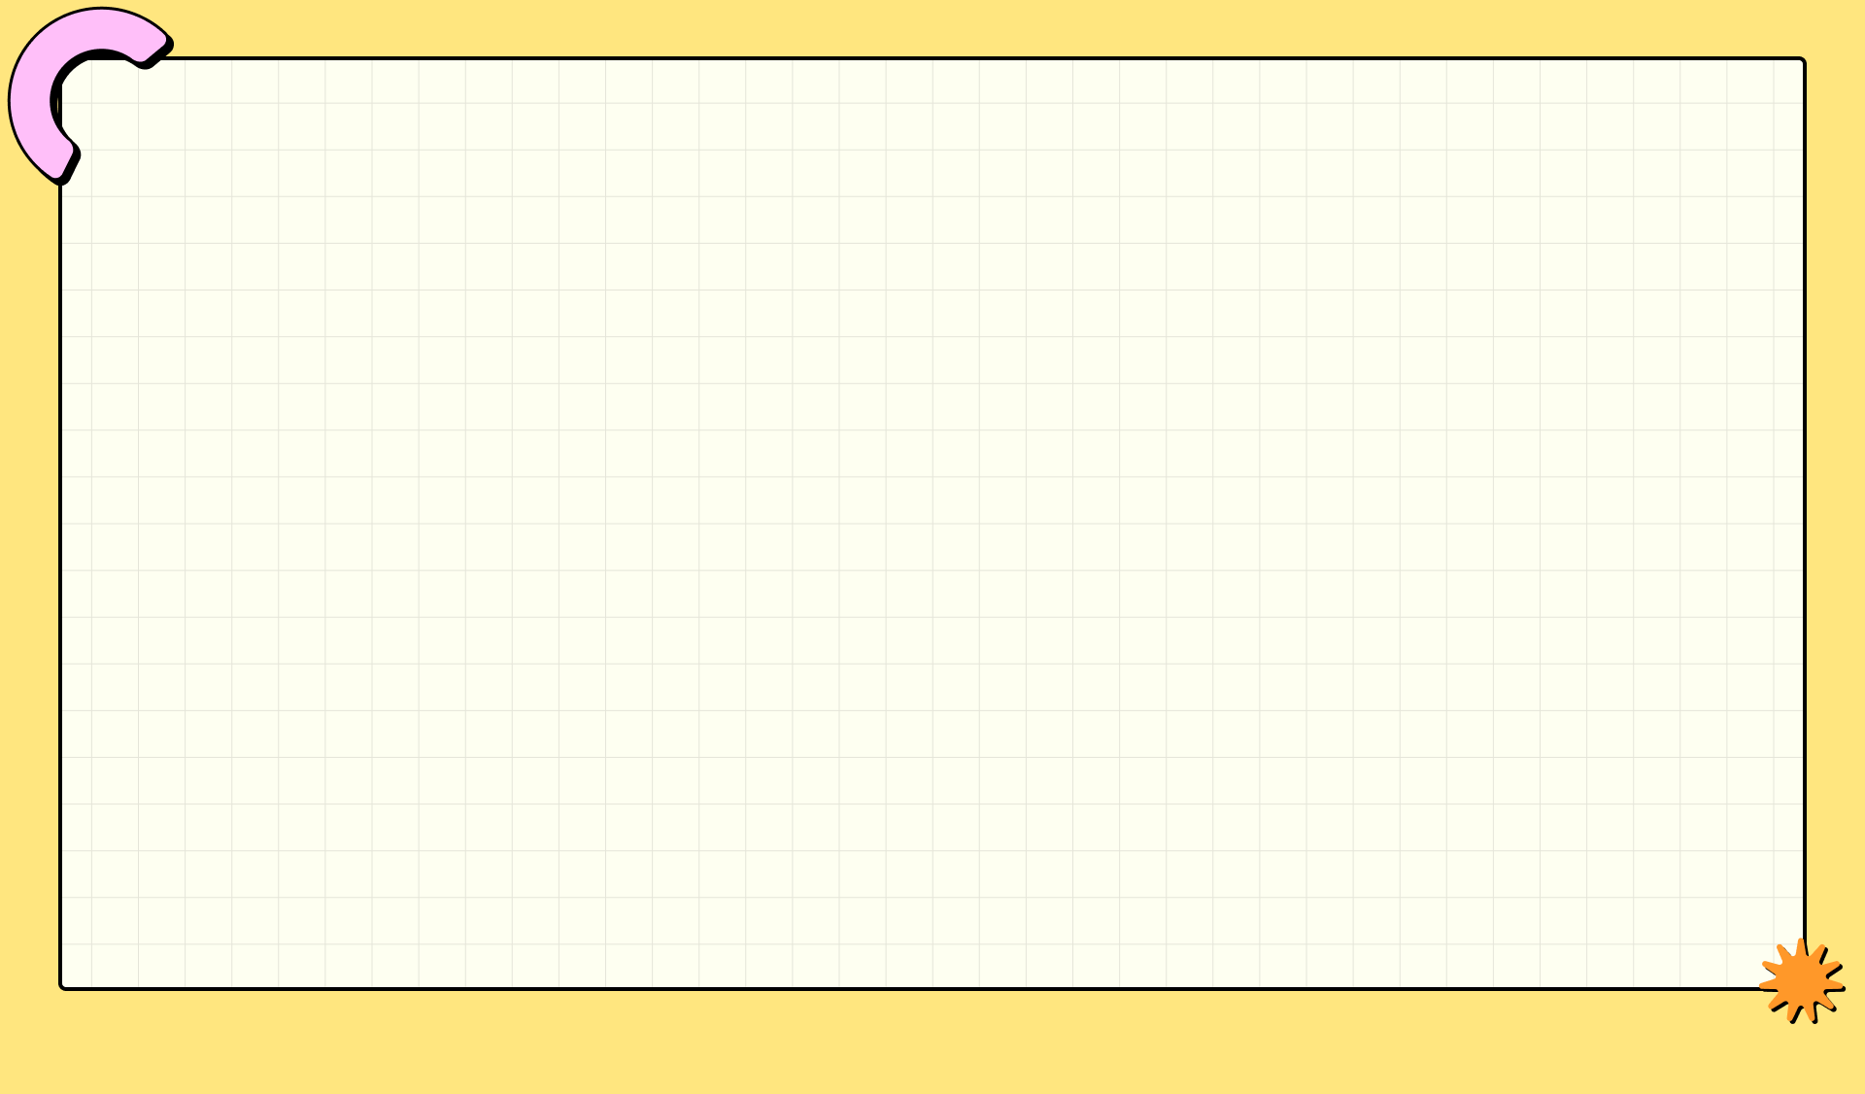

Comics Art Creator: Unleash Your Inner Hero!
Generate captivating comic panels with AI. Styles inspired by iconic DC and Marvel universes are available.
From plot outlines to dialogue, our AI assists in crafting compelling narratives for your superhero comics.
Design unique heroes and villains with customizable features. Bring your imagination to life, panel by panel.
Explore diverse comic art styles, from classic Golden Age to modern, gritty realism. Tailor art to your vision.

Slide 5
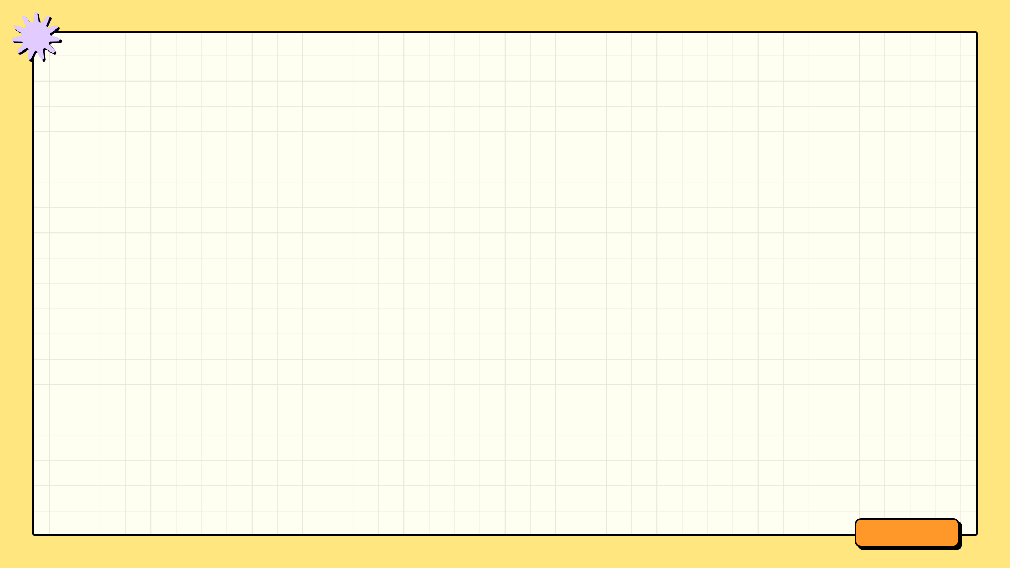



Comic Creation Unleashed
The Upsides
The Downsides
Unleash your creativity by visualizing unique characters and stories, bringing your imaginative worlds to life on the page.
Develop valuable artistic skills in character design, panel layout, and visual storytelling techniques applicable to various creative fields.
Potentially build a portfolio showcasing original comic art, attracting opportunities for freelance work or collaborations with other artists.
Developing consistent artistic skills requires dedicated practice and time, which may compete with other commitments and responsibilities.
Creating high-quality comic art can be resource-intensive, involving costs for art supplies, software, and potential professional feedback.
Facing criticism or rejection is a common part of the creative process, demanding resilience and a thick skin to overcome potential setbacks.

Slide 6

Crafting Memorable Characters
Develop unique appearances. Consider distinct hairstyles, clothing styles, and any noticeable physical traits to make them stand out.
Infuse quirks and habits. Maybe a nervous tick, favorite saying, or unusual hobby that defines their personality.
Create rich backstories, exploring formative experiences that shaped their present motivations and overall worldview.
Give characters clear motivations, exploring why they act and what they want to achieve within the comic's narrative.

Slide 7

Unleash Your Inner Storyteller
Develop relatable and engaging characters that drive the plot forward, making your story believable and emotionally resonant with readers.
Craft intricate and suspenseful plotlines, filled with twists and turns that keep your audience guessing until the very end.
Write authentic and impactful dialogue that reveals character, advances the plot, and enhances the overall narrative experience.
Construct immersive and believable worlds, complete with rich histories, unique cultures, and captivating environments for your stories.

Slide 8
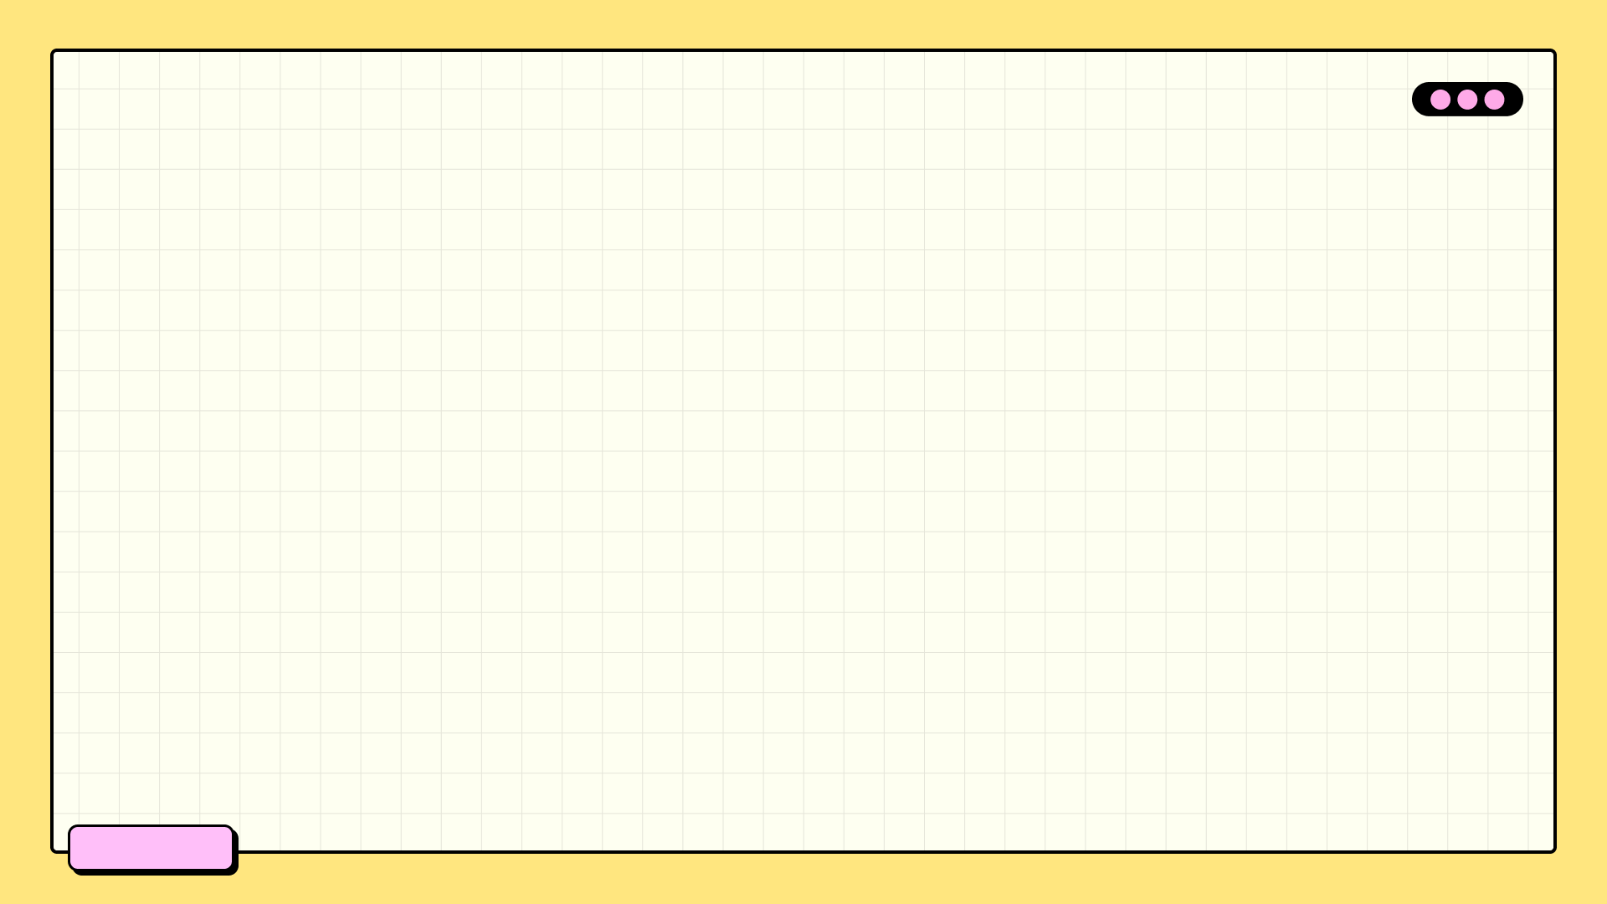

Comic Style AI Power-Up
Style Accuracy
95%
Image Resolution
2k
Generation Speed
2s
User Engagement
4.8/5

Slide 9

Unleash Your Creativity!
Effortlessly create your account and unlock a world of comic creation possibilities. Start your journey in just a few clicks.
Access your comic creation tools from anywhere, anytime. Seamlessly create and manage your projects with ease and flexibility.
Dive straight into the action and begin designing your very own comic strips and stories. Let your imagination run wild!
Connect with other comic enthusiasts, share your work, and receive valuable feedback to enhance your creative process and skills.

Slide 10

Benefits of Using Comics Art Creator
1.Unleash Creativity
2.Easy Interface
Bring your comic book visions to reality with powerful and intuitive design tools at your fingertips.
Simple drag-and-drop features make designing your comic book fun and remarkably easy, regardless of skill level.
3.Vast Library
4.Customizable Options
Access a massive library of pre-made assets like backgrounds, characters, and sound effects to enhance your comics.
Tailor every aspect of your comic, from character design to panel layouts, to match your unique artistic style.

Slide 11
Comics Art Creator: Unleash Your Vision
Craft compelling characters with unique designs, poses, and expressions, bringing your stories to life visually.
Visualize your narrative flow with detailed storyboards, planning each scene for maximum impact and clarity.
Develop breathtaking concept art, exploring environments, props, and overall aesthetics for your comic universe.
Seamlessly build your comics panel by panel, arranging artwork and dialogue to create a captivating reading experience.

Slide 12
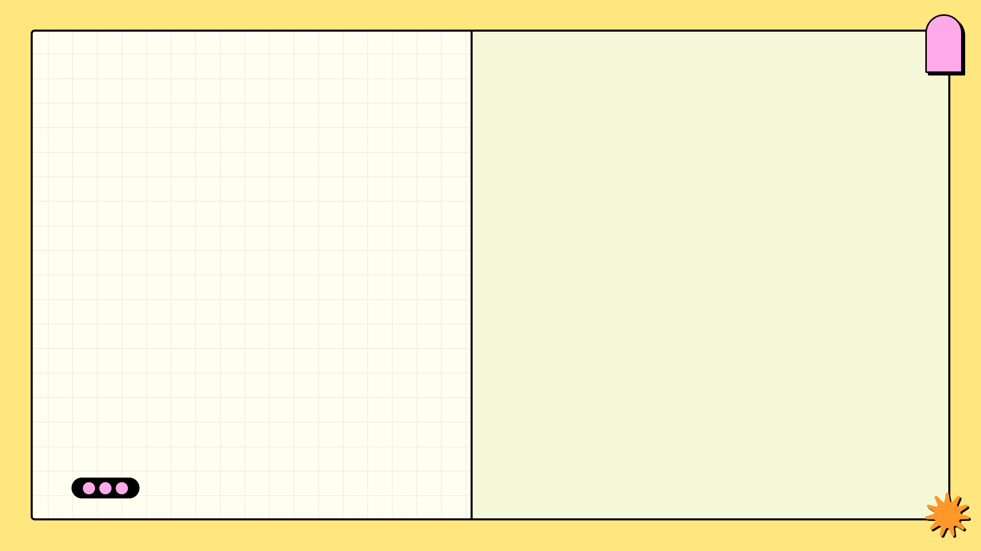
2022
✓
Comic Creation: Unleash Heroes
Concept Ignition
Brainstorming initial ideas for the superhero, their powers, weaknesses, and the overall narrative. This stage involves outlining the core themes and target audience. We also research existing heroes to avoid overlap and identify unique angles.
Detailed guide to superhero comic creation.
Using our tool, bring your heroes to life!
✓
2023
Script & Storyboard
Developing a detailed script with dialogue and action sequences. Creating a storyboard with rough sketches of each panel to visualize the comic's layout and flow. This step ensures clear storytelling and efficient page composition. The script drives the entire story.
2024
✓
Art & Inking
Creating the final artwork, including character design, backgrounds, and detailed illustrations. Inking the pencil sketches to create crisp, defined lines. Colorists then add depth and vibrancy to the pages, defining the tone and emotion of each scene.

Slide 13

Conclusion: Unleash Your Inner Hero!
Fuel your creativity and bring unique superhero stories to life. Explore endless possibilities with Comics Art Creator's versatile tools.
Design captivating narratives with dynamic characters and thrilling plots. Comics Art Creator empowers you to create unforgettable sagas.
Transform your ideas into stunning visuals with ease. Customize every detail and create a truly unique comic book experience.
Publish and share your creations with the world. Connect with fellow comic enthusiasts and showcase your superhero universe.

