Slide 1
Methods of Separating Components from Mixtures
Exploring various techniques for component separation

Slide 2
Introduction to Mixtures
• Mixtures are physical combinations of two or more substances
• Examples of mixtures include soil, garbage, and concrete
• Most materials in our surroundings are mixtures of two or more components
• Mixtures can be classified as solutions or heterogeneous mixtures
Photo by Pexels

Slide 3
Methods of Separation
• Mixtures can be separated into their components using various techniques
• Common methods include evaporation, filtration, extraction, flotation, and magnetic separation
• The choice of method depends on the nature of the mixture and its components
Photo by Pexels

Slide 4
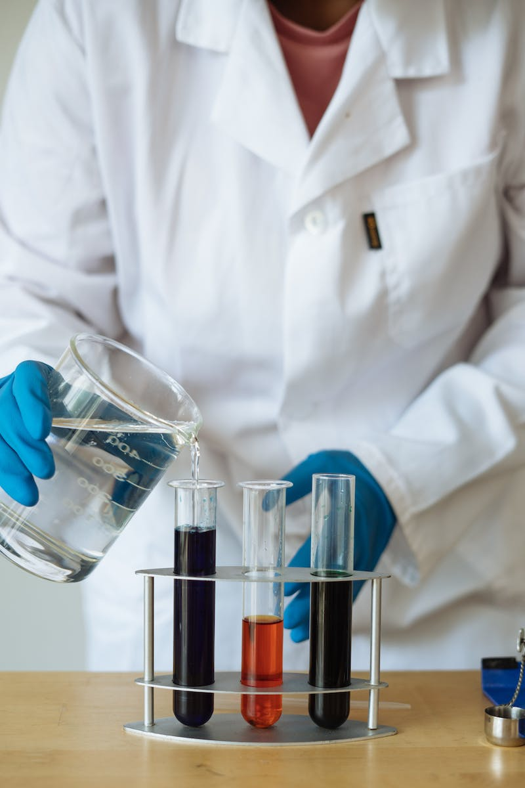
Separating Homogeneous Mixtures
• Homogeneous mixtures have evenly dispersed components
• Examples include sea water, which is a mixture of water and salt
• Homogeneous mixtures can be separated by methods like evaporation and simplification
Photo by Pexels

Slide 5
Separation by Evaporation
• Sea water can be separated by evaporating the water to obtain salt
• Solar evaporation is one method of separating components from mixtures
• Explore other potential ways to separate components from sea water
Photo by Pexels

Slide 6
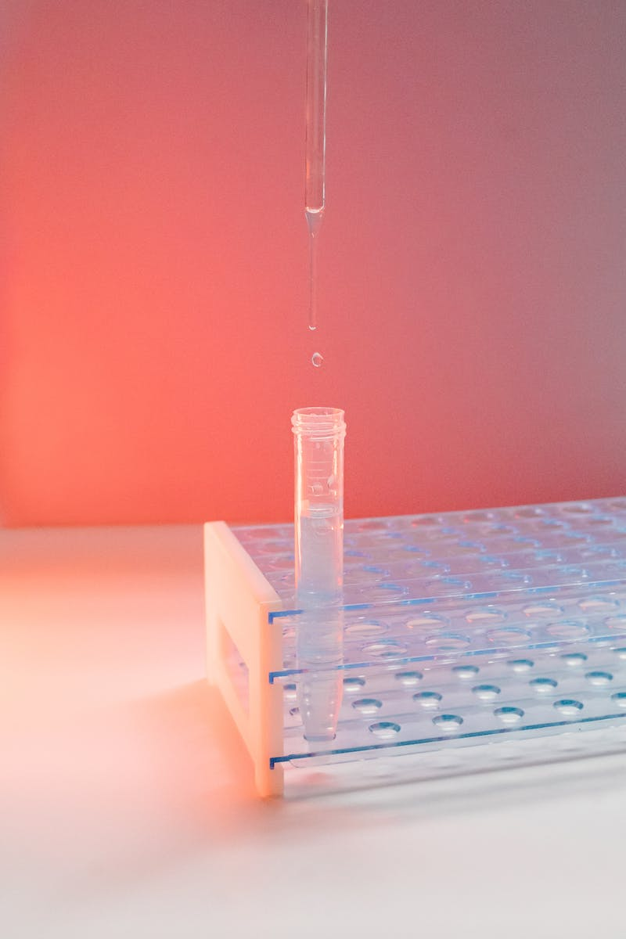
Separation by Simplification
• Centrifugation is a method of separating substances in mixtures
• Sugar can be obtained from sugarcane juice through simplification
• Discuss the extraction of components from plant sources
Photo by Pexels

Slide 7
Separation by Electrification
• Air can be purified and its components separated through electrification
• Different gases in air have different boiling points
• Discuss the uses of the components separated from air
Photo by Pexels

Slide 8
Separation by Crystalization
• Certain components can be separated by crystallization from hot solutions
• Water-soluble components crystallize out of the solution
• Discuss the methods of separation for heterogeneous mixtures
Photo by Pexels

Slide 9
Other Methods of Separation
• Separation can also be done using winnowing, panning, strainers, filters, and magnets
• Each method is suitable for specific types of mixtures and components
• Highlight the importance of appropriate separation techniques
Photo by Pexels

Slide 10
Conclusion
• Mixtures can be separated into their components through various techniques
• The choice of method depends on the nature of the mixture and its components
• Understanding these methods helps us utilize and extract valuable substances from mixtures
Photo by Pexels

