Slide 1
Changes in the Environment: Useful or Harmful?
Identifying and Understanding the Impact of Environmental Changes

Slide 2
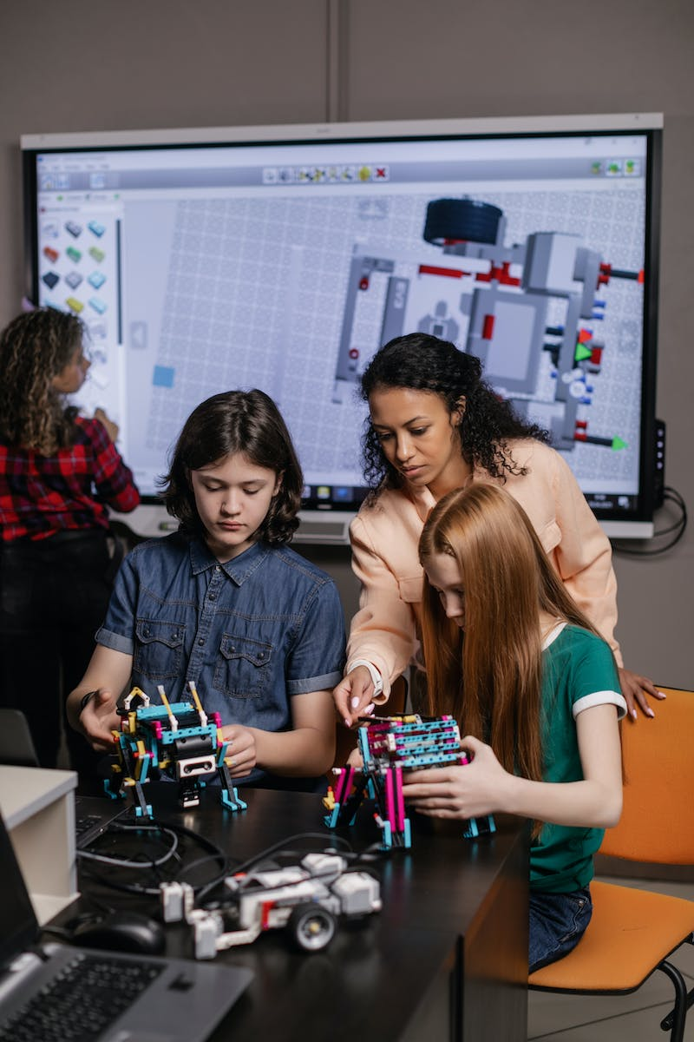
Welcome to Science Class
• Lesson: Identifying changes that are useful and harmful in the environment
• Science for grade four, week seven and eight
• Objective: To be able to identify changes in the environment
• Image: classroom or science-related image
Photo by Pexels

Slide 3
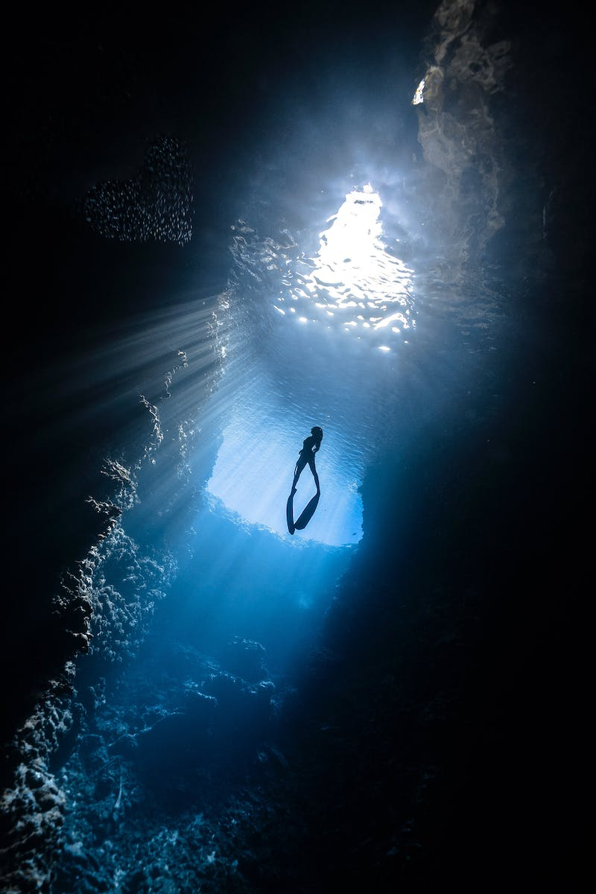
Your Environment: Home and Sea
• Environment: Your home and the sea
• Components: Living and non-living things
• Examples: Rocks, stones, sand, water, humans, marine organisms
• Interactions: How living and non-living things interact
• Image: Illustration of a home and a sea
Photo by Pexels

Slide 4
Changes in the Environment
• Cause of Changes: Interactions between living and non-living things
• Examples of Changes: Materials in the home and environment
• Habitat: Sea as a habitat for fish and marine organisms
• Components: Benches, slides, and materials in the playground
• Image: Illustration of changing environment
Photo by Pexels

Slide 5
Harmful Pollution in the Environment
• Types of Pollution: Water, land, and air pollution
• Causes: Human activities, such as garbage disposal and smoke emissions
• Effects: Skin itch, respiratory diseases, global warming
• Image: Visual representation of water, land, and air pollution
Photo by Pexels

Slide 6
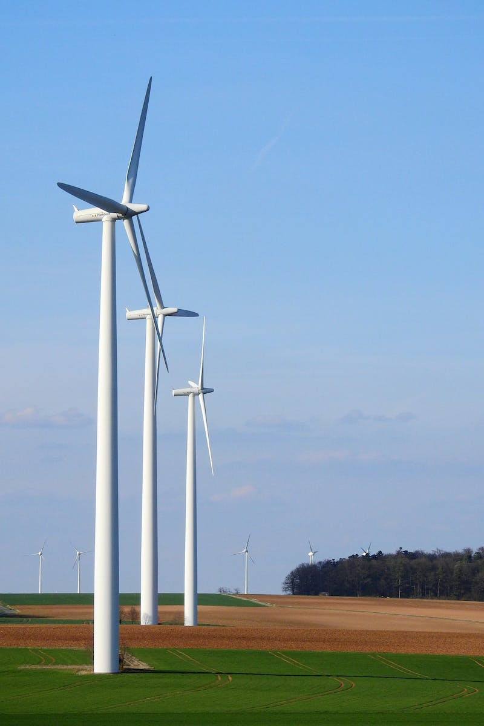
Useful Changes in the Environment
• Examples of Useful Changes: Trees flowering into fruits, composting, recycling
• Benefit: Cleaner and more adaptable environment
• Activities: Food production, maintaining cleanliness
• Image: Illustration depicting useful changes in the environment
Photo by Pexels

Slide 7
Determining Usefulness or Harmfulness
• Activity: Identifying the usefulness or harmfulness of given situations
• Happy Face: Indicates changes that are useful in the environment
• Sad Face: Indicates changes that are harmful in the environment
• Examples: Cutting and shaping wood, water contamination, respiratory diseases
• Image: Illustration of happy and sad faces
Photo by Pexels

Slide 8
Identifying Pollution Types
• Matching Activity: Identifying the type of pollution
• Options: Air pollution, water pollution, land pollution
• Examples: Smoke from factories, chicken waste, dumping garbage
• Image: Visual representation of pollution types
Photo by Pexels

Slide 9
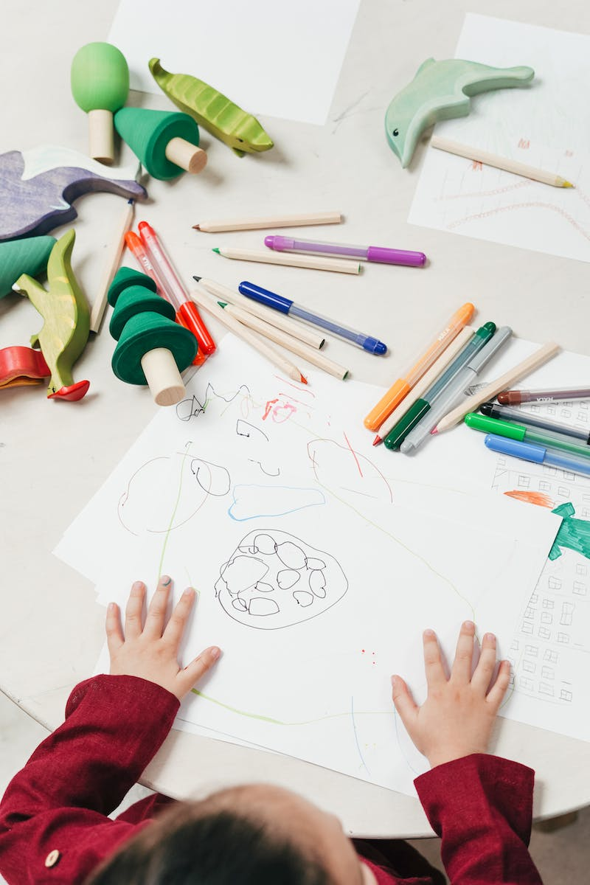
Wrapping Up
• Summary of the Presentation
• Appreciation for Participation
• Encouragement to Learn More
• Closing Remarks: Subscribe for more videos and visit theteachersgraph.com
• Image: Image related to education or learning
Photo by Pexels

