Slide 1
Laboratory Diagnosis of Cancer
Methods and Techniques for Diagnosing Cancer

Slide 2
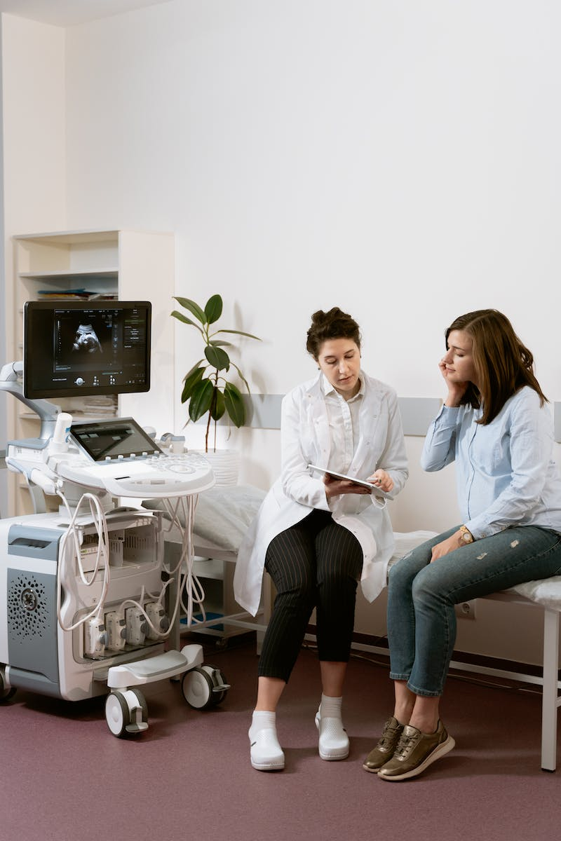
Introduction
• Welcome to Pathology Made Simple tutorial on the laboratory diagnosis of cancer
• In this presentation, we will discuss various methods utilized to diagnose cancer and their utilities in cancer management
• Physicians thoroughly examine patients for vague symptoms and clues for cancer diagnosis
• Routine blood investigations can reveal anemia or polycythemia, which may be secondary to underlying malignancy
Photo by Pexels

Slide 3
Cytopathological Examination
• Cytopathological examination involves studying cells for cancer diagnosis
• Cells for diagnosis can be obtained through exfoliative cytology or interventional cytology
• Exfoliative cytology involves spontaneously shed cells from organ linings, such as Pap smears for cervix lesions
• Interventional cytology involves obtaining cells through active intervention, e.g., fine needle aspiraion cytology

Slide 4
Histopathological Examination
• Histopathological examination involves diagnosing cancer based on microscopic features of the neoplasm
• Tissues for examination can be obtained through needle biopsy, endoscopic biopsy, incision biopsy, or excision biopsy
• Needle biopsy involves taking a small chunk of tissue through a core needle
• Endoscopic biopsy is performed during gastrointestinal endoscopy procedures
• Incision biopsy involves taking a part of the lesion along with normal tissue
• Excision biopsy involves removing the entire tumor along with surrounding tissue

Slide 5
Immunohistochemistry
• Immunohistochemistry is a special investigation used to detect specific proteins in tissue sections
• Antibodies are used to recognize and bind to the target proteins
• Markers are used to visualize the antigen-antibody complex
• Immunohistochemistry helps in determining the nature of the tumor, extent of tumor involvement, and categorizing undifferentiated cancer

Slide 6
Flow Cytometry
• Flow cytometry is a technique used to analyze cell properties as they pass through a fluid stream
• Light scattering is used to obtain information about the cells
• Flow cytometry helps in identification and characterization of specific types of cancers
Photo by Pexels

Slide 7
Molecular Techniques
• Molecular techniques involve studying the genetic makeup of cancer cells
• Polymerase Chain Reaction (PCR) is used to detect and amplify specific DNA sequences
• Fluorescence in situ hybridization (FISH) is used to detect genetic changes and chromosomal abnormalities
• Gene sequencing is used to identify mutations and other genetic changes
• Next Generation Sequencing (NGS) is an advanced method for reading DNA in a short amount of time
Photo by Pexels

Slide 8
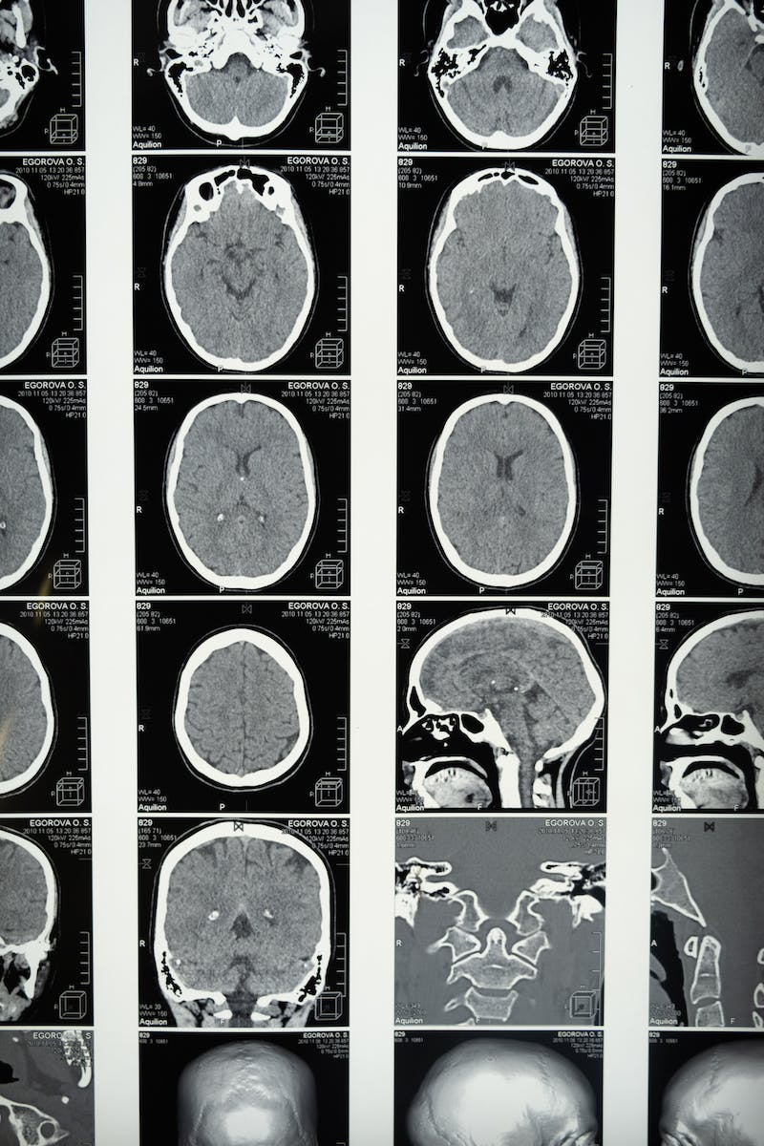
Imaging Techniques
• Imaging techniques like X-rays, ultrasound, computed tomography (CT) scan, magnetic resonance imaging (MRI), and positron emission tomography (PET) are used in cancer diagnosis
• Each technique uses different technologies to produce detailed images of the body
• Imaging techniques can be used alone or in combination for diagnosing cancers
Photo by Pexels

Slide 9
Liquid Biopsy
• Liquid biopsy is a technique that uses blood to detect the genetic makeup of cancers
• Circulating tumor DNA (ctDNA) test detects DNA shed by cancer cells in the blood
• Liquid biopsy provides real-time information about the presence of cancer and can be used to monitor response and detect minimal residual disease
Photo by Pexels

Slide 10
Tumor Markers
• Tumor markers are products of tumors that can be detected in cells, blood, or body fluids
• Tumor markers can be used to monitor the progression of the disease and evaluate the effectiveness of cancer treatment
• Examples of tumor markers include prostate-specific antigen (PSA), cancer antigen 125 (CA125), and alpha-fetoprotein (AFP)
Photo by Pexels

Slide 11
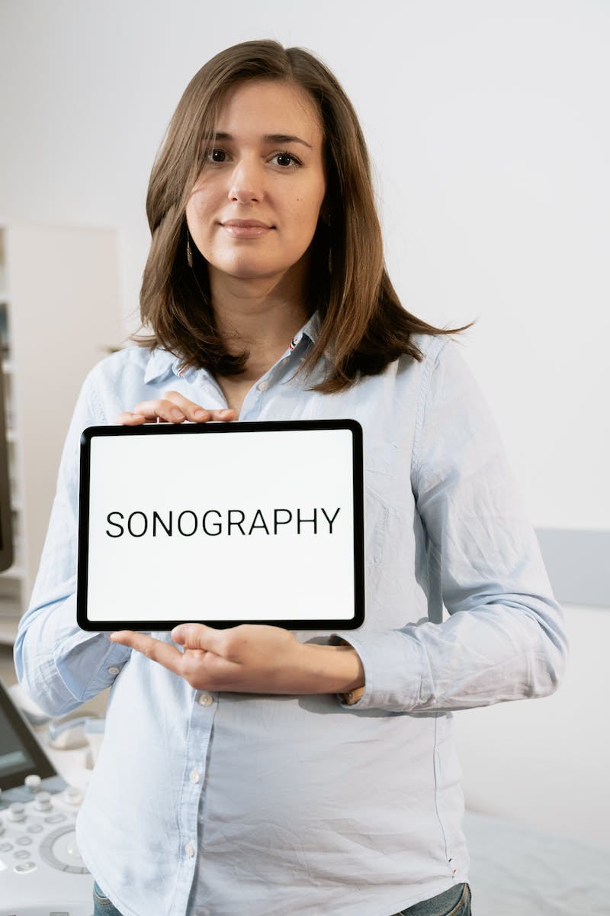
Conclusion
• In conclusion, the laboratory diagnosis of cancer involves multiple methods and techniques
• Each method has its own advantages and utilities in cancer diagnosis and management
• A combination of physical examination, laboratory investigations, imaging, and molecular techniques provides a comprehensive approach to cancer diagnosis
• It is important to integrate these diagnostic methods for accurate and conclusive cancer diagnosis
Photo by Pexels

