Slide 2
Introduction
Discover the best places to visit near Delhi in June. Escape the summer heat and explore scenic destinations perfect for a refreshing getaway.
Photo by Pexels

Slide 3
Rishikesh
Adventure and Serenity
Rishikesh offers a blend of adventure and tranquility. Enjoy activities like river rafting, and yoga retreats, or visit the iconic Laxman Jhula.
Photo by Pexels

Slide 4
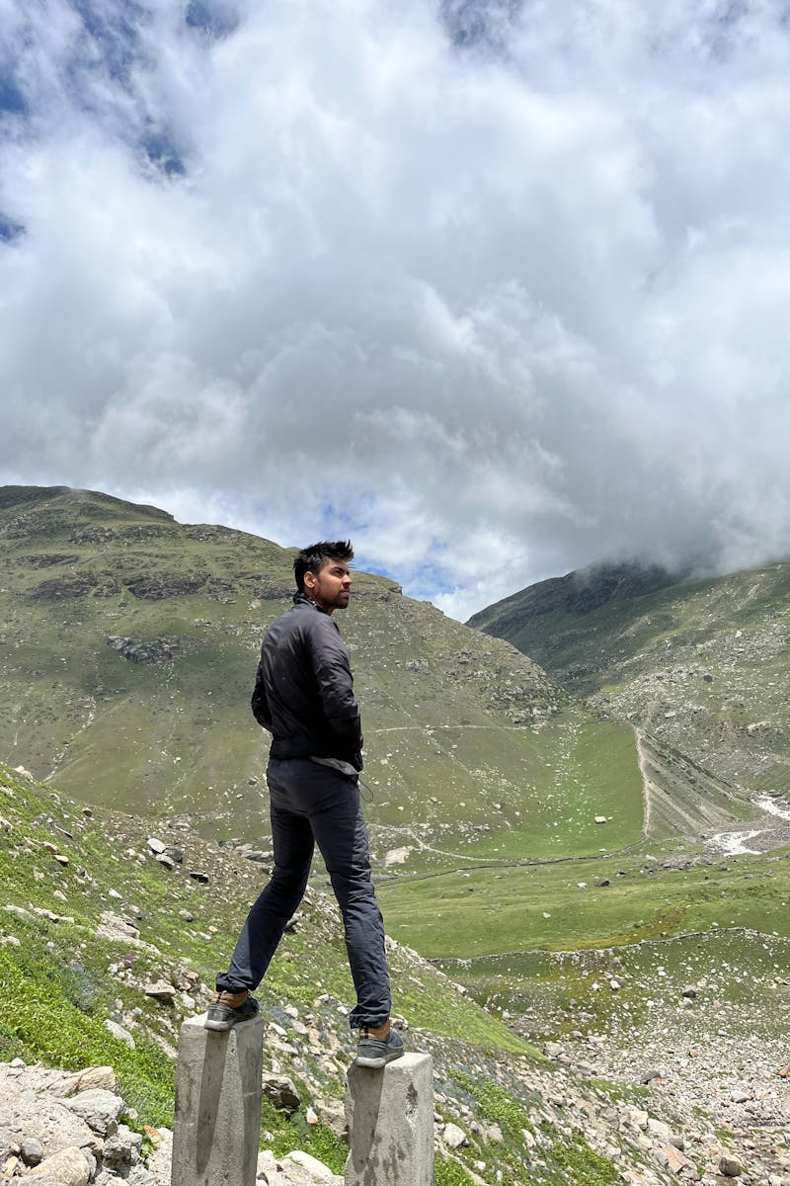
Ladakh
Majestic Landscapes
Ladakh is known for its stunning landscapes, high-altitude passes, and vibrant culture. Key attractions include Pangong Lake and Leh Palace.
Photo by Pexels

Slide 5
Shimla
Colonial Charm
Shimla offers colonial charm with attractions like the Mall Road, Christ Church, and scenic viewpoints such as Jakhoo Hill.
Photo by Pexels

Slide 6
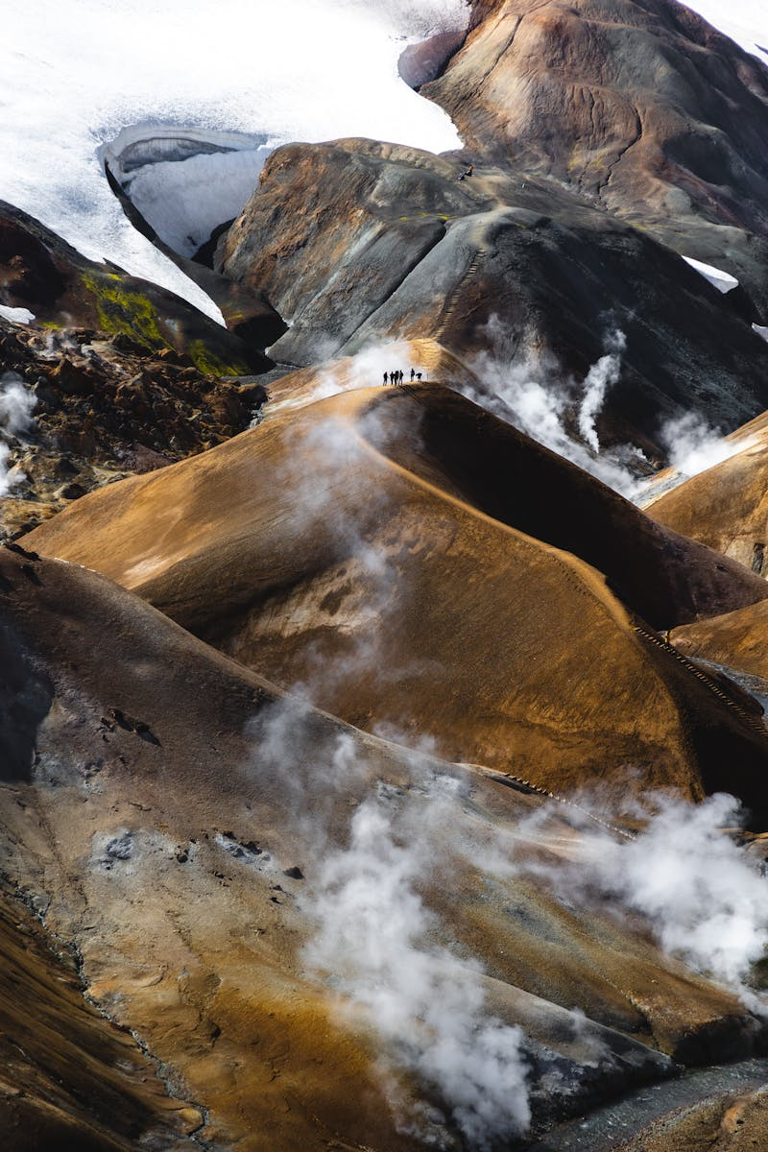
Kullu
Nature's Paradise
Kullu is a paradise for nature lovers with its lush greenery, river valleys, and adventure sports like paragliding and trekking.
Photo by Pexels

Slide 7
Nainital
Lake District of India
Nainital is famous for its picturesque lakes, such as Naini Lake, and attractions like the Naina Devi Temple and Tiffin Top.
Photo by Pexels

Slide 8
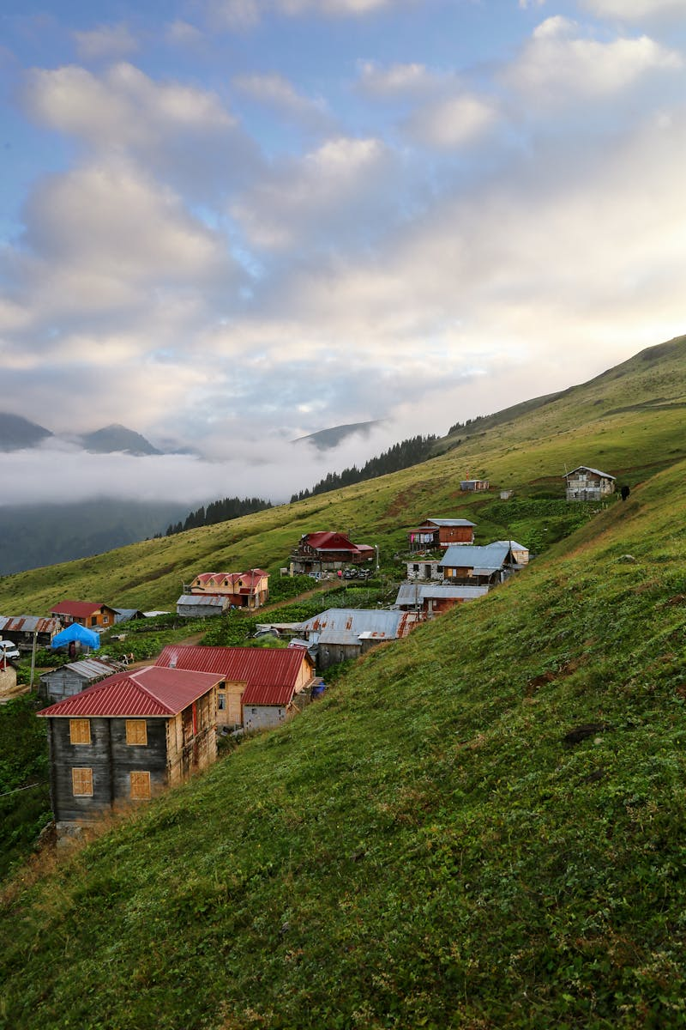
Manali
Adventure Hub
Manali offers a mix of adventure activities and natural beauty, with attractions like Solang Valley, Rohtang Pass, and Hidimba Temple.
Photo by Pexels

