Slide 1
Meiosis: The Reduction Division
An In-depth Study of Meiosis 1

Slide 2
Introduction to Meiosis
• Meiosis is a nuclear division that occurs in germ cells of sexually reproducing organisms.
• It produces reproductive cells called gametes.
• Meiosis is a reduction division that reduces the chromosome number of a cell by half.
• The entire process of meiosis results in the formation of four haploid daughter cells.
• Chromosome number is restored after fertilization.

Slide 3
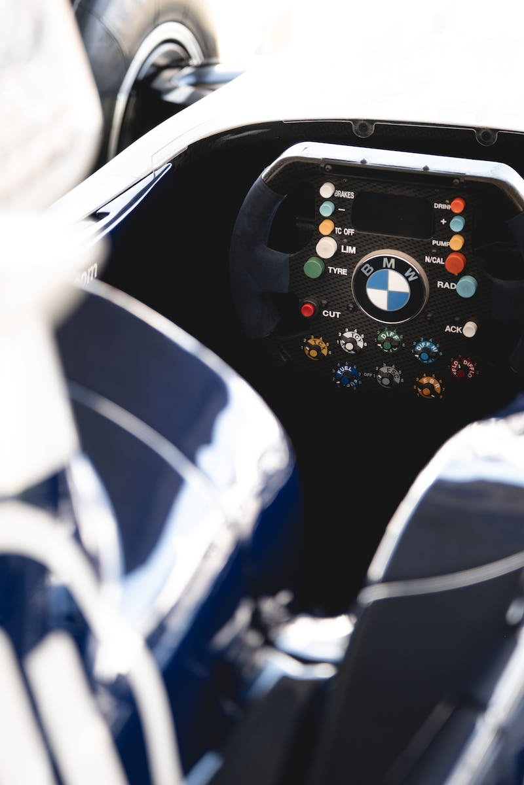
Meiosis 1: The Reduction Division
• Meiosis 1 is the first round of cell division in meiosis.
• It involves four stages: Prophase 1, Metaphase 1, Anaphase 1, and Telophase 1.
• Prophase 1 is further subdivided into five stages: Leptotene, Zygotene, Pachytene, Diplotene, and Diakinesis.
• Each stage has distinct events and processes.
Photo by Pexels

Slide 4
Prophase 1: Leptotene and Zygotene
• Leptotene: Chromosomes condense and become visible.
• Zygotene: Chromosomal crossing over takes place between non-sister chromatids of homologous chromosomes.
• Crossing over makes each individual unique and causes recombination.
• Formation of bivalents occurs.
Photo by Pexels

Slide 5
Prophase 1: Pachytene, Diplotene, and Diakinesis
• Pachytene: Homologous chromosomes are fully synapsed, allowing further crossing over.
• Diplotene: Synaptonemal complex breaks down and chromosomes start to separate.
• Diakinesis: Chromosomes are fully condensed, nucleolus and nuclear membrane dissolve, mitotic spindle assembles.
Photo by Pexels

Slide 6
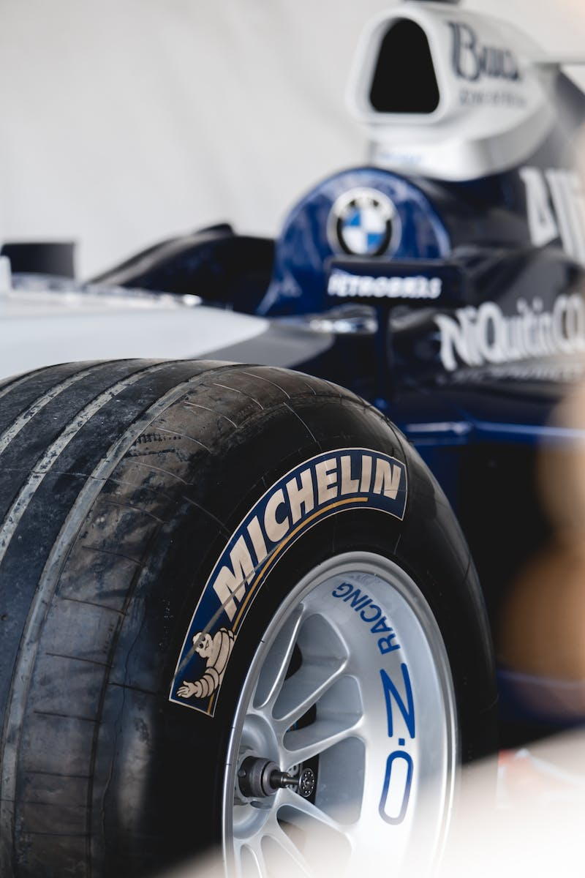
Metaphase 1: Alignment of Homologous Chromosomes
• Microtubules from opposite poles attach to the chromosomes at the kinetochores.
• Bivalents align along the equatorial plate with random orientation.
• Parental homologues can take up any site on the spindle.
• Metaphase 1 marks the alignment of the bivalents.
Photo by Pexels

Slide 7
Anaphase 1: Separation of Homologous Chromosomes
• Homologous chromosomes separate and move to opposite poles.
• Microtubules shorten, pulling the homologous chromosomes apart.
• Sister chromatids remain attached at the centromere.
• Anaphase 1 results in two haploid sets of chromosomes.
Photo by Pexels

Slide 8
Telophase 1: Nuclear Reformation and Cell Division
• Chromosomes reach the poles and nuclear envelopes reform around the daughter nuclei.
• Nuclei reappear and a furrow appears in the cytoplasm.
• The cell divides into two daughter cells.
• Telophase 1 completes the first round of cell division in meiosis.
Photo by Pexels

