Slide 1
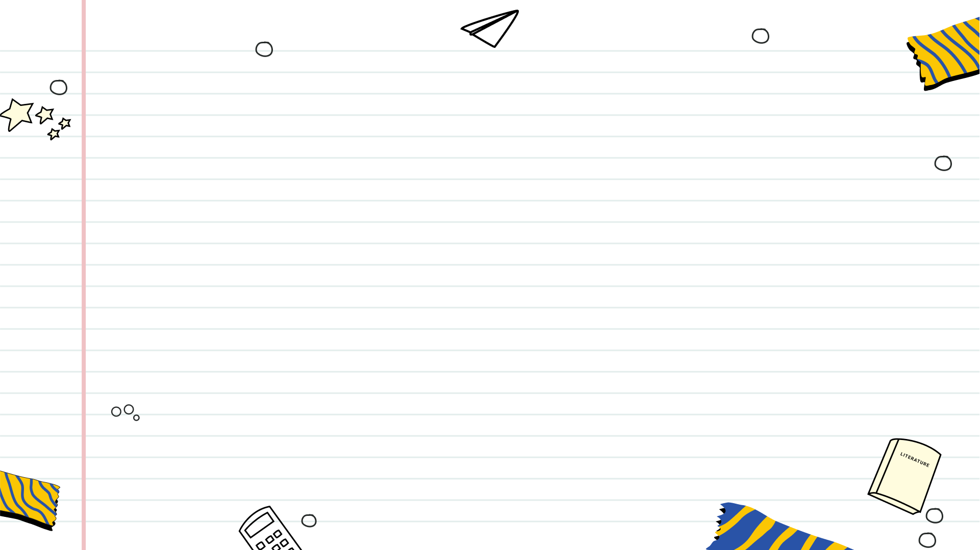

Rebrand the Snack Aisle: A Graphic Design Challenge!
Unleash your creativity: Design new logos and packaging for snacks.

Slide 2
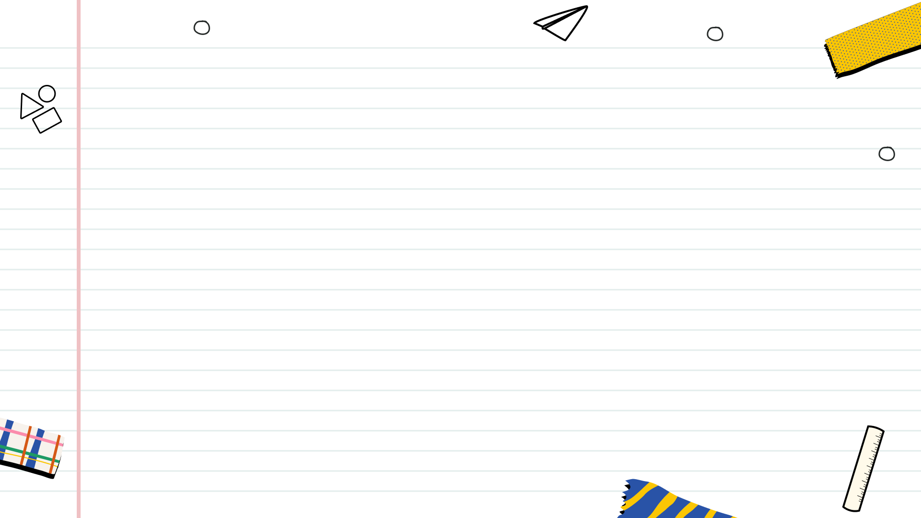

Table of Contents
1
Snack Aisle Revolution: Project Kickoff!
2
NJSLS: Project Fit?
3
Project Timeline: Quick Sprint
4
Reimagining Snacks: Project Overview
5
Crafting the Brand Voice
6
Digital Design Toolkit

Slide 3
Table of Contents
7
Project Deliverables: Creative Showcase
8
Snack Vision: Deliverable 1
9
Logo & Packaging Unveiled!
10
Decoding Your Art: The Artist Statement

Slide 4
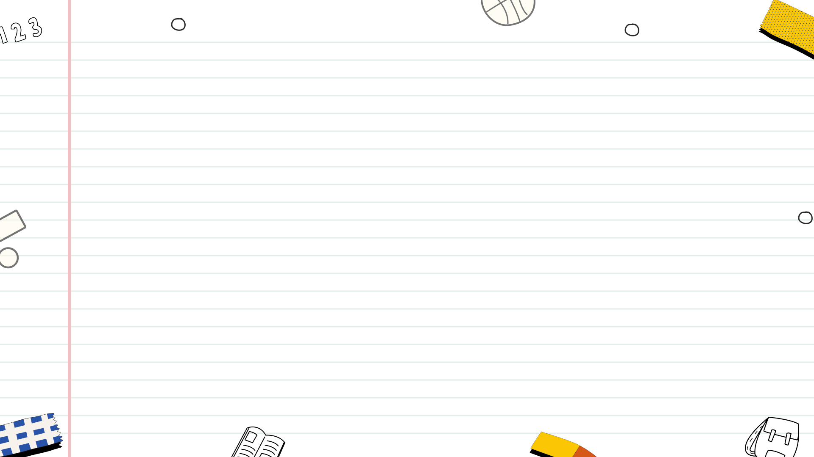
Snack Aisle Revolution: Project Kickoff!
We're tackling a full snack rebrand, from logo to packaging. Get ready to create something delicious!
Completely reimagine a snack product's brand identity to capture new customer segments and boost sales.
Logo creation and packaging innovation are key. Think shelf appeal, brand story, and sustainability.
Understand your snack's ideal consumer. What are their preferences, needs, and purchasing habits?

Slide 5



NJSLS: Project Fit?
Ensures curriculum relevance, seamlessly integrating into existing lesson plans and meeting mandated learning objectives.
Provides a structured framework for assessment, allowing teachers to accurately gauge student progress and understanding.
Enhances student engagement by connecting learning to real-world standards and future academic expectations.
May limit creative exploration if strictly adhered to, potentially stifling innovative teaching approaches and student expression.
Requires careful interpretation to avoid rote learning, demanding educators to foster critical thinking and deeper understanding.
Can create pressure to 'teach to the test,' potentially narrowing the curriculum and neglecting other valuable skills.

Slide 6
Project Timeline: Quick Sprint
Week 1
Week 1
Week 2
Week 2
Concept Ignition
Design Draft
Refinement Iteration
Final Delivery
Kick off the project by brainstorming ideas, defining the core objectives, and establishing a clear vision for the final product. This crucial stage sets the foundation for all subsequent tasks,...
Translate the initial concepts into tangible design drafts. This involves sketching wireframes, creating mockups, and experimenting with different visual styles. Early feedback at this stage is essential for refining the...
Incorporate feedback from stakeholders and iterate on the design drafts. This phase focuses on polishing the details, optimizing the user experience, and ensuring that the final product aligns with the...
Prepare the final design for delivery. This includes packaging the assets, creating documentation, and ensuring that everything is ready for implementation. A final review is conducted to catch any lingering...

Slide 7

Reimagining Snacks: Project Overview
1
Project Goal
2
Snack Selection
Redesign a snack's branding to attract a new, clearly defined target audience. Think creatively and outside the box!
Choose a snack (real or invented). Consider current trends and potential market gaps before deciding.
3
Target Audience
4
Branding Redesign
Identify your new target audience. Define their demographics, psychographics, needs, and aspirations clearly.
Develop a new brand identity: name, logo, packaging, and messaging, all tailored to your chosen audience.

Slide 8

Crafting the Brand Voice
Harnessing color to evoke specific emotions and associations, reflecting the snack's intended feeling and target audience appeal.
Selecting fonts that visually represent the snack's personality – playful, sophisticated, or wholesome – for impactful communication.
Choosing images and illustrations that align with the snack's brand identity, creating visual consistency and instant recognition.
Designing packaging that not only protects the product but also acts as a visual ambassador, conveying the brand's essence.
Photo by Google

Slide 9
Digital Design Toolkit
Adobe Illustrator: Create scalable vector graphics for logos, illustrations, and print materials. Precision and flexibility guaranteed.
Adobe Photoshop: Edit and enhance photos, create composites, and design graphics for web and print with ease.
Canva: A user-friendly platform for creating stunning designs quickly, even without extensive graphic design experience. Accessible to everyone.
Combine software strengths for optimal design workflows. Leverage each program's unique capabilities for better output.

Slide 10
Project Deliverables: Creative Showcase
Visually explore the project's aesthetic. A curated collection of images, colors, and textures for direction.
Craft a unique and memorable brand identity. The core visual representation of the client's brand.
Design packaging that grabs attention. Showcase the product presentation for tangible consumer impact.
A sample advertisement to promote the brand. Illustrates the brand message in an engaging way.

Slide 11

Snack Vision: Deliverable 1
Gathering diverse images, textures, and styles that resonate with our snack's intended vibe and consumer appeal, guiding our design.
Selecting a harmonious color scheme that evokes the right emotions and enhances brand recognition. Consistency is key here!
Identifying the specific demographics and psychographics of our ideal consumer. Tailoring the snack to their tastes and preferences is vital.
Combining inspiration, colors, and target audience insights into a cohesive visual representation. A guiding light for our design.
Photo by Google

Slide 12
Logo & Packaging Unveiled!
Brainstorming and initial concepts, exploring brand identity and visual representation for our snack.
Crafting a logo that's memorable, reflects the snack's essence, and appeals to our target audience.
Designing the front of the packaging to be eye-catching, informative, and enticing to customers.
Creating the back packaging design to include nutritional information, ingredients, and brand story.

Slide 13
Decoding Your Art: The Artist Statement
1
Vision Explained
2
Choices Justified
Articulate your core artistic vision. What drives your creative process and what impact do you hope to make?
Explain the 'why' behind your choices. Connect materials, techniques, and composition to your artistic intent.
3
Creative Process
4
Sentence Structure
Briefly describe your creative process. Show how inspiration turns into finished artwork. Be concise.
Aim for 3–5 sentences. Be succinct and impactful. Every word should contribute to the overall message.

