Slide 1
The Art of Getting Press
Strategies and Tactics for Startups

Slide 2
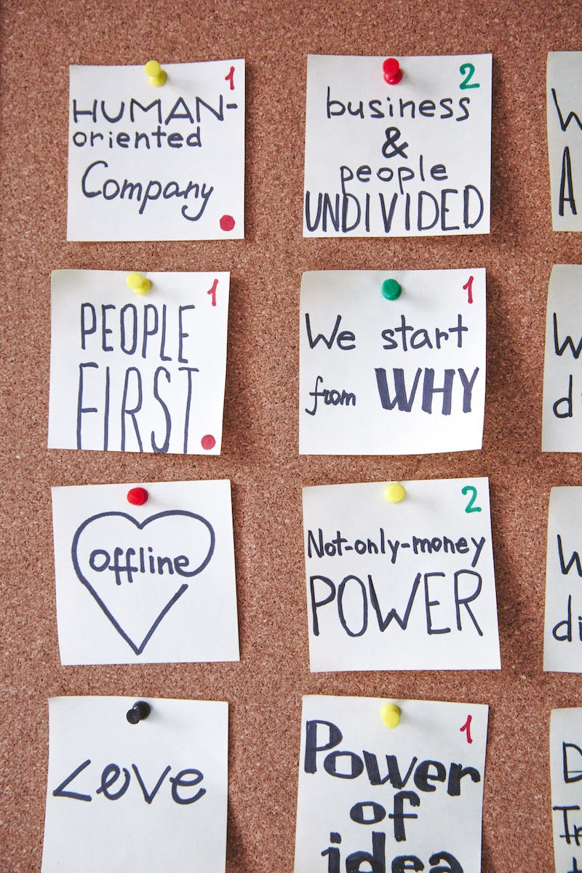
Setting Goals
• Define your target audience and goal
• Consider what you want to achieve with press coverage
• Align your goals with your product or business needs
Photo by Pexels

Slide 3
Different Types of Stories
• Product launches
• Fundraising announcements
• Milestones or metrics
• Business stories
• Stunts
• Hiring announcements
• Contributed articles
Photo by Pexels

Slide 4
Choosing Newsworthy Stories
• Objective evaluation of the story's appeal
• Originality or novelty compared to existing coverage
• Consider the potential interest of the target audience
• Don't have to be completely original, just 'original enough'

Slide 5
Mechanics of Getting Press
• Think of press coverage as a sales funnel
• Build relationships with journalists
• Craft compelling pitches tailored to each outlet
• Utilize PR distribution services for broader reach
• Leverage personal connections and introductions
• Prepare press kits with relevant information
Photo by Pexels

Slide 6
Developing a Media List
• Research and identify relevant writers and outlets
• Create a database or spreadsheet to track contact information
• Follow and engage with journalists on social media
• Attend industry events and network with journalists
Photo by Pexels

Slide 7
Crafting Compelling Pitches
• Personalize pitches to the journalist or outlet
• Highlight the newsworthy aspects of your story
• Keep pitches concise and easy to read
• Include relevant information such as company background and key metrics
• Follow up respectfully and be persistent
Photo by Pexels

Slide 8
Utilizing PR Distribution Services
• Submit press releases to distribution services like PR Newswire or Business Wire
• Reach a broader audience through syndication
• Consider the cost and ROI of distribution services
• Tailor press releases to target audience and outlet
Photo by Pexels

