Slide 1
The Impact of Technology on Education
Transforming the Learning Landscape

Slide 2
Introduction
• Technology has revolutionized the education sector
• Enhancing learning opportunities for students
• Enabling personalized and interactive learning experiences
• Expanding access to education globally
Photo by Pexels

Slide 3
Online Learning Platforms
• Online platforms provide virtual classrooms and interactive resources
• Students can access educational materials anytime and anywhere
• Facilitates remote and distance learning
• Digital assessments and feedback systems
Photo by Pexels

Slide 4
Enhanced Collaboration and Communication
• Technology enables real-time collaboration among students and teachers
• Facilitates global connections and cultural exchange
• Group projects and virtual classrooms
• Communication through forums and video conferences
Photo by Pexels

Slide 5
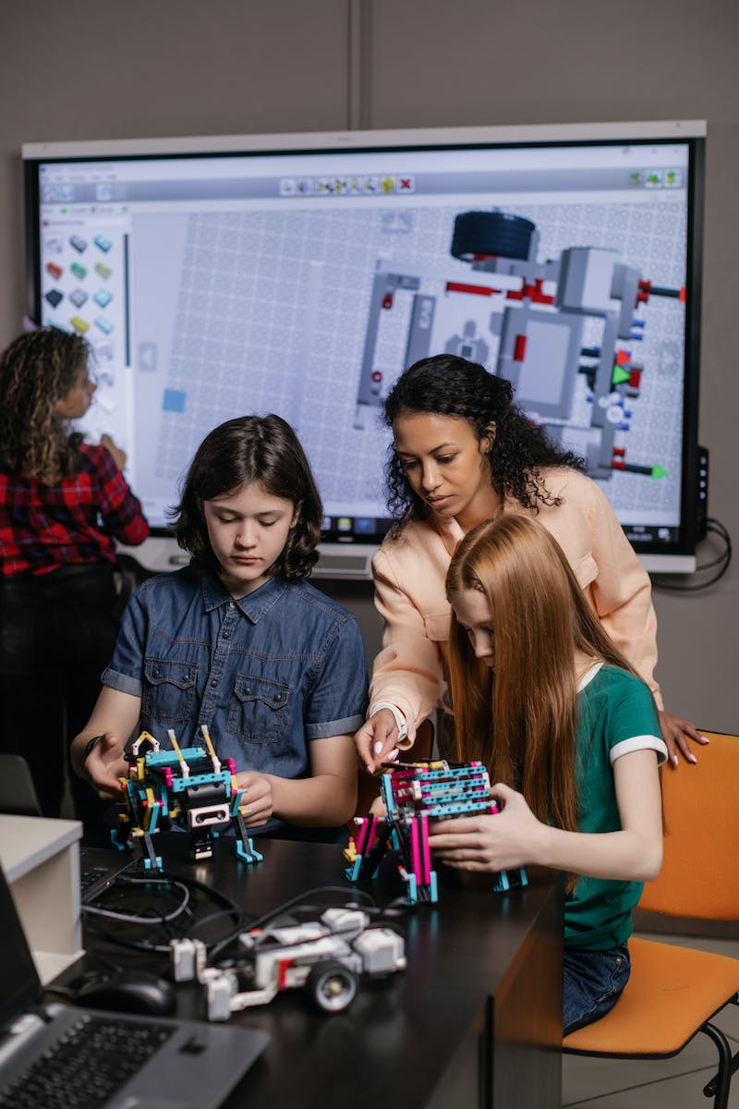
Personalized Learning
• Technology allows adaptive and individualized learning experiences
• Tailored content based on students' abilities and preferences
• Supports differentiated and self-paced learning
• Real-time feedback and progress tracking
Photo by Pexels

Slide 6
Emerging Technologies in Education
• Virtual reality (VR) and augmented reality (AR)
• Artificial intelligence (AI) in adaptive learning
• Blockchain for secure credentialing
• Internet of Things (IoT) in smart classrooms
Photo by Pexels

Slide 7
Conclusion
• Technology has revolutionized education, providing new opportunities
• Challenges and considerations for technology integration
• Continuous adaptation to keep up with evolving trends
• Ensuring equitable access for all learners
Photo by Pexels

