Slide 1
Contemporary Philippine Arts from the Regions
Lesson Seven: National Artist and Ga Awards

Slide 2
Welcome to Lesson Seven
• Lesson overview: National Artist and Ga Awards
• National Artist: Order of National Artist of the Philippines
• Ga Award: National Living Treasure Award
• Significant contributions to Philippine Arts and Cultural Heritage
Photo by Pexels

Slide 3
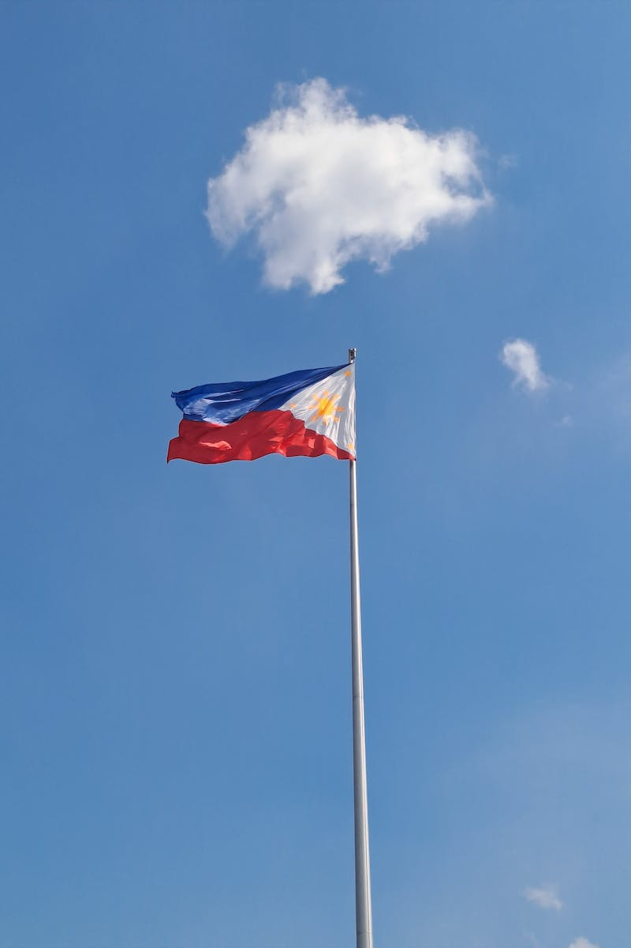
National Artist of the Philippines
• Official name: Order of National Artist of the Philippines
• Established in 1972 by President Ferdinand Marcos
• Awarded to individuals who have made significant contributions to Philippine Arts
• Categories: Music, Dance, Theater, Visual Arts, Literature, Film and Broadcast Arts, Architecture, Design, and Allied Arts
Photo by Pexels

Slide 4
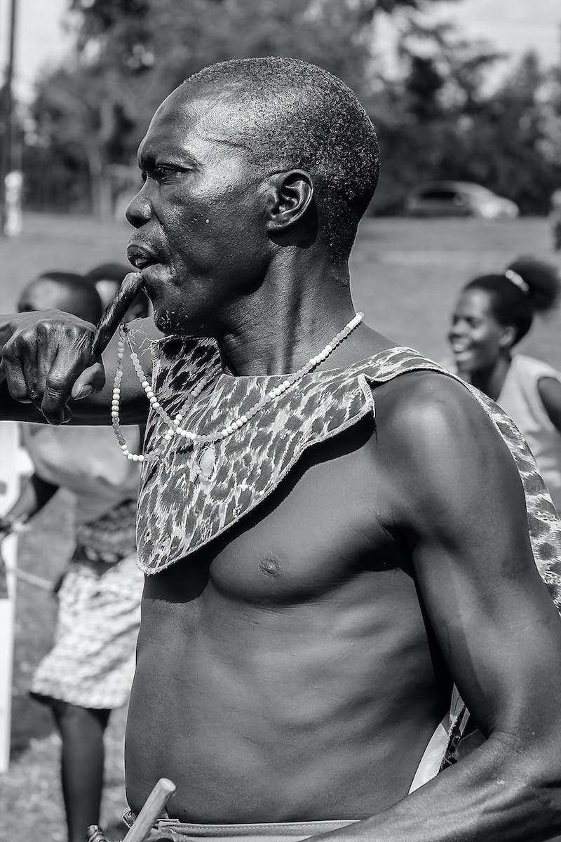
Categories of National Artist Award
• Music: Singing, Composition, Direction, Performance
• Dance: Choreography, Direction, Performance
• Theater: Direction, Performance, Production Design
• Visual Arts: Paintings, Sculpture, Printmaking, Photography, Installation art, etc.
• Literature: Poetry, Fiction, Essay, Playwriting, Journalism, Literary Criticism
• Film and Broadcast Arts: Direction, Writing, Production Design, Cinematography, etc.
• Architecture, Design, and Allied Arts: Architecture, Interior Design, Landscape Architecture, etc.
Photo by Pexels

Slide 5
Selection and Nomination Process
• Cultural organizations, educational institutions, and private foundations can nominate
• The order is administered by the Cultural Center of the Philippines and National Commission of Culture and Arts
• Nominees are screened and deliberated by these organizations
• Recommended nominees are submitted to the President for final selection
• The President issues a proclamation and confers the award
Photo by Pexels

Slide 6
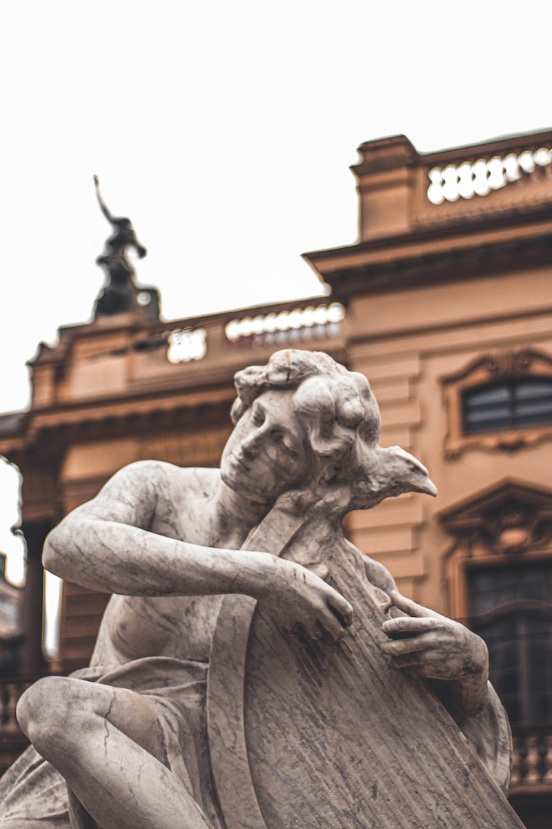
Qualifications for National Artist Award
• Living artists who are Filipino citizens or those who died after 1972
• Artists who have made significant contributions to Filipino arts
• Artists who have pioneered in a creative expression or style
• Artists with a substantial body of work and consistent excellence
• Artists with broad national and international recognition
Photo by Pexels

Slide 7
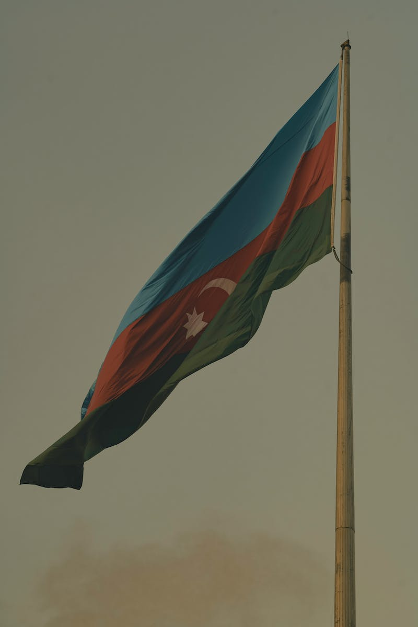
Benefits of National Artist Award
• Rank and title of National Artist
• Gold-plated medallion and citation
• Lifetime emoluments and material benefits
• Cash Award for living awardees: 100,000 PHP
• Cash Award for posthumous awardees: 75,000 PHP
• Monthly life pension, medical and hospitalization benefits
• Funeral assistance and place of honor at national events
Photo by Pexels

Slide 8
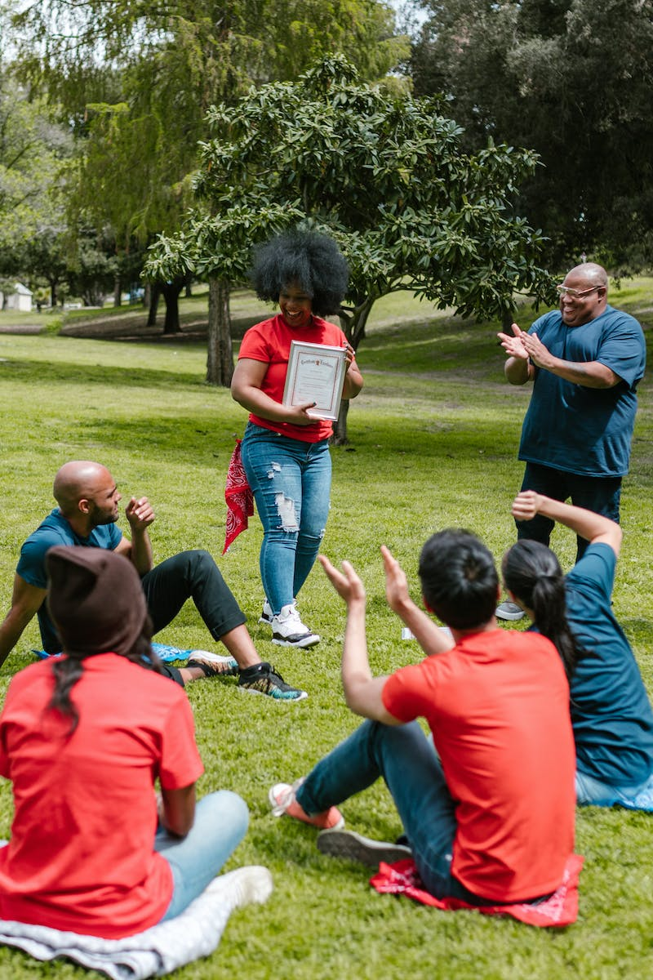
National Living Treasure Award (Ga Award)
• Introduced in 1992 through Republic Act No. 7355
• Recognizes individuals or groups for their contribution to intangible cultural heritage
• Administered by the National Commission of Culture and Arts
• Selection process similar to National Artist Award
• Award for preserving traditional and folk arts and skills
Photo by Pexels

Slide 9
Criteria for Ga Award
• Mastery of tools and materials for traditional folk art
• Consistent production of works with exceptional technical quality
• Involvement in traditional and folk art for at least 50 years
• Command, respect, and admiration within the community
• Transfer of skills to others in the community
Photo by Pexels

Slide 10
Benefits of Ga Award
• Gold-plated medallion and citation
• Lifetime emoluments and material benefits
• Cash Award of 250,000 PHP
• Lifetime personal monthly stipend of 50,000 PHP
• Medical and hospitalization benefits
• State funeral arrangement (optional)
• Representational role at cultural events
Photo by Pexels

Slide 11
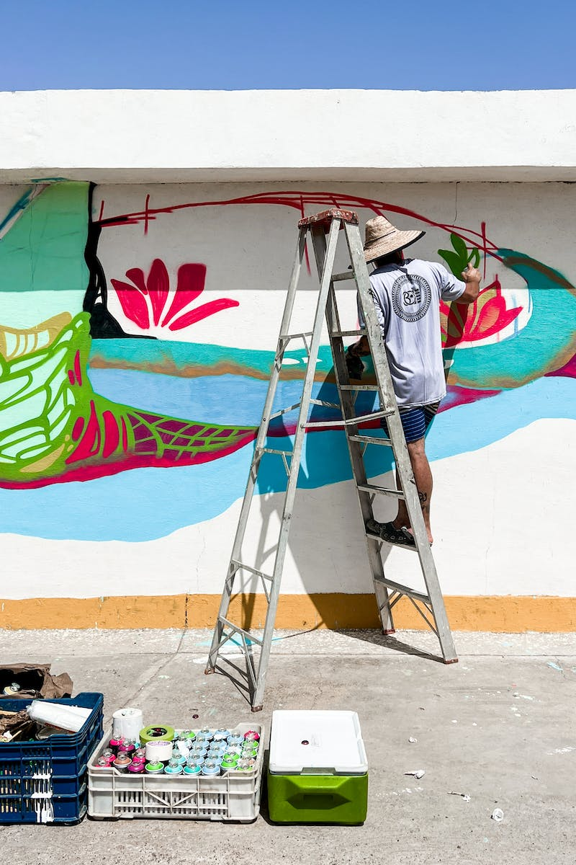
National Artist Awardees
• Levi Celerio - National Artist for Literature and Music
• Ryan Cayabyab - National Artist for Music
• Francisco Santiago - National Artist for Music
• Alice Reyes - National Artist for Dance
• Bienvenido Lumbera - National Artist for Theater
• Salvador F. Bernal - National Artist for Theater Design
• Fernando Amorsolo - National Artist for Visual Arts
• Francisco Coching - National Artist for Visual Arts
Photo by Pexels
• NVM Gonzalez - National Artist for Literature
• Lino Brocka - National Artist for Film and Broadcast Arts
• Leandro Locsin - National Artist for Architecture

Slide 12
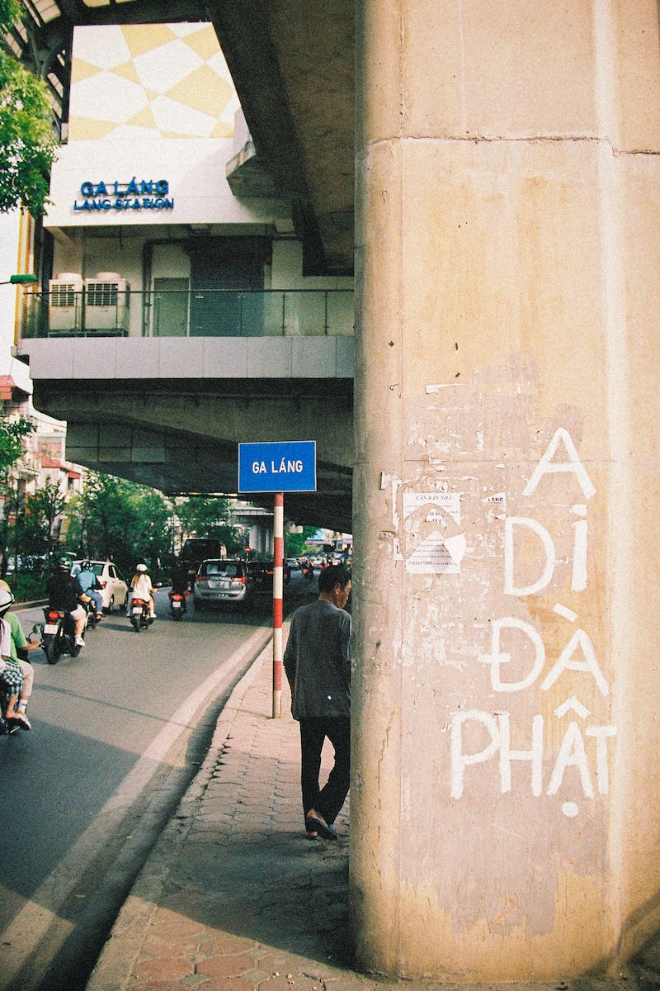
Ga Awardees
• Folk Architecture - Antonino D. Austria
• Maritime Transport - Amang Pintor
• Weaving - Magdalena Gamayo
• Carving - Yabing Masalon Dulo
• Performing Arts - Ligaya Fernando-Amilbangsa
• Literature - Genevieve Asenjo
• Graphic and Plastic Arts - Eduardo Mutuc
• Textile or Fiber Art - Ambalang Ausalin
• Pottery - Juliana Labi
• Other Artistic Expressions - Lang Dulay
Photo by Pexels

