Slide 1
Creating a Sticker Ordering Website
Building a Website to Order Custom Stickers with Airtable Integration

Slide 2
Introduction
• Created a website for ordering custom stickers
• Utilized Airtable for sticker listings and order submission
• Inspired by using Mid-Journey for sticker generation
• Generated 20 stickers with Studio Ghibli theme
• Utilized Figma to remove backgrounds and prepare stickers
• Built website using Arrow Page and synced with Airtable
Photo by Pexels

Slide 3
Process Overview
• Generated stickers using Mid-Journey
• Used Figma to remove backgrounds and prepare stickers
• Exported stickers and organized them in Airtable
• Built website using Arrow Page and synced with Airtable
• Aligned branding with logo, colors, and fonts
• Optimized website for different screen sizes
Photo by Pexels

Slide 4
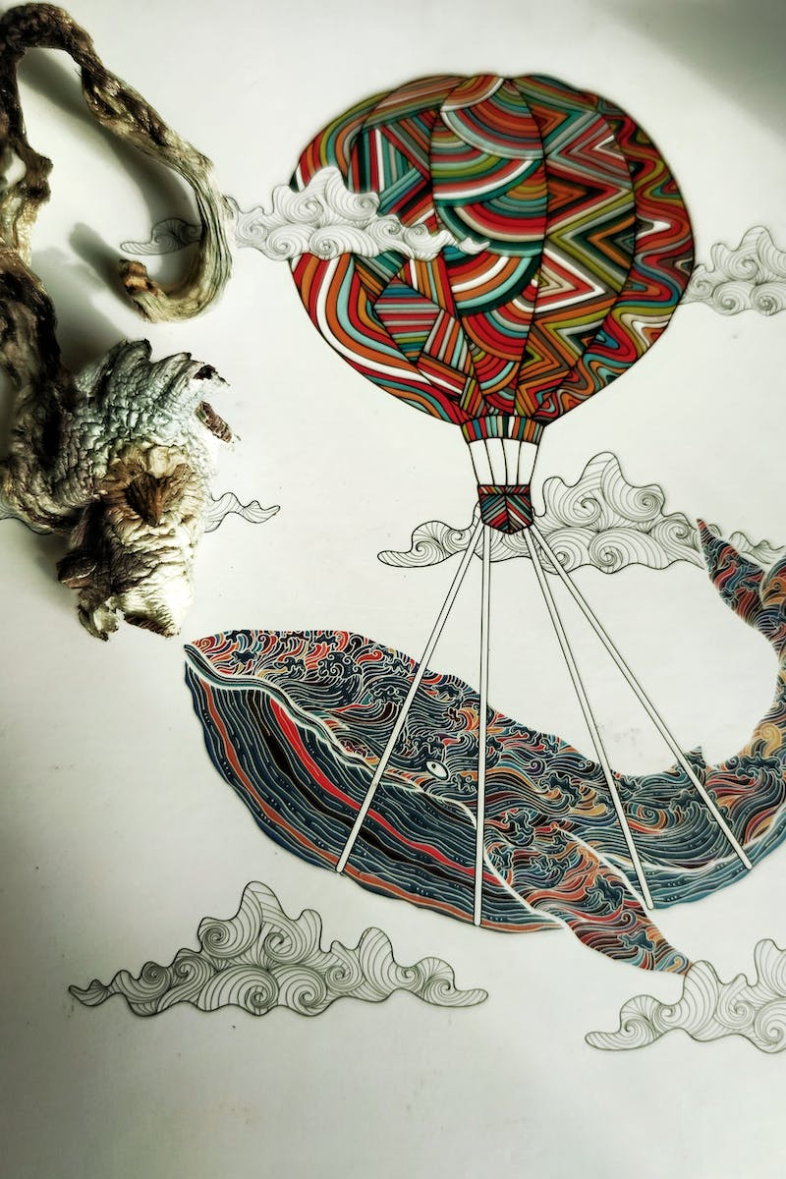
Sticker Preparation
• Used Mid-Journey to generate stickers with Studio Ghibli theme
• Removed backgrounds using Figma plugin called Background Remover
• Organized stickers on a single sheet using Figma
• Utilized an image cutter plugin in Figma to create individual sticker images
• Renamed and prepared images for exporting and import to Airtable
• Designed the hero image and logo using Figma
Photo by Pexels

Slide 5
Website Development
• Created a new table in Airtable for the stickers
• Built the website using Arrow Page builder with Airtable integration
• Synchronized the stickers as a data source
• Customized branding with logo, colors, and fonts
• Designed and implemented the hero section of the website
• Created dynamic pages for individual sticker display
Photo by Pexels

Slide 6
Order Form Integration
• Configured an order form using Arrow Page builder
• Created fields for customers to fill in their information
• Set up a new table in Airtable to collect order details
• Connected the order form to submit data to Airtable
• Customized the layout and design of the order form
• Implemented conditional editing for mobile responsiveness
Photo by Pexels

