Slide 1
The Invasion of Ukraine: Putin's Power Play
Understanding the Conflict and its Consequences

Slide 2
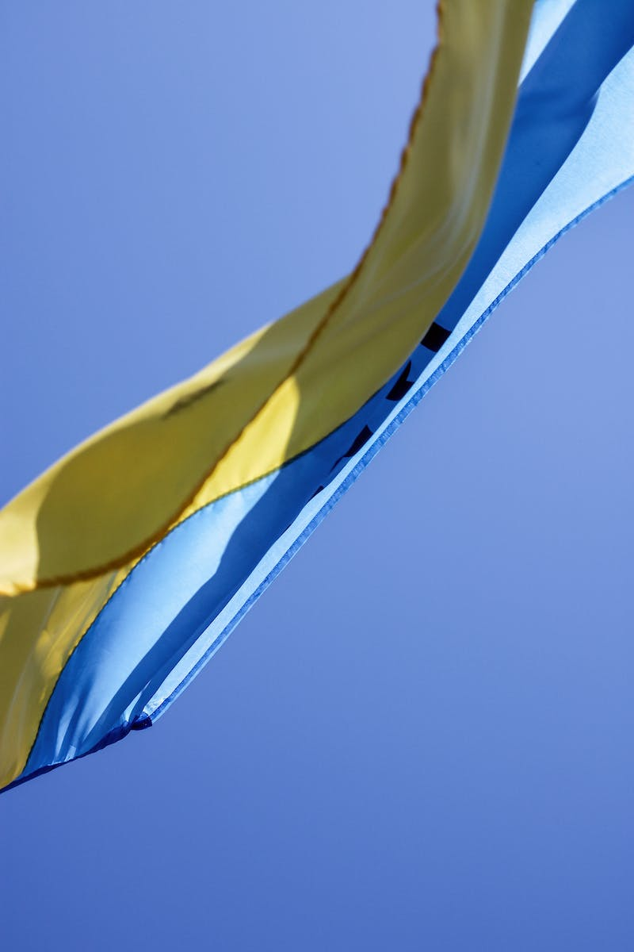
Introduction: A Full-Scale Invasion
• Putin's decision for a military operation
• Total panic and widespread destruction
• Cities under attack, including Kyiv
• Hundreds of casualties and forced displacement
Photo by Pexels

Slide 3
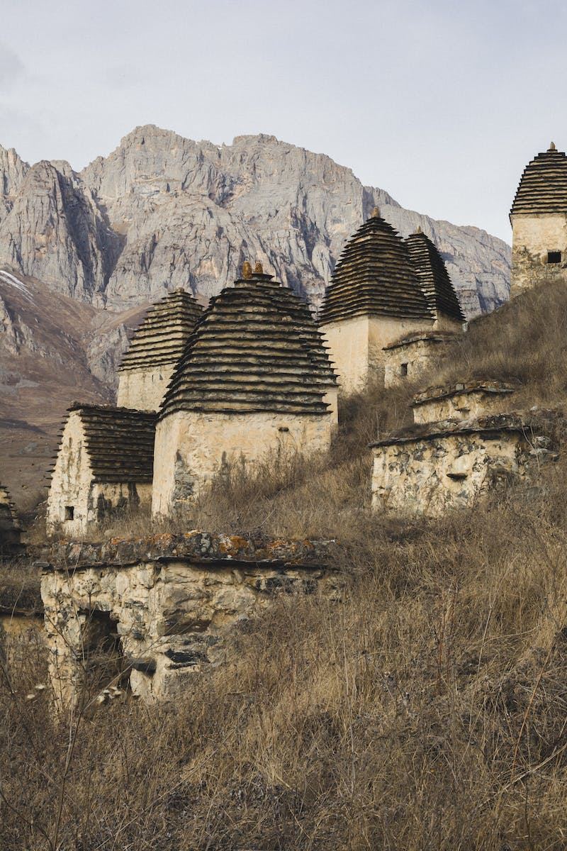
History of Ukraine and Russia
• Shared history but distinct identities
• Ukraine's fight for independence
• Ukraine's inclusion in the Soviet Union
• The Cold War and division of Europe
Photo by Pexels

Slide 4
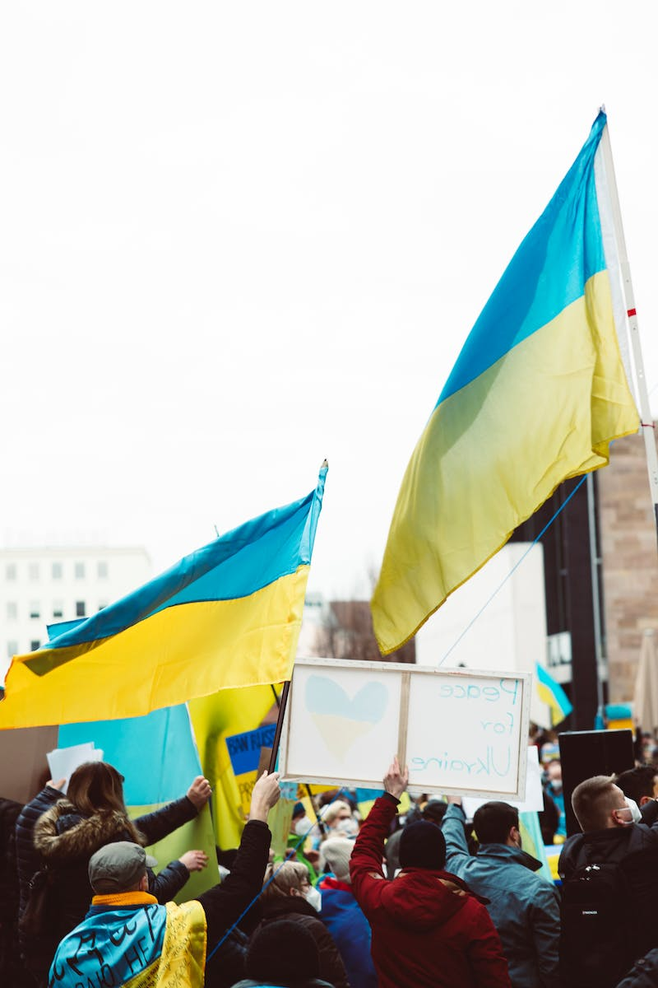
The Rise of NATO
• Formation of NATO and its purpose
• Expansion into former Soviet sphere
• Desire of Ukraine and Georgia to join
• Russia's opposition to NATO expansion
Photo by Pexels

Slide 5
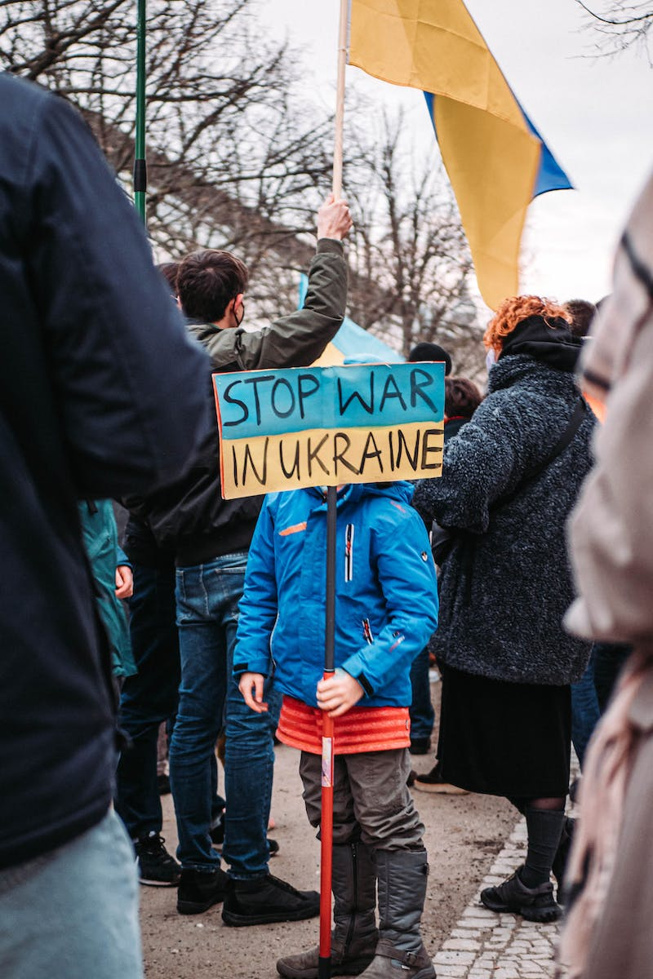
Events Leading to the Invasion
• Ukraine's pro-European aspirations
• Refusal to sign EU association agreement
• Protests and fall of the pro-Russian regime
• Annexation of Crimea and separatist regions
Photo by Pexels

Slide 6
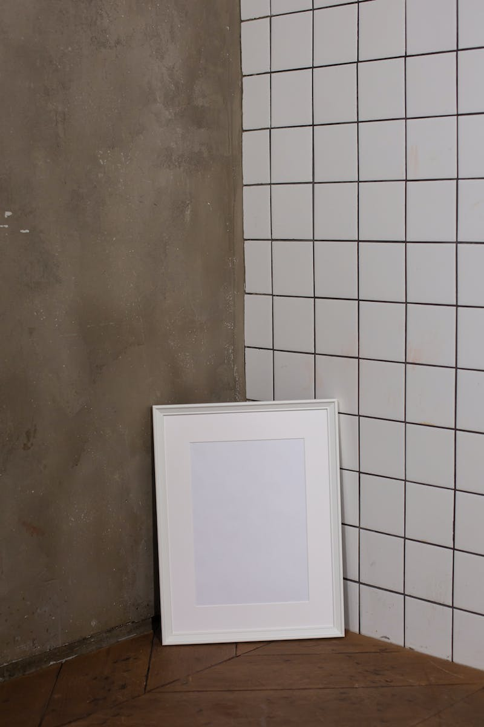
The Escalation and Global Response
• Putin's demands to the West
• Rejection and reinforcement of NATO
• Build-up of Russian troops and drills
• Full-scale invasion and international condemnation
Photo by Pexels

Slide 7
Current Situation and Consequences
• Worldwide anti-war protests
• Open borders for fleeing Ukrainians
• Activation of NATO's response force
• Imposition of economic sanctions on Russia
Photo by Pexels

Slide 8
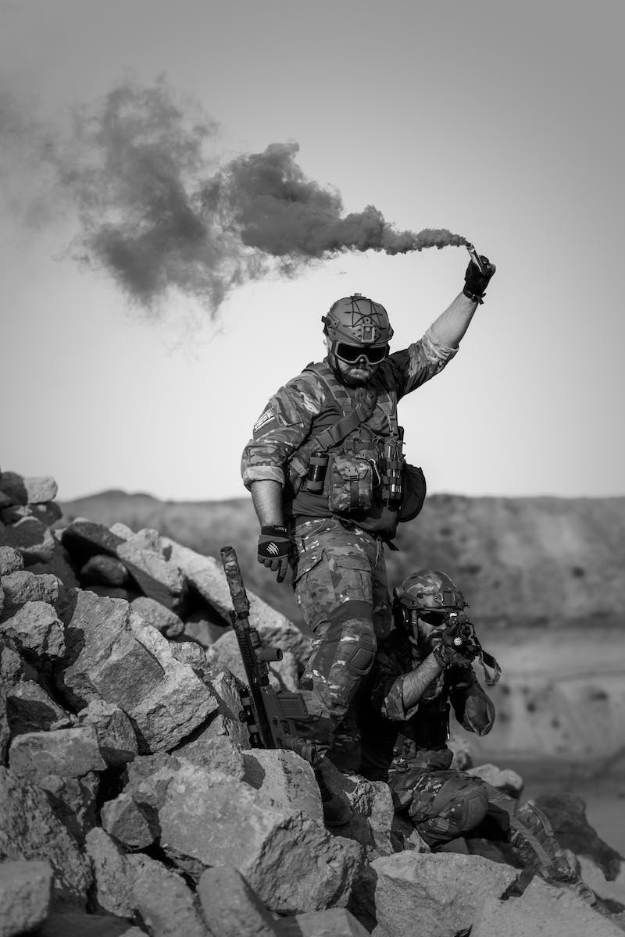
Conclusion: The Battle for Ukraine
• Ukraine's fight for independence
• Putin's control and destabilization
• International support and military aid
• The risk of nuclear escalation
Photo by Pexels

