Slide 1
The Future of Artificial Intelligence
Exploring the Impact and Potential of AI in Modern Society

Slide 2
Introduction to Artificial Intelligence
• Definition of AI
• Historical development
• Types of AI
• Current applications
• Future possibilities
Photo by Pexels

Slide 3
Machine Learning
• Definition and principles
• Supervised vs unsupervised learning
• Deep learning and neural networks
• Real-world applications
• Ethical considerations
Photo by Pexels

Slide 4
Impact of AI on Healthcare
• Improved diagnosis and treatment
• Precision medicine
• Patient monitoring
• Drug discovery
• Ethical and privacy concerns
Photo by Pexels

Slide 5
AI in Business and Industry
• Automation and optimization
• Predictive analytics
• Supply chain management
• Customer service
• Job displacement and retraining
Photo by Pexels

Slide 6
Ethical Considerations in AI Development
• Bias and fairness
• Transparency and explainability
• Data privacy and security
• Accountability and oversight
• Social and economic impact
Photo by Pexels

Slide 7
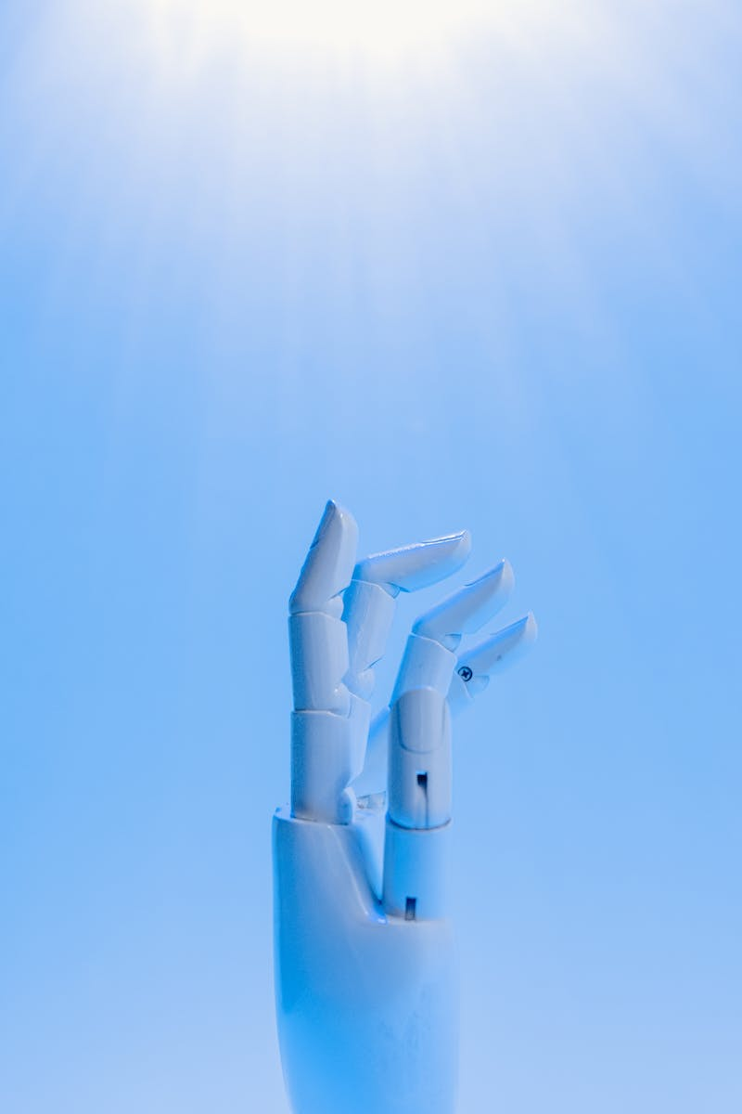
The Future of AI
• Advancements in AI research
• Integration with other technologies
• AI and human collaboration
• Potential risks and benefits
• Ethical and regulatory frameworks
Photo by Pexels

