Slide 1
Building a Strong Company Culture
Creating a high-performance team and a lasting brand

Slide 2
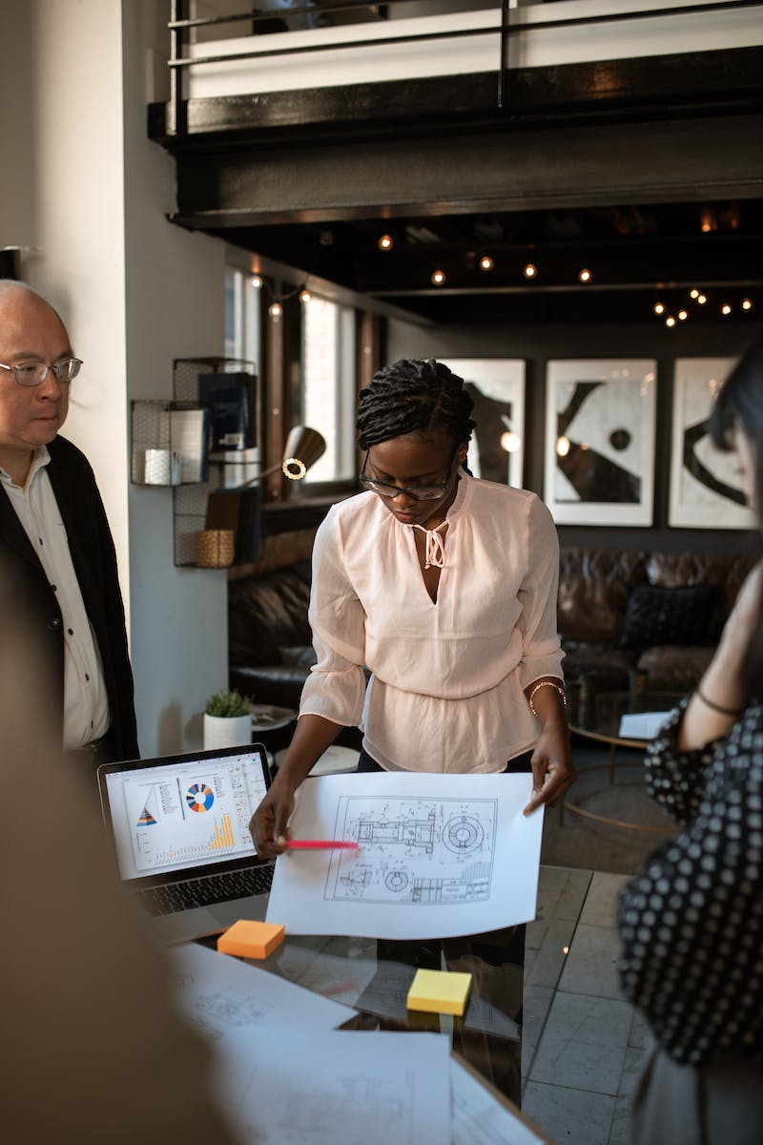
Introduction
• Set the stage with a few slides
• Explaining the importance of company culture
• The main focus will be on building Airbnb's culture
• Highlighting the connection between culture and team performance
Photo by Pexels

Slide 3
Defining Company Culture
• Culture is the shared values and behaviors of a team
• Core values and mission drive the culture
• Culture provides stability, trust, and alignment
• Good culture helps retain the right employees
Photo by Pexels

Slide 4
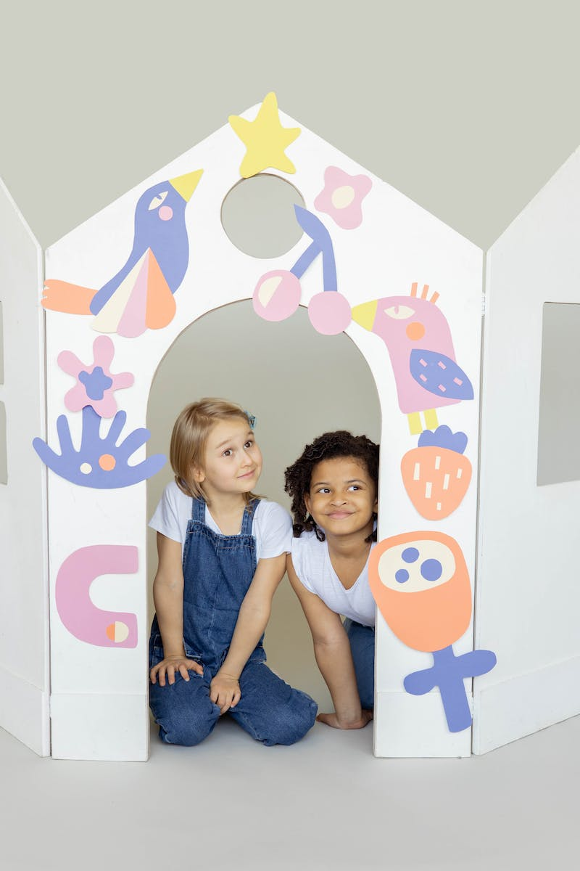
Creating Core Values
• Start with personal and business values
• Consider the values of the people you want to work with
• Align values with the mission and support it
• Ensure values are credible and uniquely tied to the mission
Photo by Pexels

Slide 5
Key Core Values
• Examples of core values: honesty, integrity, service, teamwork
• Values should be clear, relevant, and distinct
• Dive deeper into each value to ensure understanding
• Emphasize the importance of company-first mentality
Photo by Pexels

Slide 6
The Pyramid of High-Performing Teams
• Trust – the foundation of the team
• Conflict and debate – necessary for finding the right answer
• Commitment – holding each other accountable
• Accountability and results – driving success
Photo by Pexels

Slide 7
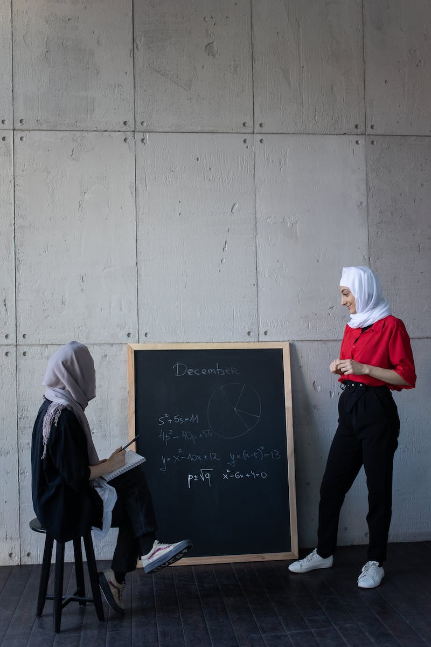
Best Practices and Considerations
• Incorporate your mission into your values
• Interview for culture fit, not just technical fit
• Make culture a daily habit, not just a buzzword
• Continuously iterate and refine your culture
Photo by Pexels

Slide 8
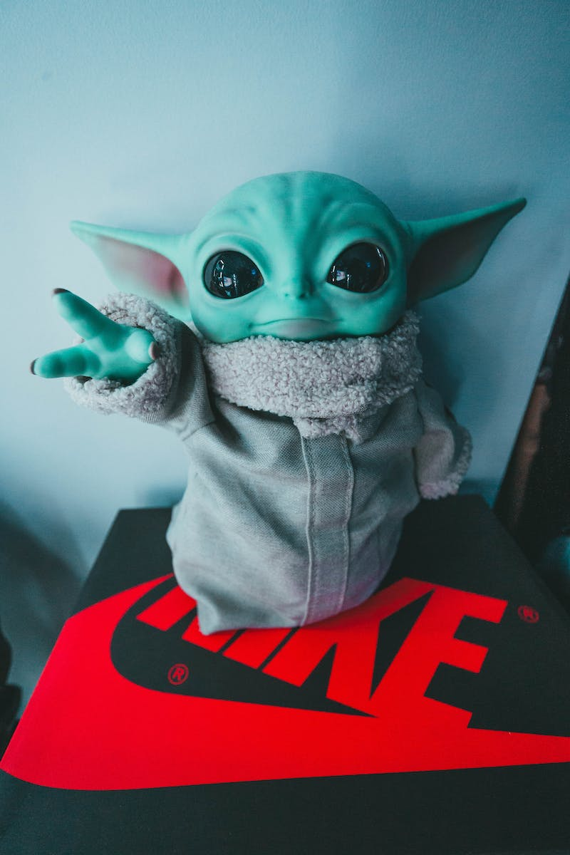
Culture and Branding
• Culture and brand are two sides of the same coin
• Culture shapes the brand and customer perception
• Strong culture attracts passionate employees and customers
• Brand reflects the promise and values of the company
Photo by Pexels

