Slide 1
Fine-tuning LLMS using Q Laura
A Quick Walkthrough

Slide 2
Introduction
• Luke Monington presents a quick walkthrough on fine-tuning LLMS using Q Laura
• LLMS reduces GPU VRAM requirement for model fine-tuning
• Subscribe for more content
• Follow Luke Monington on Twitter for interesting articles, thoughts, and updates
Photo by Pexels

Slide 3
Required Libraries
• Bits and bytes library: CUDA functions for 8-bit optimization and matrix multiplication
• Transformers library: Collection of pre-trained models for various tasks
• PEFT library: Parameter efficient fine-tuning methods
• Accelerate: User-friendly tool for writing training loops for PyTorch models
Photo by Pexels

Slide 4
Bits and Bytes Library
• Offers custom CUDA functions for 8-bit optimization and matrix multiplication
• Improves performance of AI models on GPU
• Accessible to developers
• Optimizes how AI models run on GPU
Photo by Pexels

Slide 5
Transformers Library
• Collection of pre-trained models for various tasks
• Text, images, audio, and multi-data types
• Compatible with Jax, PyTorch, and TensorFlow
• Train models with one library, load them with another
Photo by Pexels

Slide 6
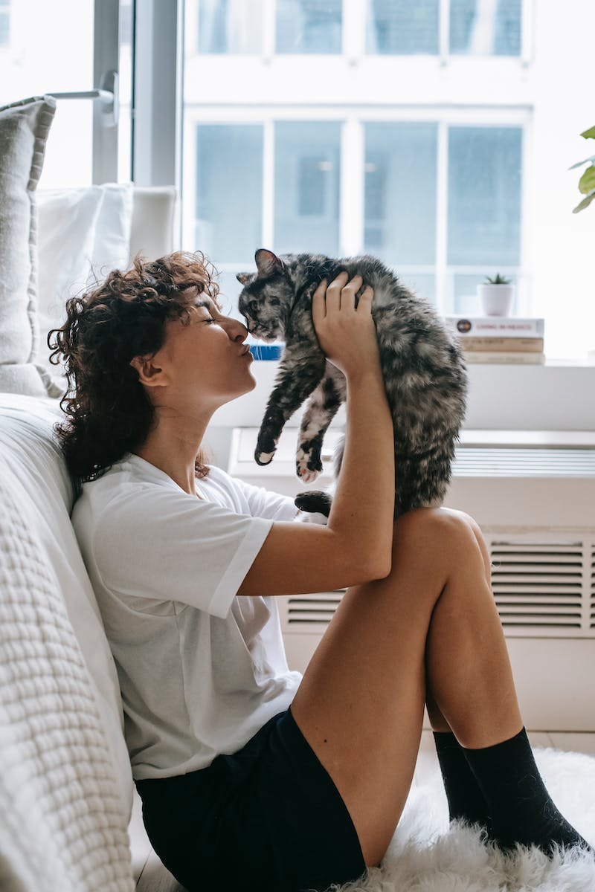
PEFT Library
• Parameter efficient fine-tuning methods
• Tweak pre-trained language models for different applications
• Significantly reduces computational and storage costs
• PEFT methods include Laura, P-tuning, and Adalora
Photo by Pexels

Slide 7
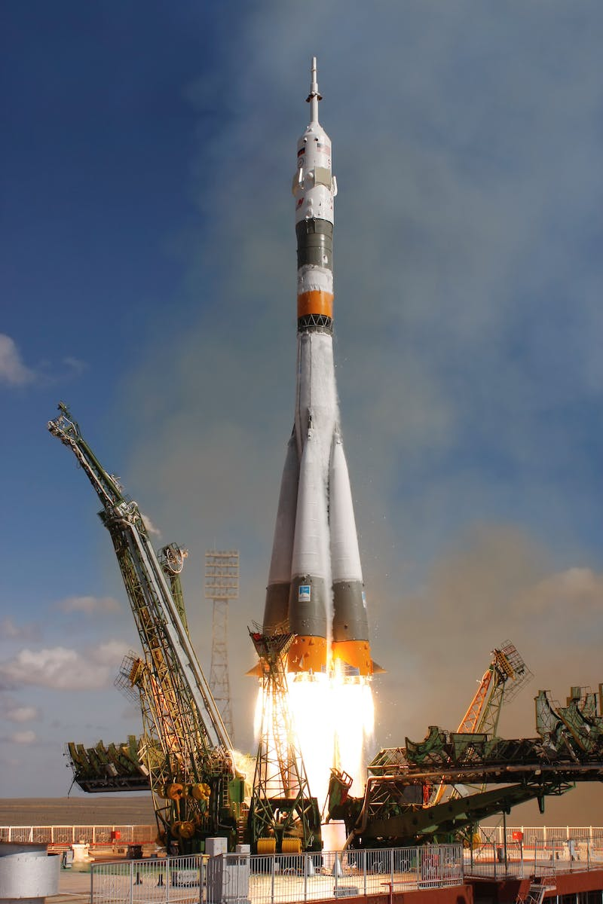
Accelerate
• User-friendly tool for writing training loops for PyTorch models
• Handles multi-device setups
• Supports multiple GPUs, TPUs, and mixed precision
• Easily switch between different environments
Photo by Pexels

Slide 8
Loading the Model
• Load the LLM model (eleuther AI GPT Neo x20b) from Hugging Face's Model Hub
• Configure bits and bytes for 4-bit quantization and B float 16 data type
• Prepare the model for k-bit training
• Get the number of trainable parameters
Photo by Pexels

Slide 9
Data Preparation
• Load the dataset from the datasets library
• Feed the data through the tokenizer
• Convert data to machine-readable tokens
• Check the first line of the dataset
Photo by Pexels

Slide 10
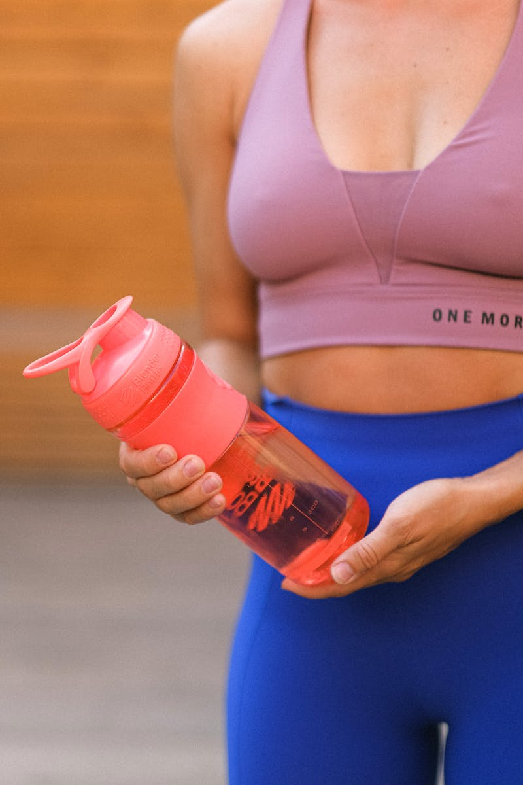
Training Q Laura Parameters
• Define hyperparameters for training
• Use PagedAdam W-8bit Optimizer
• Disable caching for training, enable for inference
• Train the Q Laura parameters
Photo by Pexels

Slide 11
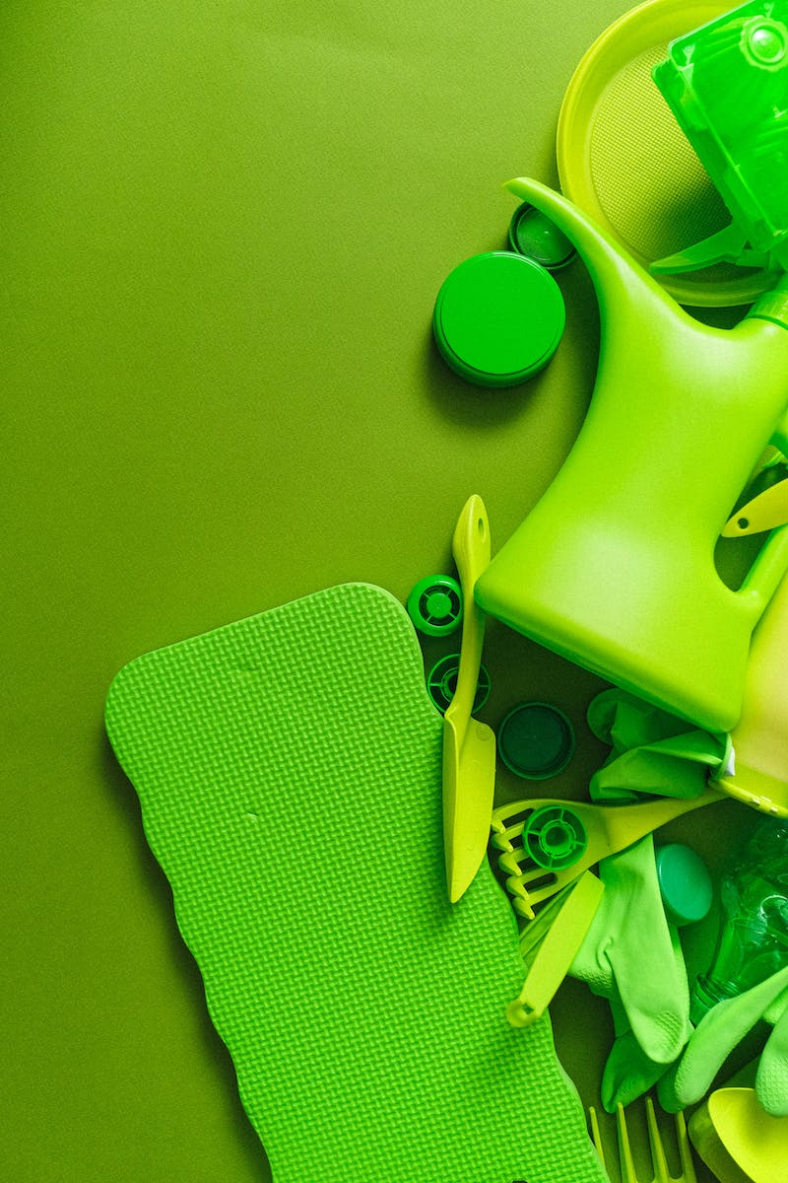
Saving and Uploading
• Save the Q Laura parameters locally
• Or upload them to Hugging Face's Model Hub
• Choose the best hyperparameters for optimal results
• Perform hyperparameter tuning if desired
Photo by Pexels

Slide 12
Inference
• Tokenize the input text
• Feed tokens through Q Laura
• Convert machine-readable outputs to human-readable

