Slide 1
Navigating the City
Making your way through unfamiliar streets

Slide 2
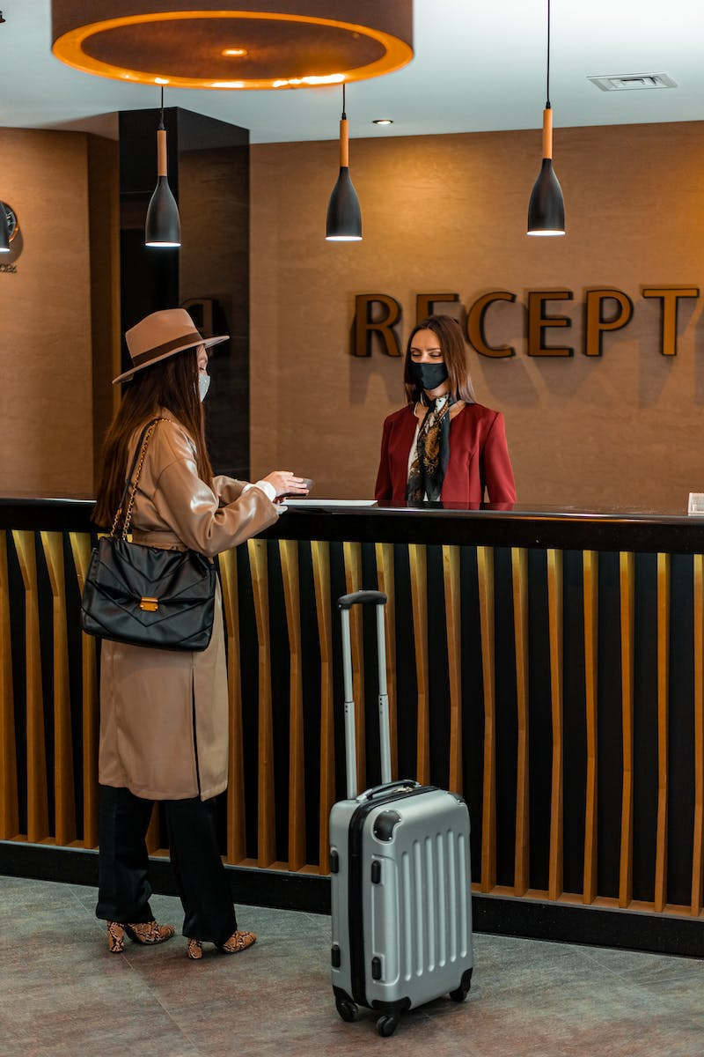
Checking in at the Hotel
• Introduce yourself and ask for help at the hotel reception
• Provide your reservation details and show your ID
• Receive your room key and instructions to reach your room
Photo by Pexels

Slide 3
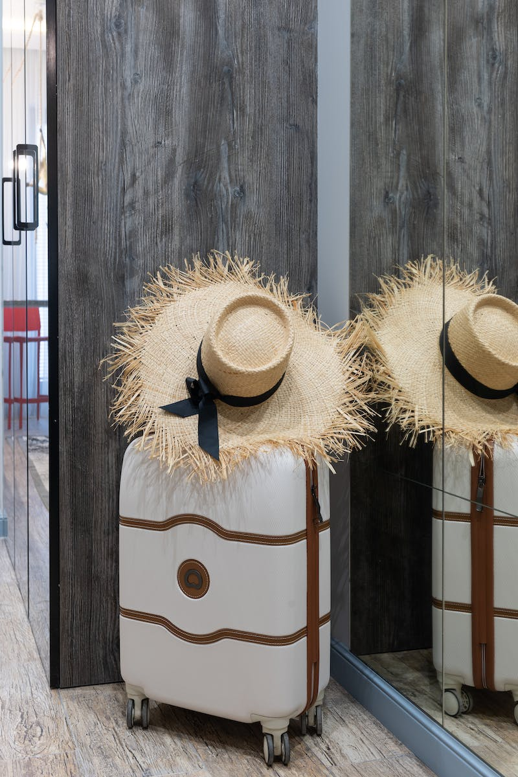
Getting to Your Room
• Take the elevator to the second floor
• Exit the elevator and turn left
• Walk to the end of the corridor and find your room on the right
Photo by Pexels

Slide 4
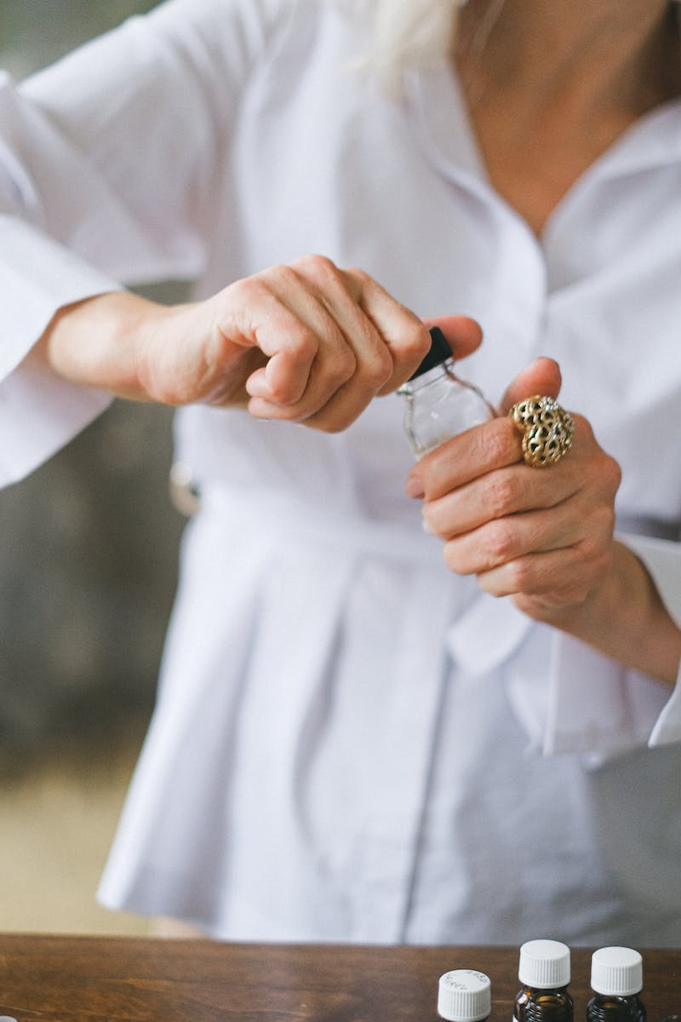
Finding Nearby Facilities
• Ask for directions to the pharmacy
• Receive instructions to turn right at the corner and find it next to the bakery
• Inquire about the location of an ATM
• Get directions to go straight, cross the road, and look for it next to the park
Photo by Pexels

Slide 5
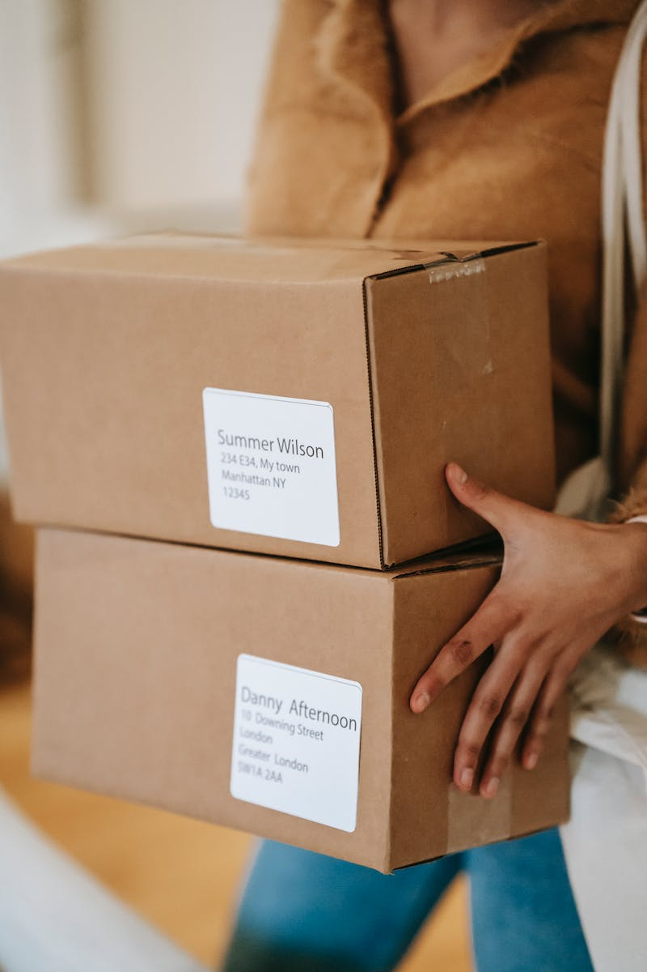
Locating the Post Office
• Ask for directions to the post office
• Receive instructions to turn right at the corner and locate it opposite the museum
• Confirm the proximity to the museum and get further guidance
• Express gratitude and wish the person a nice day
Photo by Pexels

Slide 6
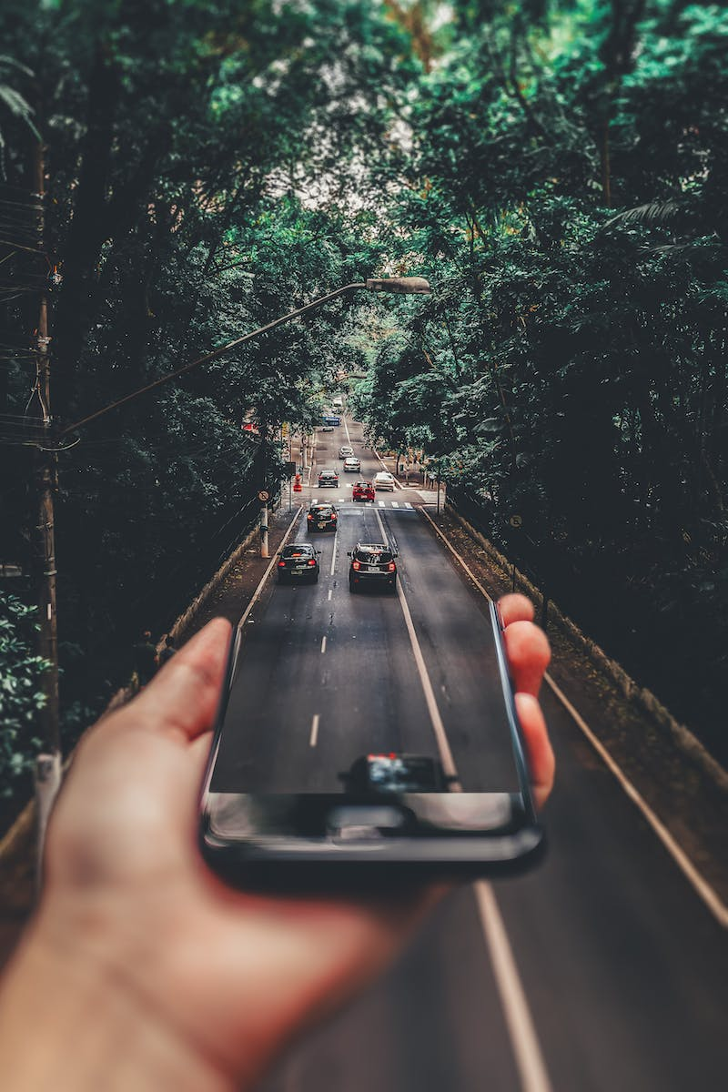
Reuniting for Further Explorations
• Receive a surprise message about renting a car
• Ask for directions to the location where you're waiting
• Get instructions to turn right at the corner and walk two blocks
• Find the post office on the corner of the third block
Photo by Pexels

Slide 7
Getting to the Amusement Park
• Express excitement about going to the amusement park
• Ask for directions to the park
• Receive instructions to walk to the crosswalk in front of the restaurant
• Follow the path, pass the clown, and find a fountain
• Sit on a bench near the fountain as a meeting point
Photo by Pexels

Slide 8
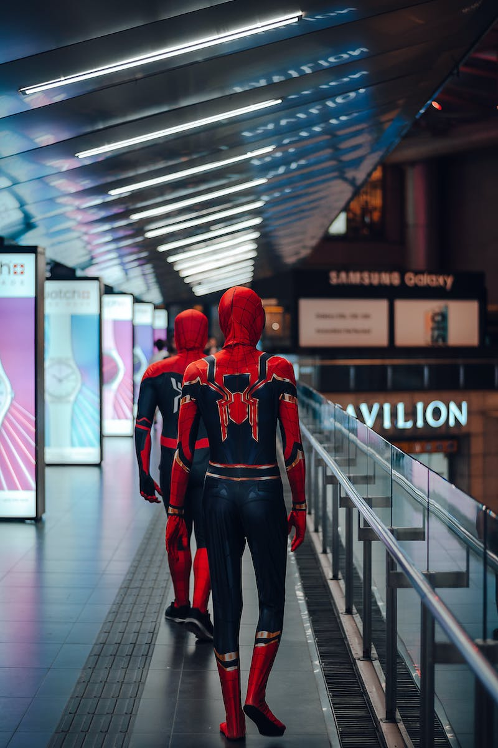
Heading to the Shopping Mall
• Express the desire to go to the shopping mall
• Ask for directions to the mall
• Receive instructions to turn right at the intersection, go one block, and then turn left
• Look for the mall next to the cinema
• Thank the person for the guidance
Photo by Pexels

Slide 9
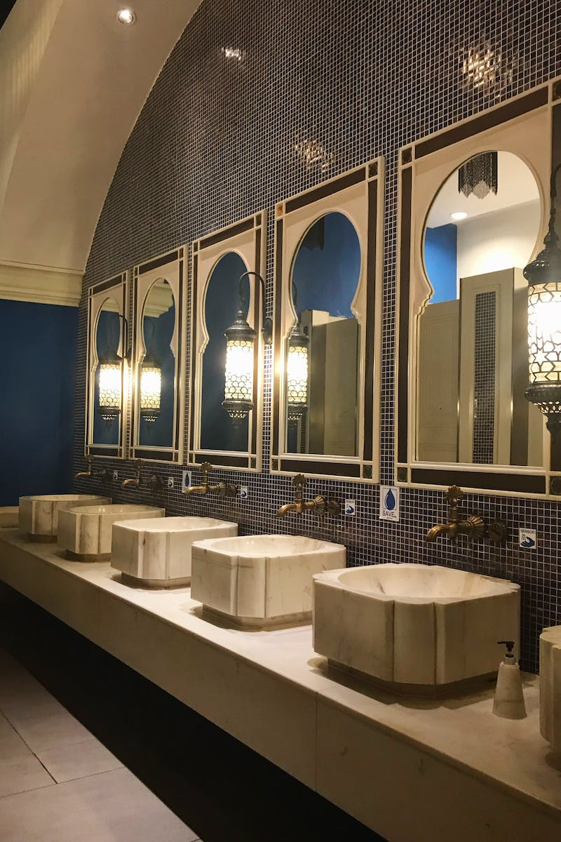
Finding the Restroom
• Express the need to find a restroom
• Ask for directions to the restroom
• Receive instructions to go to the end of the hall and turn right
• Express gratitude for the guidance
Photo by Pexels

Slide 10
Conclusion and Call to Action
• Thank the audience for watching
• Encourage them to subscribe to the YouTube channel and visit the website for more content
Photo by Pexels

