Slide 1
Introduction to Programming Languages
Understanding the Basics of Programming Languages

Slide 2
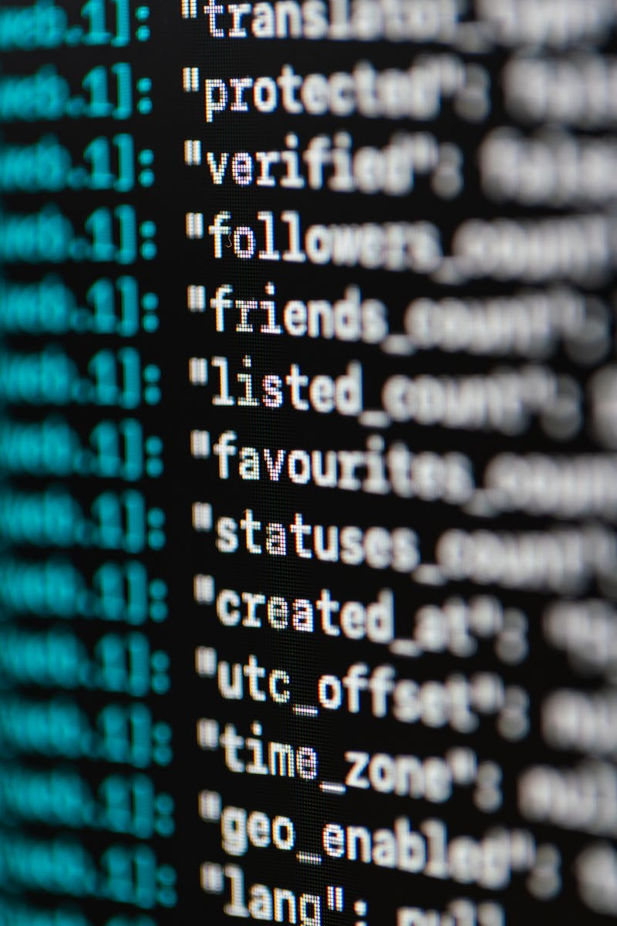
What are Programming Languages?
• Programming languages are algorithms designed for specific performers.
• Each programming language has its own command system executed by a computer.
• Commands are written in machine language or machine code.
• Assembly language is used to convert machine code into symbolic form for easier understanding.
• High-level programming languages use commands that combine sequences of machine instructions.
Photo by Pexels

Slide 3
Machine Language and Assembly Language
• Machine language commands are written in binary code.
• Assembly language is a low-level language that reflects machine code.
• High-level programming languages use English-like commands for easier human understanding.
• Fortran, Pascal, C++, and Python are examples of high-level programming languages.
Photo by Pexels

Slide 4
Compilers and Interpreters
• Compilers translate source code into executable files directly run by the operating system.
• Interpreters read and execute code line-by-line or transform code into bytecode.
• Languages like Pascal and BC have built-in compilers in their development environments.
• Languages like JavaScript, Perl, and Python use interpreters to execute code.
Photo by Pexels

Slide 5
High-Level Programming Languages
• High-level programming languages abstract from hardware implementation.
• They allow algorithms to be independent of specific computer hardware.
• Functional programming languages, like Haskell and Lisp, focus on evaluating function values.
• Object-oriented programming languages, like Java and Python, use objects and classes for code organization.
• Structured programming languages, like Pascal and C, emphasize block structures.
• Multi-paradigm languages combine multiple programming paradigms.
Photo by Pexels
• Most modern programming languages support multiple paradigms.

Slide 6
Programming Language Classifications
• Programming languages can be classified based on their semantic differences from machine code.
• Low-level languages are closer to machine code, like assembly languages.
• High-level languages are more abstract and easier for humans to understand.
• Languages can also be classified as compiled or interpreted, although many languages blur this distinction.
• Educational languages focus on simplicity and ease of understanding, while esoteric languages are created for experimental or entertainment purposes.
Photo by Pexels
• Pseudocode is a language used to describe algorithms using natural-language-like syntax.

Slide 7
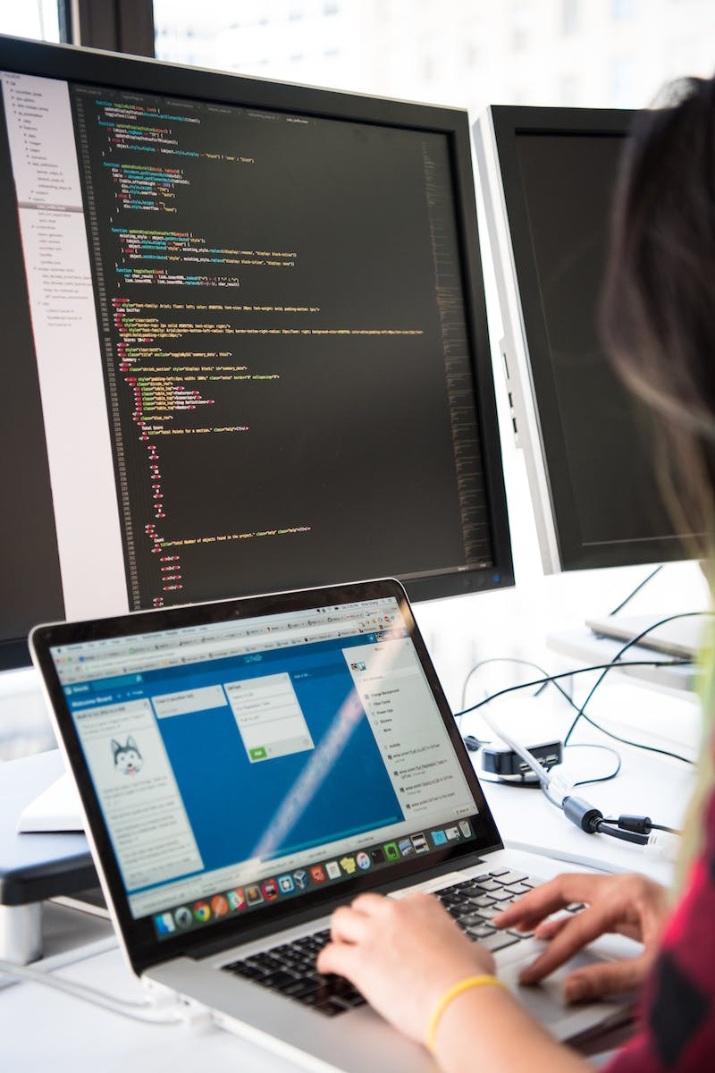
Syntax, Semantics, and Operators
• Syntax and grammar define the rules for writing programs in a language.
• Semantics determine the meaning and interpretation of language constructs.
• Syntax and semantics are checked during program analysis.
• Operators are fundamental concepts in programming languages and allow for data manipulation.
• Operators can vary between languages.
Photo by Pexels

Slide 8
Variables, Functions, and Procedures
• Variables can be constants or changeable values.
• Functions represent processes that compute a specific value based on input arguments.
• Procedures are sets of commands executed in sequence without returning a value.
• High-level languages provide libraries of standard functions.
• Objects and classes are key concepts in object-oriented programming.
Photo by Pexels

Slide 9
Operators and Expressions
• Expressions combine variables, constants, and operators to produce a value.
• Expressions can be evaluated and assigned to variables.
• Programming languages have standard operators for arithmetic, logic, comparison, and more.
• Operator precedence determines the order of evaluation in complex expressions.
Photo by Pexels

Slide 10
Conclusion
• Programming languages are fundamental tools for writing computer programs.
• They provide the means to translate high-level algorithms into executable code.
• Understanding different programming languages and their features is essential for effective coding.
• Continuous learning and exploration of new languages is crucial in the dynamic field of programming.
Photo by Pexels

