Slide 1
The Power of Artificial Intelligence
Exploring the Potential and Implications

Slide 2
Introduction
• Brief history of AI
• Definition of AI
• Current applications of AI
• Overview of the presentation
Photo by Pexels

Slide 3
Types of AI
• Narrow AI vs. General AI
• Supervised vs. Unsupervised learning
• Reinforcement learning
• Expert systems
Photo by Pexels

Slide 4
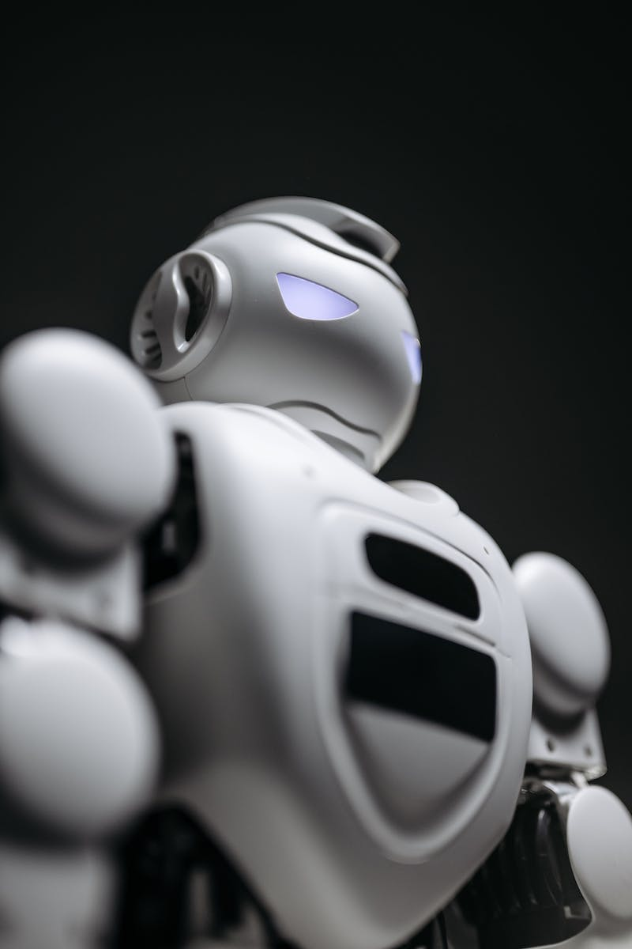
Impact of AI
• Automation of repetitive tasks
• Enhanced decision-making
• Improved healthcare outcomes
• Ethical considerations
Photo by Pexels

Slide 5
Challenges and Risks
• Job displacement
• Data privacy and security
• Bias and fairness
• Existential risks
Photo by Pexels

Slide 6
Future Possibilities
• Advancements in machine learning
• Human-AI collaboration
• AI-driven creativity
• Ethical considerations in AI development
Photo by Pexels

