Slide 1
The Beslan School Siege
A Tragic Incident and its Lasting Impact

Slide 2
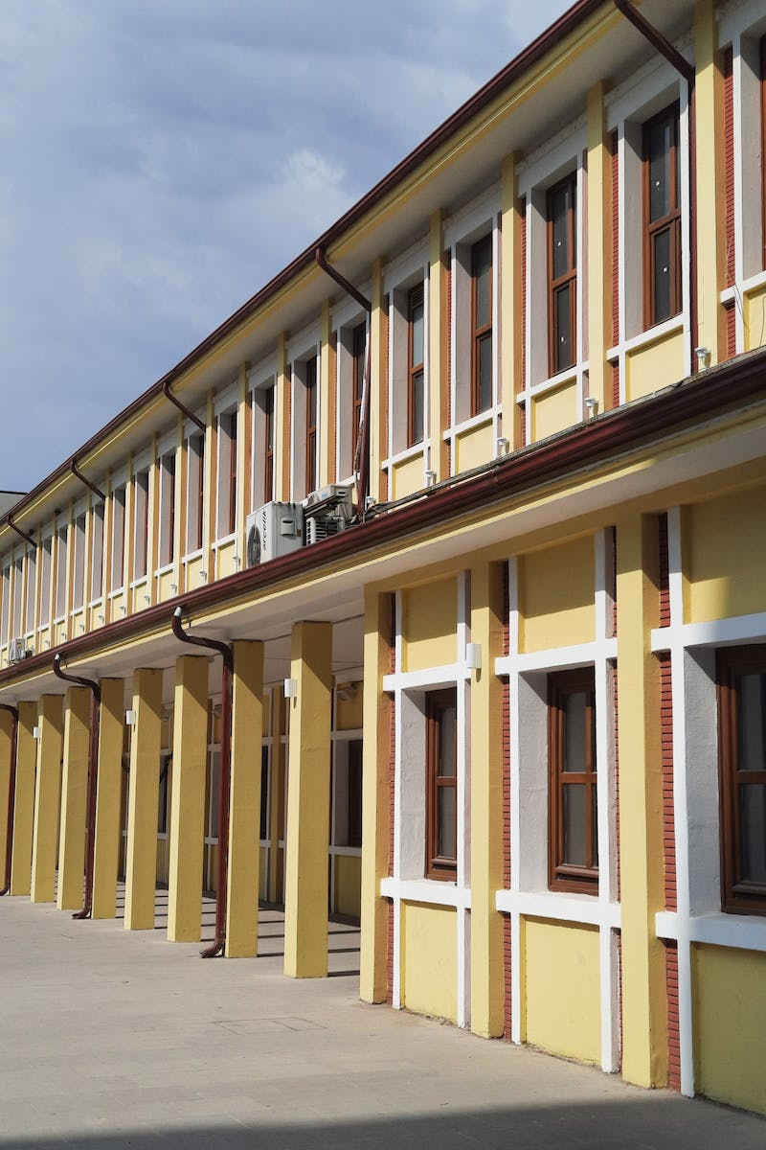
Introduction
• Brief overview of the Beslan school siege
• Date and location of the incident
• Motives behind the terrorist attack
• Impact on the local community
Photo by Pexels

Slide 3
Timeline of Events
• Sequence of events during the siege
• Actions taken by terrorists and hostages
• Response from law enforcement and authorities
• Rescue operations and aftermath
Photo by Pexels

Slide 4
Casualties and Devastation
• Number of casualties among students, teachers, and terrorists
• Physical damage to the school building
• Psychological impact on survivors and the community
• Long-term effects on the affected individuals
Photo by Pexels

Slide 5
International Response and Lessons Learned
• Reactions from world leaders and international organizations
• Lessons learned from the terrorist attack
• Improvements in school security measures
• Importance of crisis preparedness and response
Photo by Pexels

