Slide 1
Designing Dairy Farm Structures
Creating Efficient and Comfortable Environments for Dairy Cows

Slide 2
Introduction
• Welcome to the presentation on designing dairy farm structures
• Presented by Professor Thiago Ribeiro da Costa
• Focus on theoretical aspects of dairy cattle facilities
• Goal: Maximize cow comfort and optimize resource utilization
Photo by Pexels

Slide 3
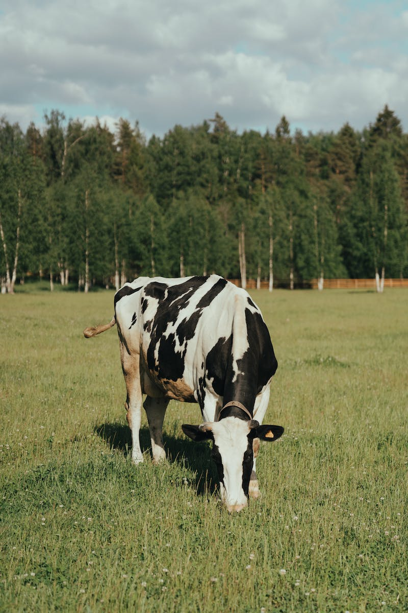
Considerations for Designing Dairy Structures
• Design based on field data
• Consider environmental factors like sun orientation and ventilation
• Optimize labor and machinery use
• Address animal needs and prioritize their comfort
Photo by Pexels

Slide 4
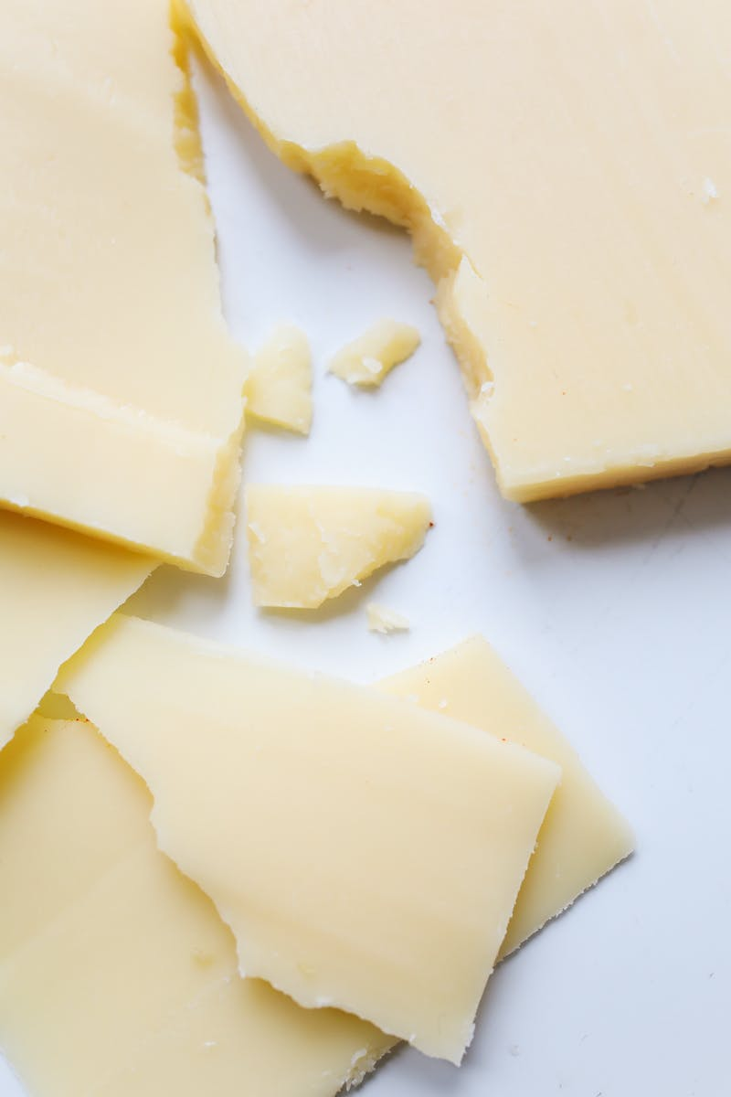
Planning Dairy Production System
• Choose appropriate system for the property
• Develop animal management plan
• Evaluate alternatives and select the best option
• Consider potential problems and develop solutions
• Determine necessary facilities for the project
Photo by Pexels

Slide 5
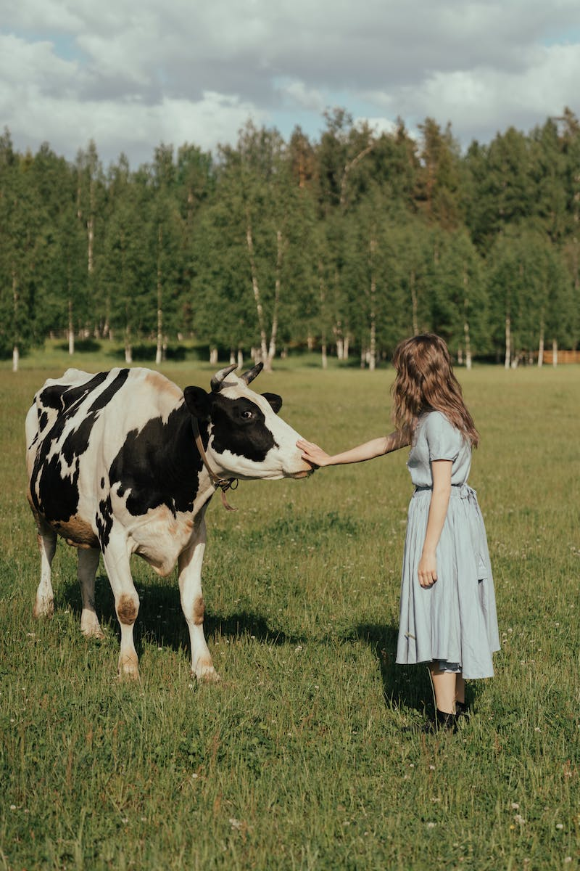
Animal Management Considerations
• Group animals based on age and number
• Consider nutritional needs, health status, and reproductive phase
• Manage manure properly
• Account for the producer's needs and priorities
Photo by Pexels

Slide 6
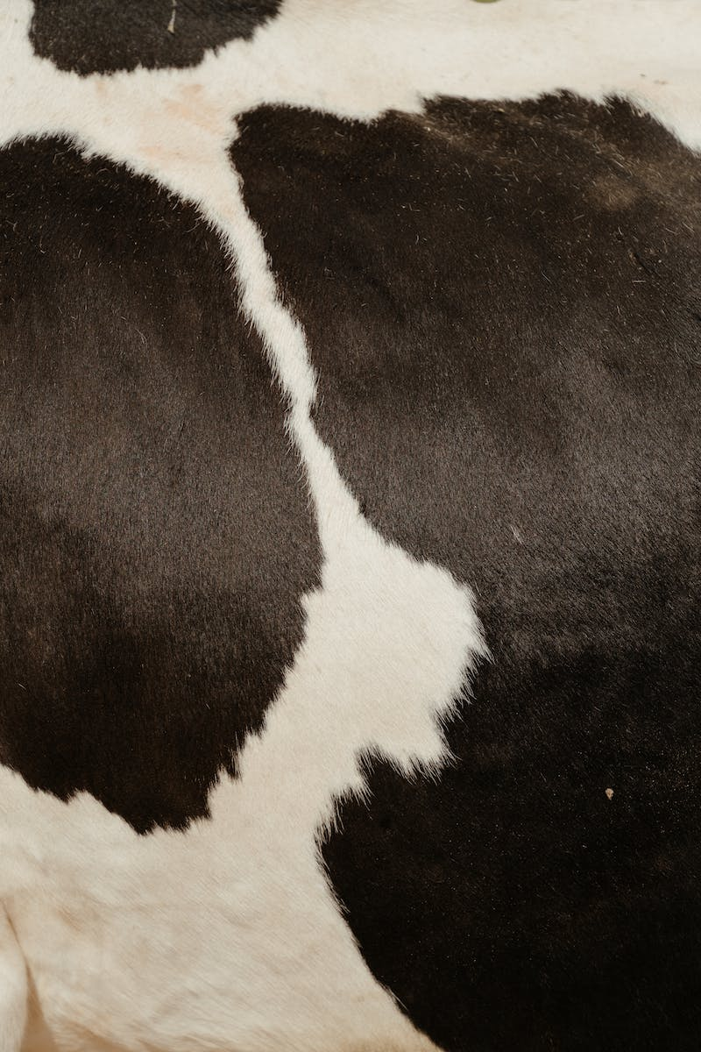
Maximizing Productivity and Efficiency
• Maximize animals per facility
• Minimize labor per liter of milk produced
• Focus on cow comfort: insulation, ventilation, and lighting
• Consider hierarchies within the group
• Maintain proper lighting for productivity
Photo by Pexels

Slide 7
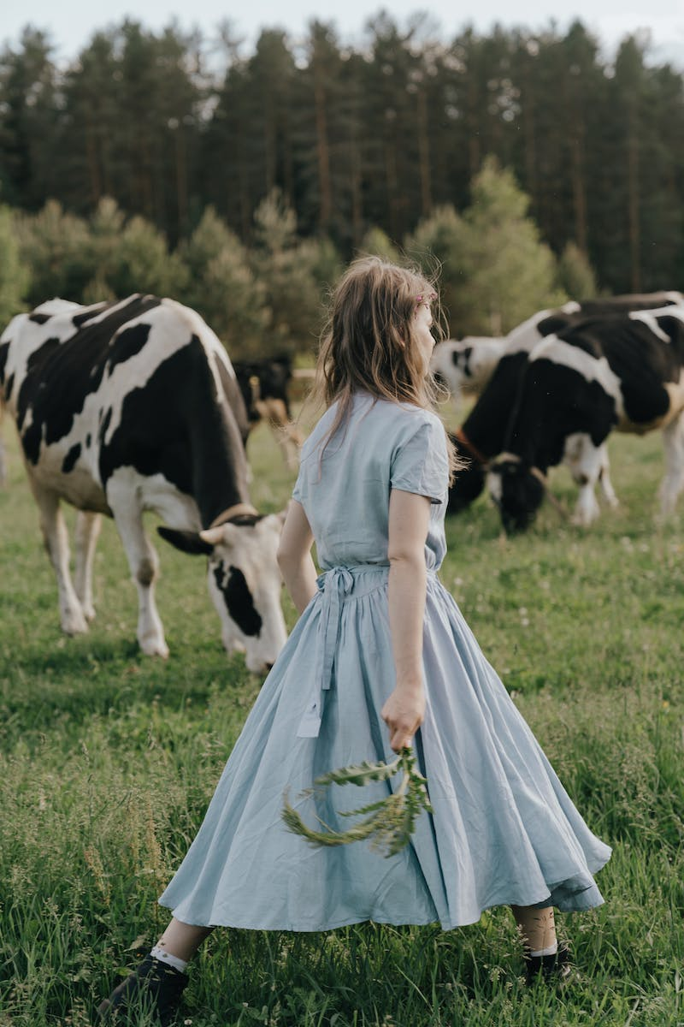
Production Systems: Extensive vs. Intensive
• Extensive system: Minimal supplementation, higher dependency on natural forage
• Intensive system: Total supplementation, high-tech equipment, and facilities
• Consider variations like confinement and rotational grazing
• Balance productivity and sustainability
Photo by Pexels

Slide 8
Milking Parlor Design
• Consider different parlor designs: Pit parlor, low-line parlor, tandem parlor
• Ensure good ventilation and easy cleaning
• Determine the number of milking units based on herd size
• Design for future expansion
Photo by Pexels

Slide 9
Milking Parlor Design Considerations
• Choose a design based on herd size and operator preferences
• Optimize cow flow and comfort
• Provide good lighting and adequate space
• Consider materials for hygiene and durability
Photo by Pexels

Slide 10
Milking Parlor Layout
• Determine the number of milking units based on herd size and desired efficiency
• Consider the number of operators and duration of milking shifts
• Balance productivity with labor requirements
• Plan for future expansion and backup options
Photo by Pexels

