Slide 1
The Power of Artificial Intelligence
How AI is Shaping Our Future

Slide 2
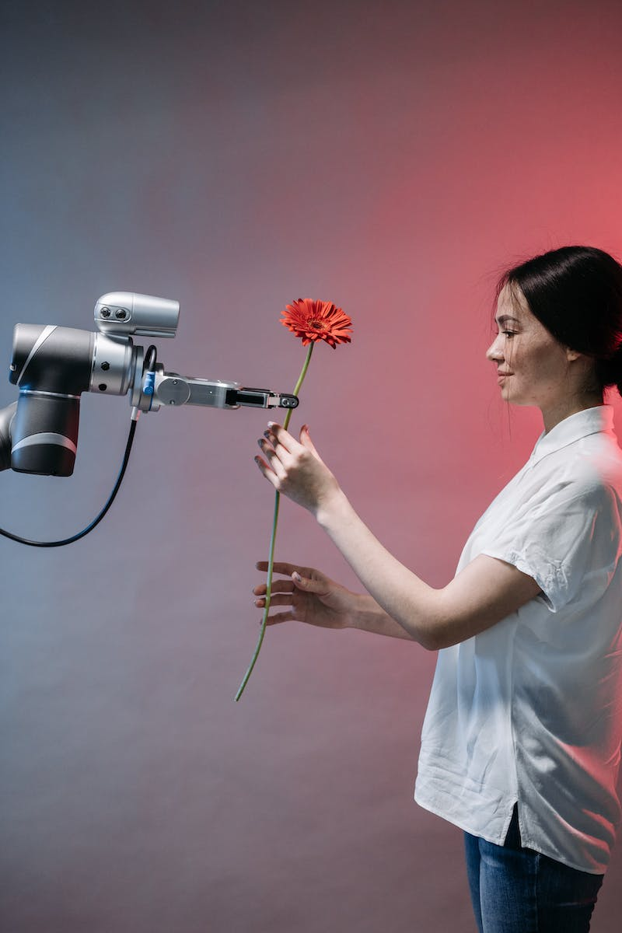
Introduction to Artificial Intelligence
• AI is a branch of computer science that focuses on creating intelligent machines
• Machine Learning and Deep Learning are key components of AI
• AI has wide-ranging applications in various industries
• Advancements in AI technology are driving automation and innovation
Photo by Pexels

Slide 3
Machine Learning: The Foundation of AI
• Machine learning is an approach to AI that enables computers to learn and improve from experience
• Supervised and unsupervised learning are two common types of machine learning
• Machine learning algorithms power various AI applications, such as image recognition and natural language processing
• Data plays a crucial role in training machine learning models
Photo by Pexels

Slide 4
Deep Learning: Advancing AI
• Deep learning is a subset of machine learning that uses artificial neural networks
• Neural networks are inspired by the human brain and have multiple layers of interconnected nodes
• Deep learning excels in tasks such as image and speech recognition
• In recent years, deep learning has revolutionized several industries
Photo by Pexels

Slide 5
AI Applications in Healthcare
• AI has the potential to revolutionize healthcare by improving diagnosis and treatment
• Machine learning algorithms can analyze medical data to identify patterns and make predictions
• AI-powered robots can assist in surgeries and patient care
• Virtual assistants and chatbots enhance patient engagement and support
Photo by Pexels

Slide 6
Ethical Considerations of AI
• AI raises ethical concerns such as privacy, bias, and job displacement
• Unbiased and transparent AI algorithms are essential for fair decision-making
• Regulatory frameworks need to be established to govern AI use
• Collaboration between technology experts, ethicists, and policymakers is crucial
Photo by Pexels

