Slide 1


April 2025
Chic on a Shoestring!
Unlock Affordable Fashion: Look Classy Without Breaking the Bank.

Slide 2


Table of Contents
1
Introduction: Fashion on a Budget
5
Linen Blend Dresses: Style Showdown
2
2025 Fashion Forecast
6
Fashion Jeans 2025: Style Guide
3
Budget-Friendly Fashion: Key Pieces
7
Budget-Chic: Accessorize!
4
Kohl's: Style on a Budget
8
Unlock Your Style Potential

Slide 3
Table of Contents
9
Fast Fashion: Style at What Cost?
10
Affordable Chic: Conclusion

Slide 4

Introduction: Fashion on a Budget
1.Thrift Store Finds
2.Sales & Discounts
Explore local thrift stores for unique, vintage pieces at unbeatable prices. Quality and style await!
Maximize savings by shopping during sales events and utilizing available student or senior discounts online and in-store.
3.Capsule Wardrobe
4.DIY Alterations
Build a versatile wardrobe with essential, interchangeable pieces for endless stylish outfit combinations. Smart and simple!
Learn basic sewing skills to tailor ill-fitting garments, breathe new life into old clothes, and express your style.

Slide 5

2023
✓
2025 Fashion Forecast
Trend Seeds Emerge
Initial trend forecasts begin to surface, influenced by cultural shifts, emerging technologies, and early runway shows. Designers start experimenting with novel silhouettes, color palettes, and sustainable materials, hinting at the direction of Spring/Summer 2025 fashion.
Spring/Summer 2025 Trends.
Stay updated without overspending.
✓
2024
Runway Reveals Style
Major fashion weeks showcase Spring/Summer 2025 collections, solidifying key trends. Influencers and media outlets analyze the shows, highlighting must-have pieces, color stories, and styling techniques. Retailers begin planning their inventories based on runway insights.
2024
✓
Consumer Trend Adoption
Early adopters and fashion-forward consumers begin incorporating Spring/Summer 2025 trends into their wardrobes. Social media platforms amplify these trends, creating widespread awareness and demand. Affordable interpretations of high-fashion looks start appearing in fast-fashion outlets.

Slide 6
Budget-Friendly Fashion: Key Pieces
1.Linen Dresses
2.Fashion Jeans
Essential linen blend dresses offer effortless style and breathability for warm weather, creating chic, affordable outfits.
Versatile fashion jeans are a wardrobe staple, easily dressed up or down for various occasions. Shop smart for deals!
3.Classic Tee
4.White Sneakers
A well-fitting, classic t-shirt in neutral colors forms the base for countless outfits. Look for durable, affordable options.
Clean white sneakers are comfortable and stylish, pairing well with dresses, jeans, and skirts. A budget-friendly must-have!

Slide 7

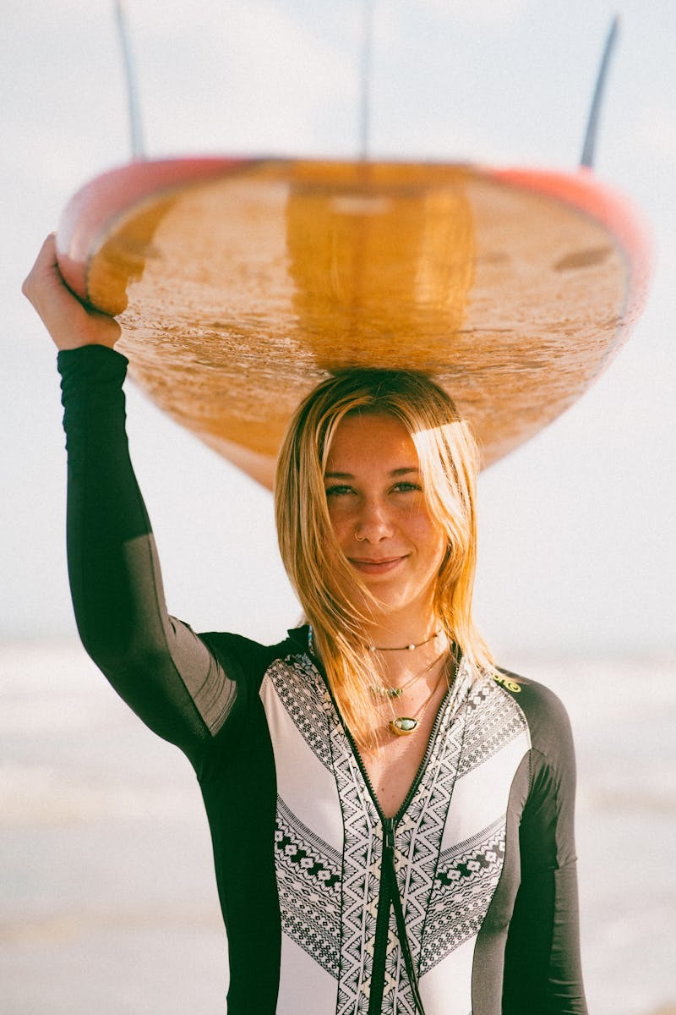
Kohl's: Style on a Budget
Explore Anna Reid's curated selection of Kohl's fashion, highlighting trendy pieces and styling tips for budget-conscious shoppers.
Uncover amazing deals and discounts on clothing, shoes, and accessories at Kohl's, maximizing your savings on stylish finds.
Learn how to style Kohl's pieces to create fashionable outfits for various occasions, from casual outings to special events.
Stay updated on the latest fashion trends at Kohl's, with Anna Reid showcasing the must-have pieces of the season.

Slide 8




Linen Blend Dresses: Style Showdown
Chic Advantages
Style Challenges
Linen blends offer breathability and comfort, ideal for warmer weather, providing a relaxed yet stylish aesthetic for everyday wear.
Versatile white and navy colors create numerous outfit combinations, easily dressed up or down with accessories for various occasions.
Petite sizing ensures a flattering and proportionate fit, enhancing the overall silhouette and confidence for smaller frames.
Linen blends are prone to wrinkling, requiring extra care and ironing to maintain a polished appearance throughout the day.
White linen can be sheer, necessitating the use of appropriate undergarments to avoid unwanted visibility, impacting overall comfort.
Navy linen can fade over time with frequent washing, demanding gentle cleaning methods to preserve the richness of the color.

Slide 9
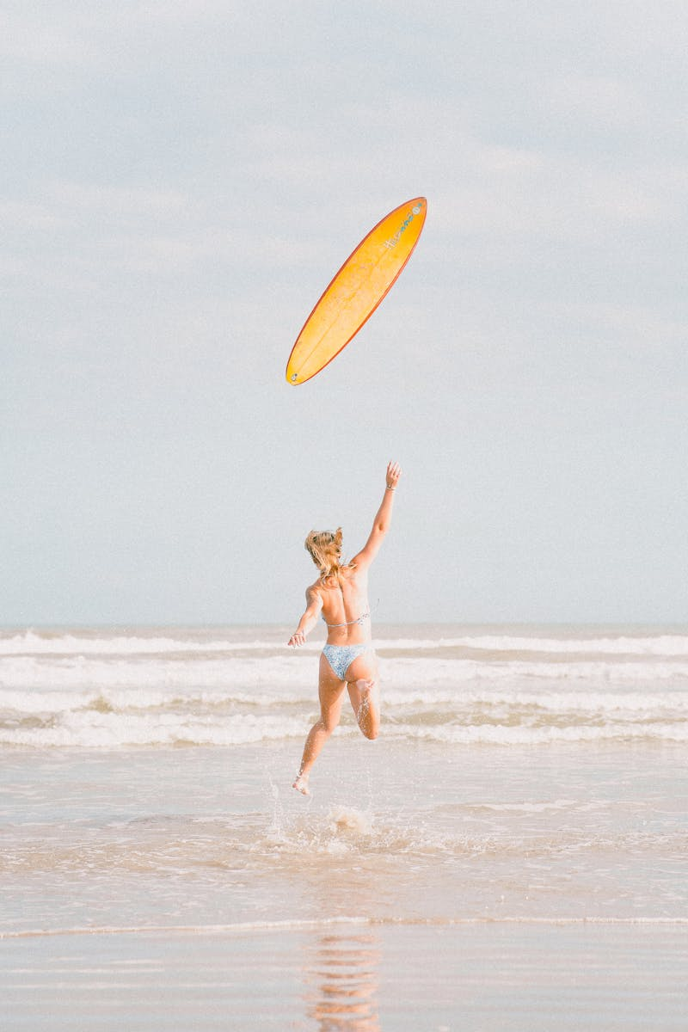
Fashion Jeans 2025: Style Guide
High-waisted jeans are back! Pair them with crop tops or tucked-in blouses for a flattering and trendy silhouette this season.
Embrace comfort and style with wide-leg jeans. Perfect for casual outings or dressed-up events, offering ultimate versatility.
Add an edgy touch with distressed jeans. Ripped knees and frayed hems create a cool, effortless look for everyday wear.
Brighten your wardrobe with colored denim. Pastel shades and vibrant hues add a playful and fashionable twist to your outfits.

Slide 10

Budget-Chic: Accessorize!
Choose one bold accessory to highlight your outfit and draw attention. Keep it simple!
Scarves add color and texture, instantly changing any look. Experiment with different tying styles.
Layer delicate necklaces or bracelets for a trendy, personalized touch. Mix metals subtly.
Belts cinch your waist and add definition. Use them to transform dresses and tops easily.

Slide 11
Unlock Your Style Potential
Take inventory of your current wardrobe. Identify staple pieces and potential combinations to begin creating outfits.
Learn basic color theory to effortlessly combine colors, creating visually appealing and stylish outfits for any occasion.
Experiment with different textures like knits, denim, and silk to add depth and visual interest to your outfits.
Use accessories like scarves, belts, and jewelry to elevate your outfits and express your personal style effortlessly and elegantly.

Slide 12
Fast Fashion: Style at What Cost?
The Upsides
The Downsides
Affordable clothing allows consumers to access trendy styles without breaking the bank, increasing personal expression and confidence.
Fast fashion provides a wide variety of clothing options, catering to diverse tastes and preferences, ensuring something for everyone.
Quick production cycles ensure that consumers can easily access the latest trends and styles as soon as they appear on the market.
Low prices often come at the expense of poor quality, leading to garments that quickly wear out and end up contributing to textile waste.
The fast fashion industry often exploits garment workers, paying them low wages and forcing them to work in unsafe conditions with few protections.
The industry relies on environmentally damaging practices, including water pollution, excessive energy use, and the use of harmful chemicals.

Slide 13
Affordable Chic: Conclusion
1.Style Confidence
2.Embrace Tips
Believe in your ability to create a stunning look without spending a fortune. Confidence is key!
Use the advice given to develop a wardrobe that suits your tastes and budget effectively.
3.Classy Look
4.Budget-Friendly
Achieve an elegant and refined appearance by focusing on quality basics and smart accessorizing choices.
Showcase your unique flair and elegance without exceeding your allocated monetary restrictions or limitations.

