Slide 1
The Journey of a Text Message: From Electron Dance to Wireless Ping
Exploring the Invisible Pathways of Communication

Slide 2
Introduction: Where Does Your Message Really Go?
• Texting across oceans
• Understanding the journey
• From electrical impulses to radio waves
• The role of an antenna
Photo by Pexels

Slide 3
The Mysterious Antenna
• A voodoo-like metal-tongued device
• Translating electrical impulses into radio waves
• Screaming at a frequency of 2.4 GHz
• Waves that can pass through walls
Photo by Pexels

Slide 4
Creating Fluctuations in the Electromagnetic Field
• Similarities between gravitational and electromagnetic waves
• Predictions by Maxwell's equations
• Electrons in conductors as the source
• Choreographed dance of electrons
Photo by Pexels

Slide 5
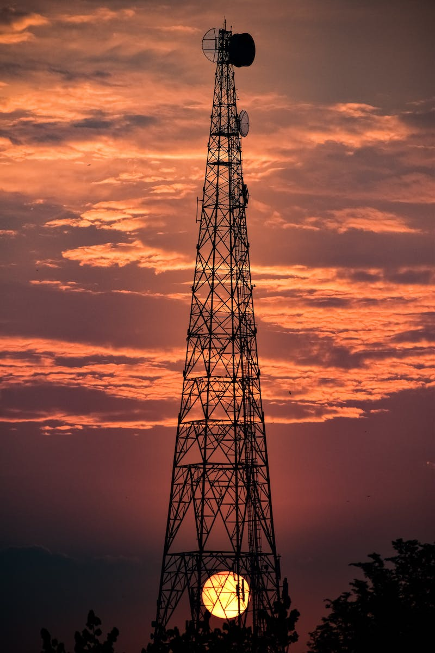
Electron Dance: Encoding the Message
• Instructions from mobile OS
• Rhythmic ebbs and flows in the electromagnetic field
• Communication with the cell tower
• Decoding by the hardware
Photo by Pexels

Slide 6
The Journey: Tower to Tower
• Ultra high-speed communication cables underground
• Transatlantic and Submarine communications cables
• No interference compared to wireless communication
• Wireless communication limited to sender to tower-1 and tower-2 to receiver
Photo by Pexels

Slide 7
Wireless Communication: Devices as Students in a Classroom
• Phones broadcasting messages in all directions
• Unique device codes for identification
• Agreeing on protocols to avoid interference
• Different times, frequencies, locations, and codes
Photo by Pexels

Slide 8
Wireless vs Cable: Why the Mix?
• Cables as high-tech data carriers
• Cable advantages: speed and minimal interference
• Satellite limitations for widespread use
• High costs of satellite deployment
Photo by Pexels

Slide 9
Conclusion: The Invisible Pathway of Communication
• Understanding the dance of electrons
• Appreciating the role of antennas and cell towers
• Importance of protocols in wireless communication
• The necessity of cables in long-distance communication
Photo by Pexels

