Slide 1
Unleashing the Power of Chess
Strategies for Success in the Game of Kings

Slide 2
Introduction: The Enduring Appeal of Chess
• Chess has captured the minds and hearts of enthusiasts for centuries.
• It stimulates critical thinking, strategic planning, and foresight.
• Often referred to as the 'Game of Kings', it symbolizes intelligence and elegance.
• Chess is a universal language, transcending cultures and languages.
Photo by Pexels

Slide 3
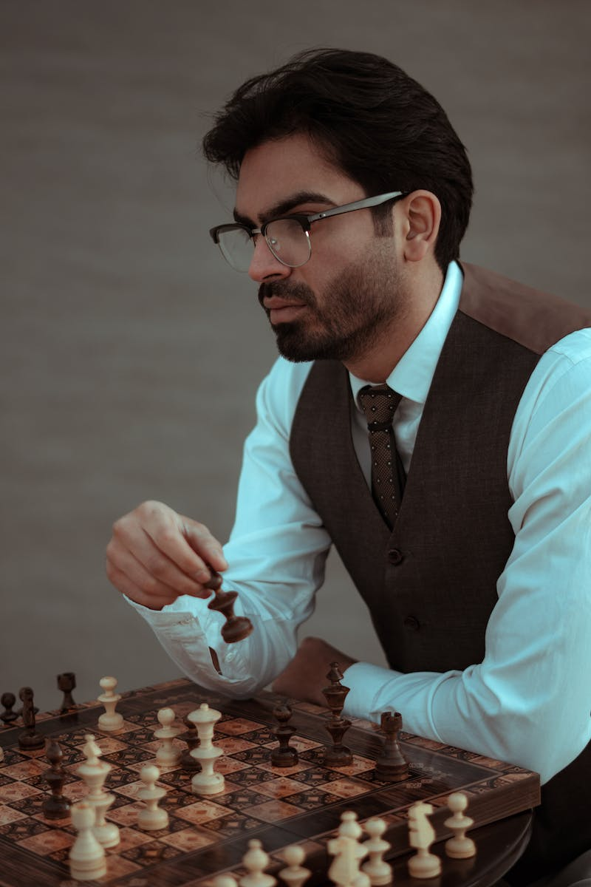
Strategic Thinking: Mind Over Matter
• Chess requires players to think several moves ahead.
• Strategic thinking involves evaluating and prioritizing options.
• Chess improves problem-solving skills and decision-making abilities.
• Strategize to outsmart your opponent and secure victory.
Photo by Pexels

Slide 4
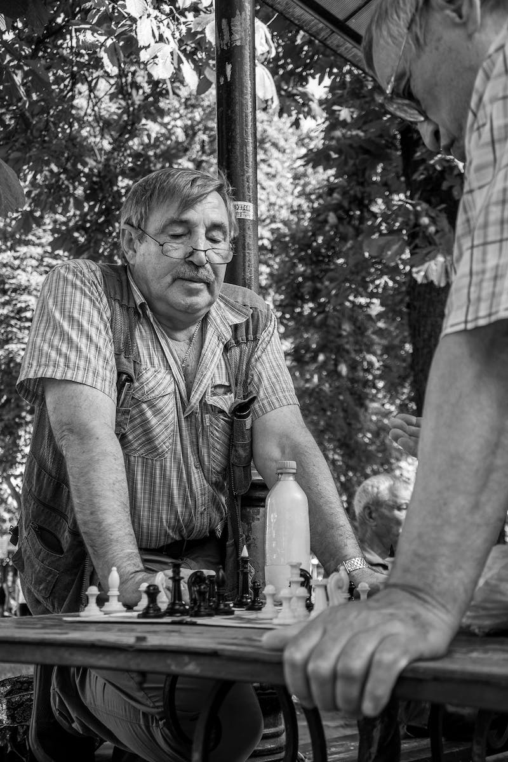
Mastering the Openings: A Game of Precision
• The openings are the initial moves that set the stage for the game.
• Each opening has its own strategies, advantages, and potential risks.
• Studying openings enhances your understanding of key concepts.
• Knowledge and mastery of openings provide a strong advantage.
Photo by Pexels

Slide 5
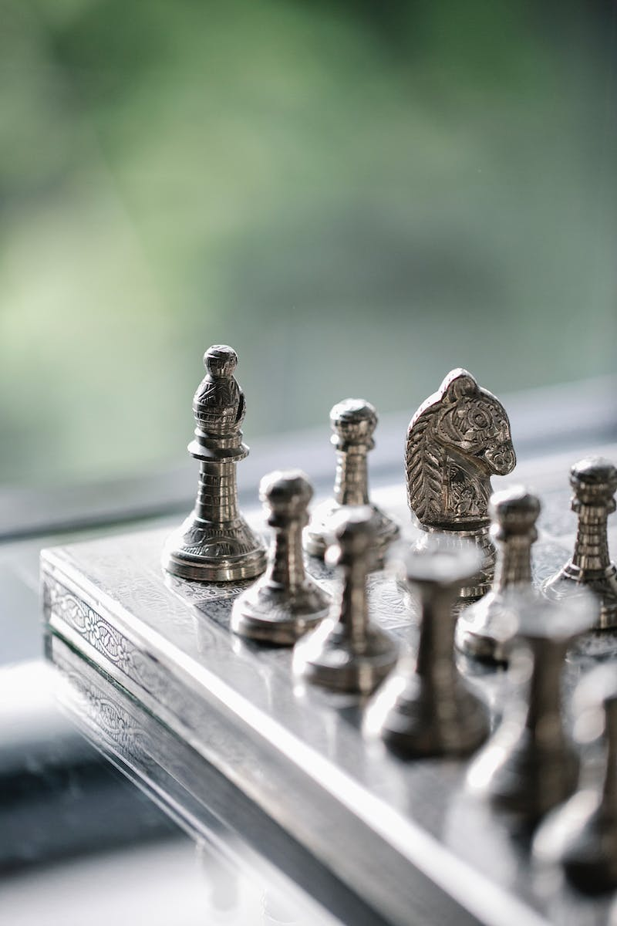
Mid-game Maneuvers: Flexibility and Adaptability
• The mid-game is a critical phase where strategies unfold.
• Mastering various tactics, such as pins and forks, is essential.
• Flexibility and adaptability enable players to respond to changing game dynamics.
• Balance offense and defense while pursuing victory.
Photo by Pexels

Slide 6
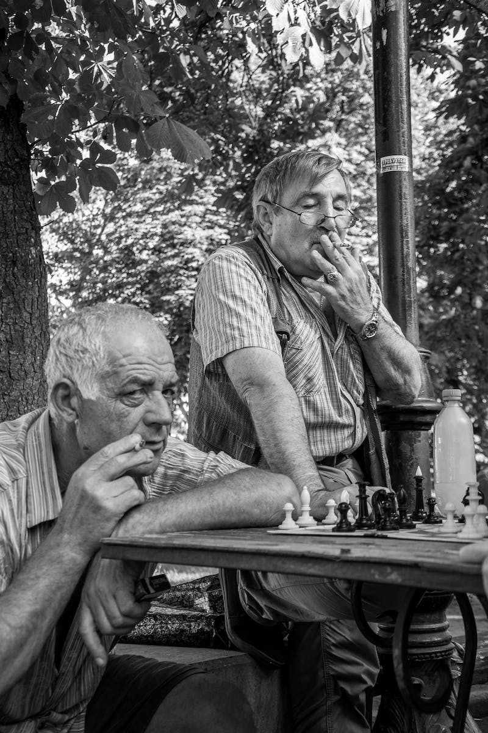
Endgame Excellence: Securing Triumph
• The endgame is the final phase where victories are secured.
• Understanding endgame fundamentals is crucial for success.
• Skills like calculation, piece coordination, and promotion come to the fore.
• Delve into the art of checkmating and endgame tactics.
Photo by Pexels

Slide 7
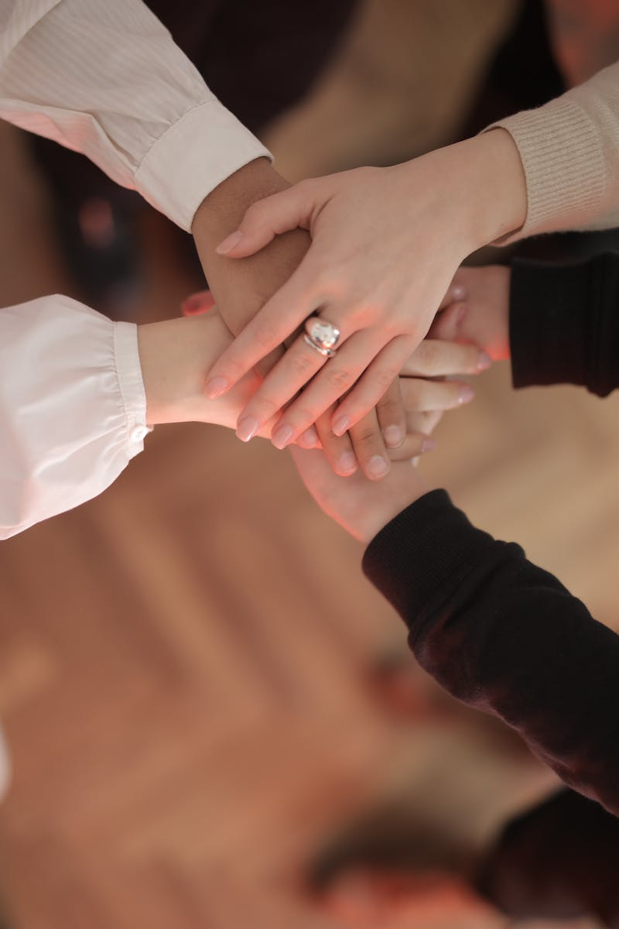
Conclusion: Harnessing the Power of Chess
• Chess offers valuable life lessons and enhances critical thinking abilities.
• Playing chess cultivates patience, resilience, and mental agility.
• Embrace the challenge and engage in the fascinating world of chess.
• Unlock your potential and join the thriving chess community.
Photo by Pexels

