Slide 1
The Evolution of Artificial Intelligence in Healthcare
Advances, Applications, and Future Possibilities

Slide 2
Introduction to Artificial Intelligence
• AI refers to the simulation of human intelligence in machines.
• It enables machines to learn from experience and perform tasks that typically require human intelligence.
• AI has the potential to revolutionize healthcare by improving diagnosis, treatment, and patient outcomes.
• Examples of AI in healthcare include robotic surgery, virtual nursing assistants, and predictive analytics.
Photo by Pexels

Slide 3
Machine Learning in Medical Imaging
• Machine learning algorithms can analyze medical images with high accuracy.
• They can detect patterns and anomalies that may be missed by human radiologists.
• This improves early detection of diseases and reduces the need for invasive procedures.
• Examples include algorithms for identifying cancerous cells in mammograms and diagnosing brain tumors.
Photo by Pexels

Slide 4
Natural Language Processing in Electronic Health Records
• Natural language processing (NLP) algorithms can extract meaningful data from unstructured clinical notes.
• This enables efficient analysis of large volumes of patient data for research and treatment purposes.
• NLP can also identify potential adverse drug interactions and improve clinical decision support systems.
• Examples of NLP applications in healthcare include automated coding, clinical documentation improvement, and sentiment analysis.
Photo by Pexels

Slide 5
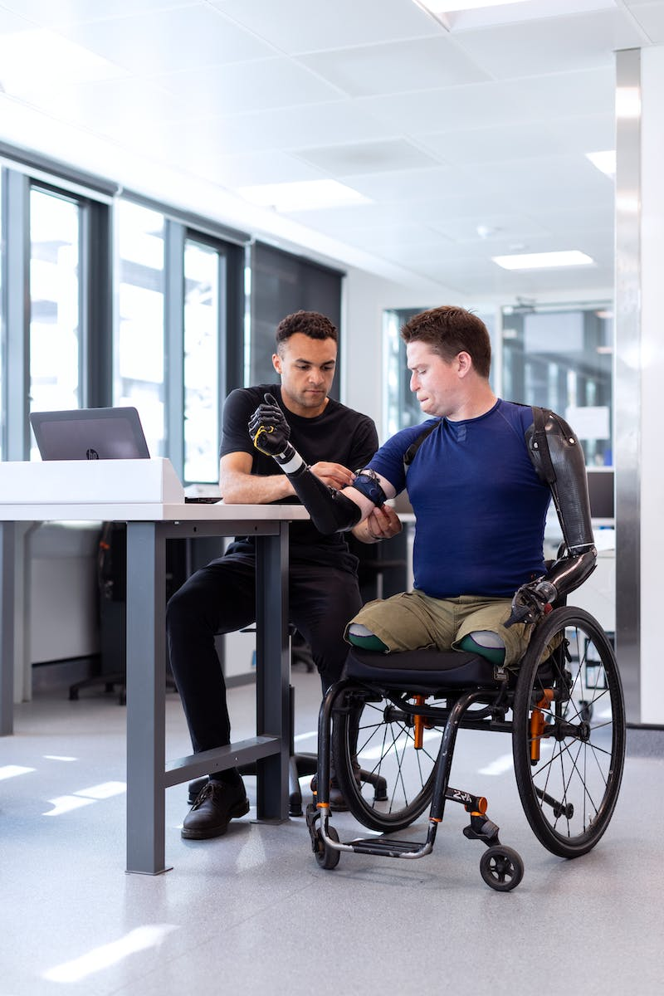
Robot-Assisted Surgery
• Robotic surgery systems enhance precision and dexterity in surgical procedures.
• They enable minimally invasive surgeries, resulting in reduced trauma, faster recovery, and better outcomes.
• Robots can perform complex tasks with minimal human intervention, allowing surgeons to operate remotely.
• Examples of robot-assisted surgeries include prostatectomy, cardiac procedures, and orthopedic surgeries.
Photo by Pexels

Slide 6
Chatbots and Virtual Nursing Assistants
• Chatbots and virtual nursing assistants provide personalized support and information to patients.
• They can answer routine questions, provide medication reminders, and offer emotional support.
• These virtual assistants improve patient engagement, reduce administrative burden, and increase accessibility to healthcare services.
• Examples of chatbots and virtual nursing assistants include Amazon's Alexa, Ada, and Your.MD.
Photo by Pexels

Slide 7
Predictive Analytics for Patient Outcomes
• Predictive analytics uses historical patient data to identify patterns and make accurate predictions.
• It helps healthcare providers anticipate and prevent adverse events, improving patient safety.
• Predictive models can assist in early detection of diseases, allowing for timely interventions.
• Examples of predictive analytics in healthcare include readmission risk prediction and sepsis detection.
Photo by Pexels

Slide 8
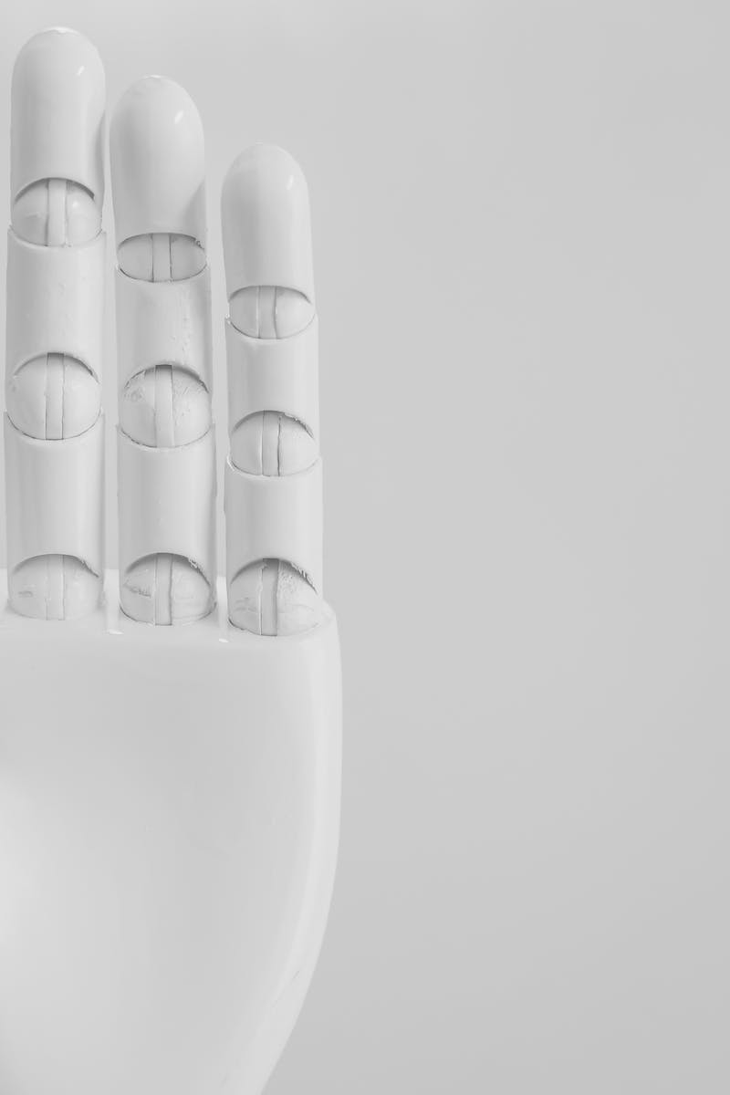
Future Directions and Challenges
• The future of AI in healthcare holds great promise but also significant challenges.
• Ethical considerations, privacy concerns, and algorithm biases need to be addressed.
• Integration of AI with existing healthcare systems and workflows is crucial for successful implementation.
• Despite challenges, AI has the potential to revolutionize personalized medicine and population health.
Photo by Pexels

