Slide 1
Advanced MRI Measurements for Brain Tumor Treatment Management
Improving Diagnosis, Surgical Planning, and Treatment Response Evaluation

Slide 2
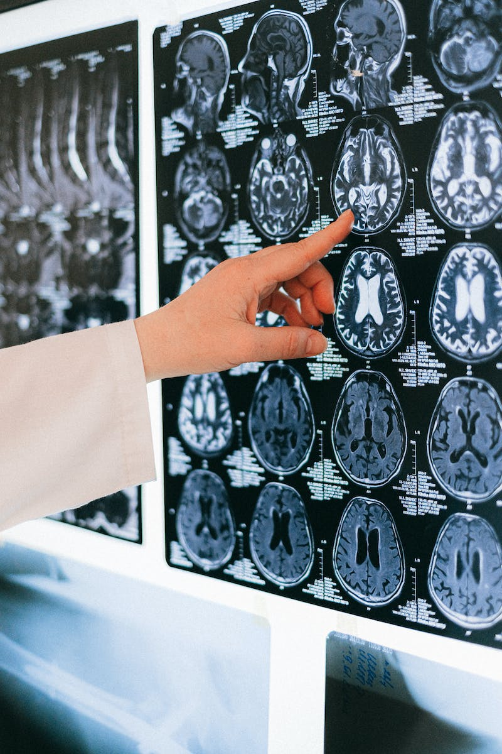
Welcome and Introduction
• Thank you to the Missile Foundation for the invitation
• Presenter: Kathleen Mind, Professor of Biophysics and Radiology
• Topic: Advanced MRI Measurements for Brain Tumor Treatment Management
• Objective: Improve diagnosis, surgical planning, and treatment response evaluation
Photo by Pexels

Slide 3
Treatment Paradigm for Adult Brain Tumor
• Timeline of various treatments undergone by patients
• MRI used to establish initial diagnosis and evaluate tumor response
• Treatment options include surgery, chemotherapy, radiation therapy
• MRIs used to assess response and possible recurrence
Photo by Pexels

Slide 4
Limitations of Standard MRI
• Standard MRI provides soft tissue contrast but lacks specific information about tumor growth patterns
• Advanced MRI metrics, such as perfusion and diffusion MRI, offer more detailed insights
• Perfusion MRI provides information about blood vessels throughout the brain
• Diffusion MRI gives information about tumor cells
Photo by Pexels

Slide 5
Advanced MRI Metrics: Perfusion MRI
• Perfusion MRI maps blood vessels throughout the brain
• Can inform diagnosis, indicate tumor aggressiveness, and guide tissue sampling
• Helps delineate tumor extent and plan subsequent treatment
Photo by Pexels

Slide 6
Advanced MRI Metrics: Diffusion MRI
• Diffusion MRI provides information about tumor cells and cell density
• Can help assess treatment response and distinguish tumor from treatment effects
• Used in combination with other metrics, such as perfusion and fractional tumor burden maps
Photo by Pexels

Slide 7
Fractional Tumor Burden Maps
• Fractional tumor burden maps help differentiate tumor from treatment effects
• Provide clinically relevant information for treatment decisions
• Available through advanced MRI metrics
Photo by Pexels

Slide 8
Clinical Application: Diagnosis and Surgical Planning
• Advanced MRI metrics assist in diagnosis and surgical planning
• Perfusion MRI correlates with tumor grade and helps locate aggressive areas
• Delta T1 map enhances tumor visualization and extent of resection
• Fractional tumor burden maps aid in surgical decision-making
Photo by Pexels

Slide 9
Clinical Application: Treatment Response Evaluation
• Standard MRI encounters challenges in distinguishing tumor from treatment effects
• Pseudo progression complicates response evaluation
• Advanced MRI Metrics, such as Rc and Delta T1 maps, provide valuable information
• Fractional tumor burden maps offer insights into tumor response
Photo by Pexels

Slide 10
Clinical Application: Treatment Selection at Recurrence
• Advanced MRI metrics aid in treatment selection at recurrence
• Rc can predict response to anti-VEGF therapy
• Delta T1 map enhances visualization of tumor and treatment effects
• Diffusion MRI offers insights into treatment response
Photo by Pexels

Slide 11
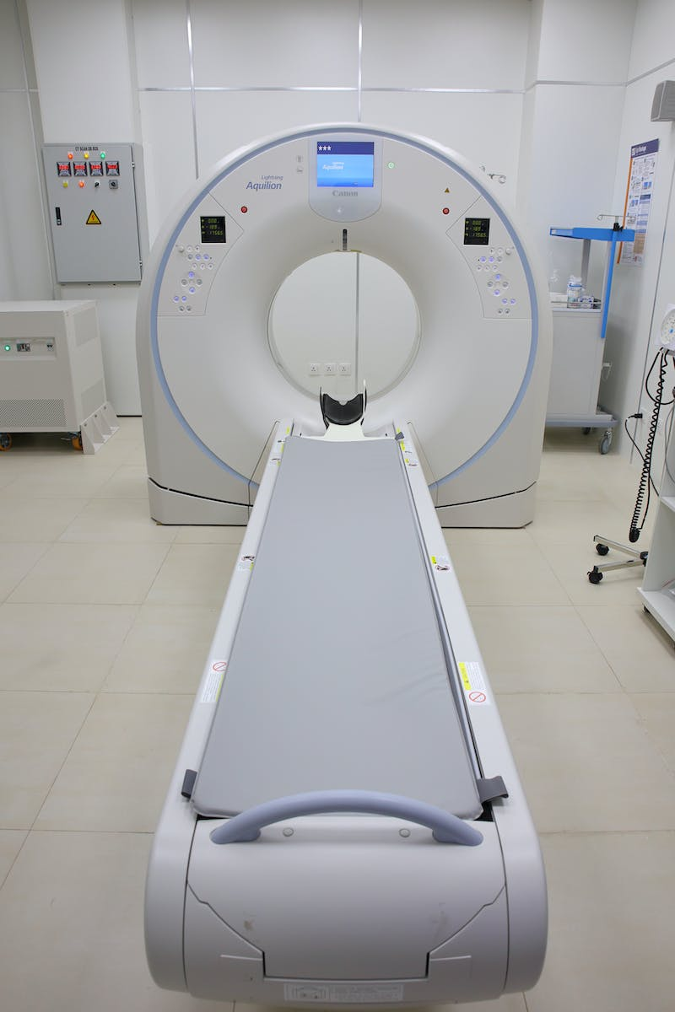
Availability and Clinical Validation
• Advanced MRI metrics are commercially available
• Clinical trials and studies have demonstrated their accuracy and relevance
• National consensus protocols confirm their robustness
• Platform-agnostic and compatible with various MRI machines
Photo by Pexels

Slide 12
Conclusion
• Advanced MRI metrics improve diagnosis, surgical planning, and treatment response evaluation
• Perfusion MRI and diffusion MRI offer valuable insights into tumor vascularity and cell density
• Fractional tumor burden maps aid in treatment decision-making
• Commercially available and nationally validated
Photo by Pexels

