Slide 1
Understanding Magnetic Resonance Imaging
A Brief Overview of MRI Spin Echo Sequence

Slide 2
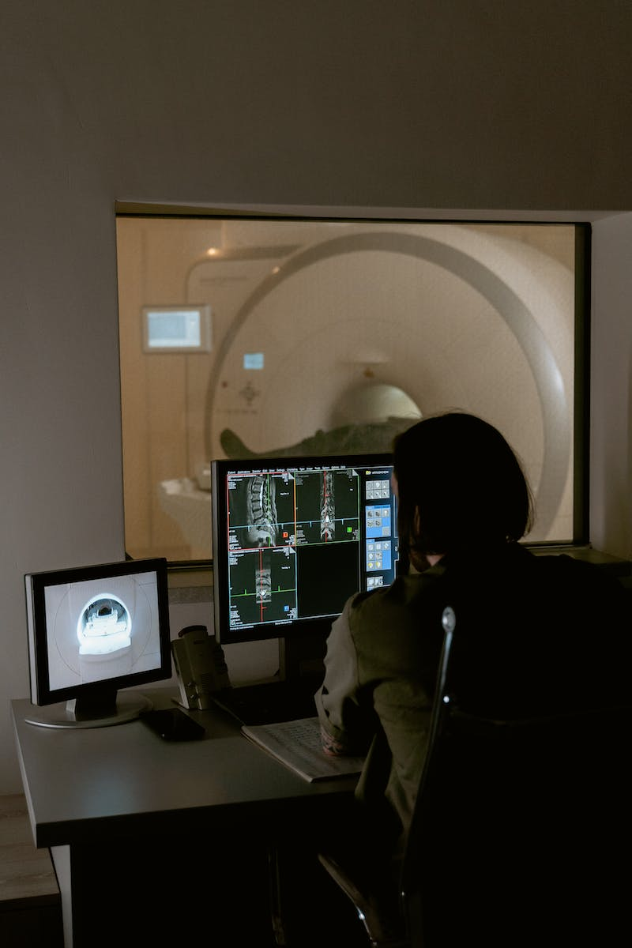
Introduction
• Dr. Erin Gomez presents an overview of magnetic resonance imaging
• Explains the concept of protons and their behavior in a magnetic field
• Introduces the role of an MRI scanner and its magnetic field
• Describes the alignment of protons with the magnetic field
Photo by Pexels

Slide 3
Proton Behavior
• Protons act like bar magnets in a magnetic field
• Normally, protons have random orientations
• External magnetic field can influence the alignment of protons
• Majority of protons align with the magnetic field, generating a net magnetization vector
Photo by Pexels

Slide 4
Spin Echo Sequence
• Protons in the body also spin on their axes
• Spin frequency depends on the applied magnetic field strength
• RF pulses can manipulate the alignment and phase of protons
• RF pulse knocks protons into an alternate plane and synchronizes their phase
Photo by Pexels

Slide 5
Signal Generation
• Synchronized protons generate an electrical signal
• Signal decay occurs due to differences in proton procession speeds
• T2* effects lead to signal loss and distortions in MRI
• T2* effects can be combated with refocus RF pulses
Photo by Pexels

Slide 6
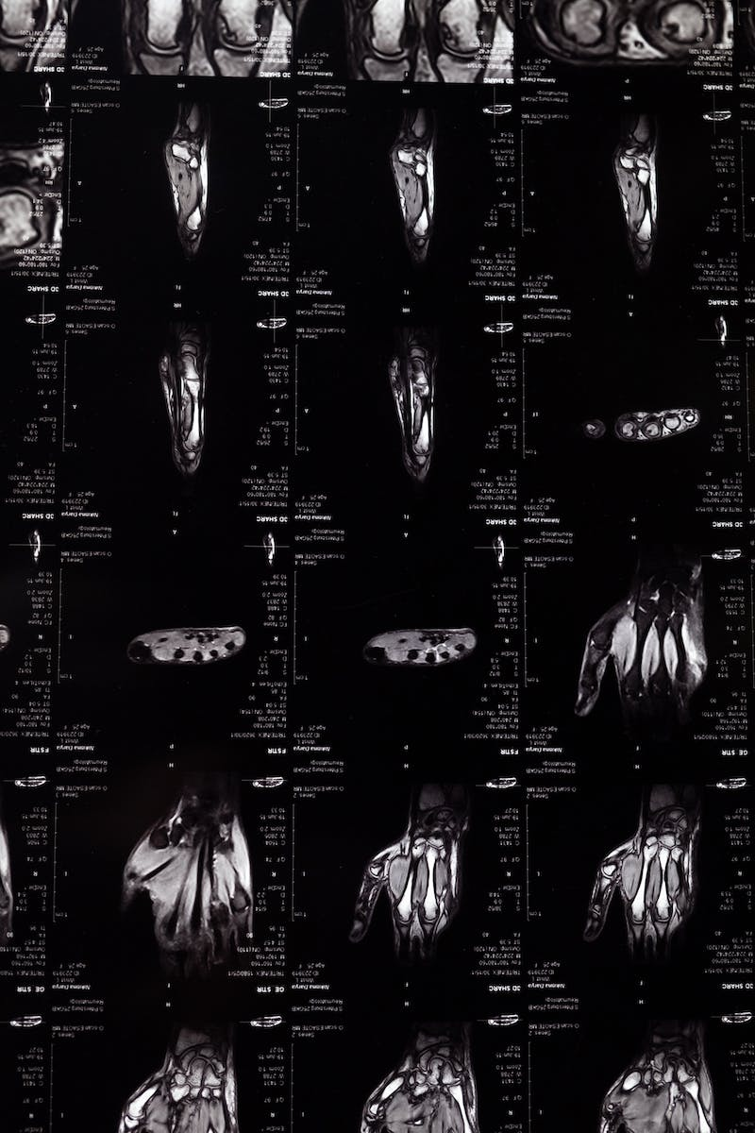
Spin Echo Imaging
• One-eighty degree refocus pulse phases protons in the opposite direction
• Echo is produced, resulting in information for imaging
• Multiple echoes can be captured to reduce T2* effects
• Spin echo or fast spin echo imaging can be performed
Photo by Pexels

Slide 7
Sequence Recap
• Alignment of protons with the magnetic field
• Ninety degree RF pulse and transverse magnetization
• Recovery, decay, and signal generation
• One-eighty degree refocus pulses and echo production
Photo by Pexels

