Slide 1
A Historical Journey: The Philippines from 1936 to 1997
Exploring key events and leaders in the Philippines' history

Slide 2
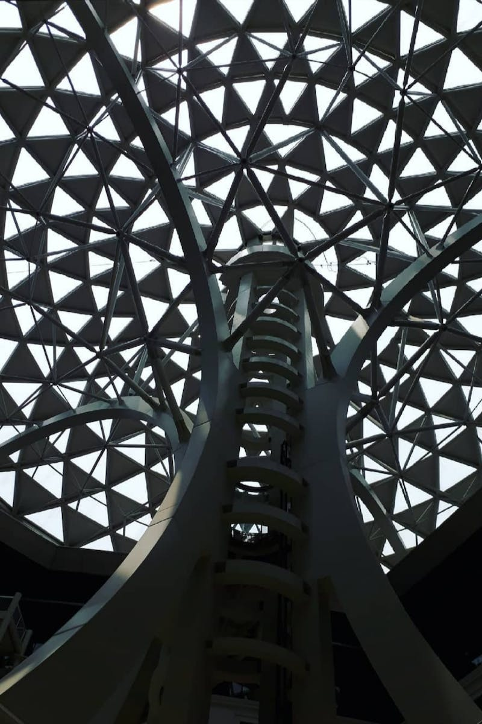
Introduction
• Timeline: 1936 - 1997
• Key letters: a, b, c, d
• Important figures: Ferdinand Marcos, Manuel Ke, Monte
• Commission on Higher Education
Photo by Pexels

Slide 3
Important Letters
• Letter b: 1937
• Letter a: 1936
• Letter c: 1940
• Letter d: 1959
Photo by Pexels

Slide 4
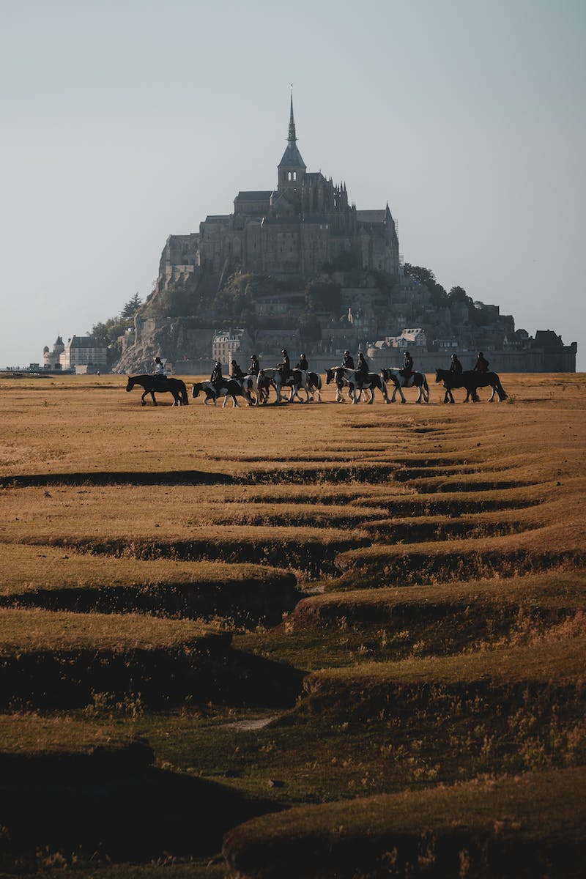
Key Figures
• Ferdinand Marcos
• Manuel Ke
• Monte
Photo by Pexels

Slide 5
Tag Conclusion
• Tag cast and Tam
• Letter b tag
• Discipline
Photo by Pexels

Slide 6
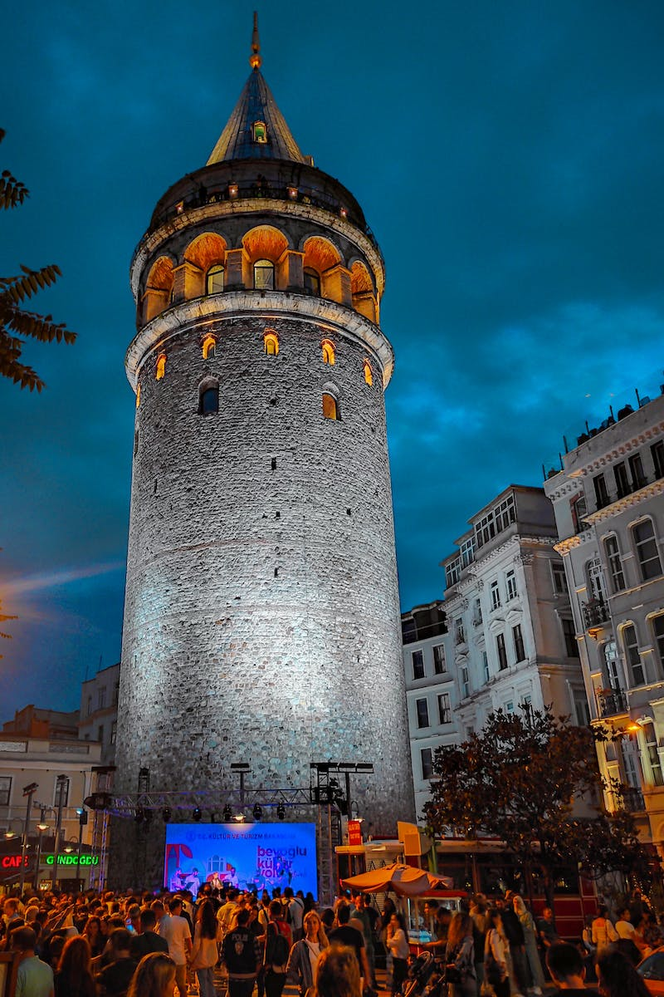
Historical Events
• 1986: Commission on Higher Education
• 1959: Loving sham
• Commonwealth 134
• 186: Manuel
Photo by Pexels

Slide 7
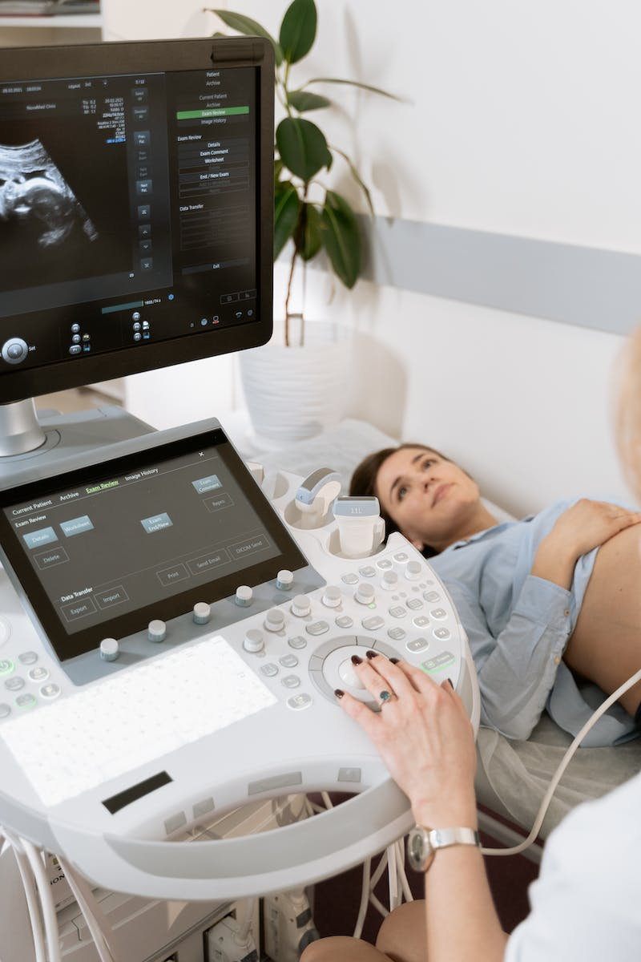
Conclusion
• 1997: Ramos
• Hills Commonwealth 184
• 1936: Manuel
Photo by Pexels

