Slide 1
Surgical Treatment Options for Pediatric Hydrocephalus
A Practical Approach with Video and Descriptions of Procedures

Slide 2
CSF Physiology and Hydrocephalus
• Hydrocephalus is a disorder of CSF physiology
• Results in increased intraventricular pressure and accumulation of CSF
• Frequently associated with elevated intracranial pressure
• Failure of CSF absorption is common cause of hydrocephalus

Slide 3
Etiology of Hydrocephalus
• Etiology varies, including congenital and acquired causes
• Common congenital causes include aqueduct stenosis and Chiari malformations
• Communicating and non-communicating hydrocephalus have different causes
• Treatment options depend on etiology and patient's age
Photo by Pexels

Slide 4
Endoscopic Third Ventriculostomy (ETV)
• ETV creates a new pathway between the ventricles and subarachnoid space
• Commonly used for non-communicating hydrocephalus
• Success rate depends on age, etiology, and previous shunt placement
• Anatomical considerations and trajectory planning are crucial
Photo by Pexels

Slide 5
Endoscopic Third Ventriculostomy Procedure
• Enter the lateral ventricle and confirm proper positioning
• Navigate to the third ventricle and identify relevant anatomical structures
• Create an ostomy or fenestration in the floor of the third ventricle
• Inspect the pre pontine cistern and ensure adequate CSF flow
Photo by Pexels

Slide 6
Success Factors and Outcomes of ETV
• Age and etiology play a significant role in ETV success
• Certain etiologies, such as obstructive aqueductal stenosis, have higher success rates
• Repeat ETV can be successful in cases of failure
• Late failures can occur, but complications are rare
Photo by Pexels

Slide 7
Temporary Measures for Small Infants
• Small infants with hydrocephalus may require temporary measures
• Ventricular access devices or subdural subgaleal shunt can help stabilize ventricles
• Timing and intervention in small infants is controversial
• Long-term non-surgical options are limited
Photo by Pexels

Slide 8
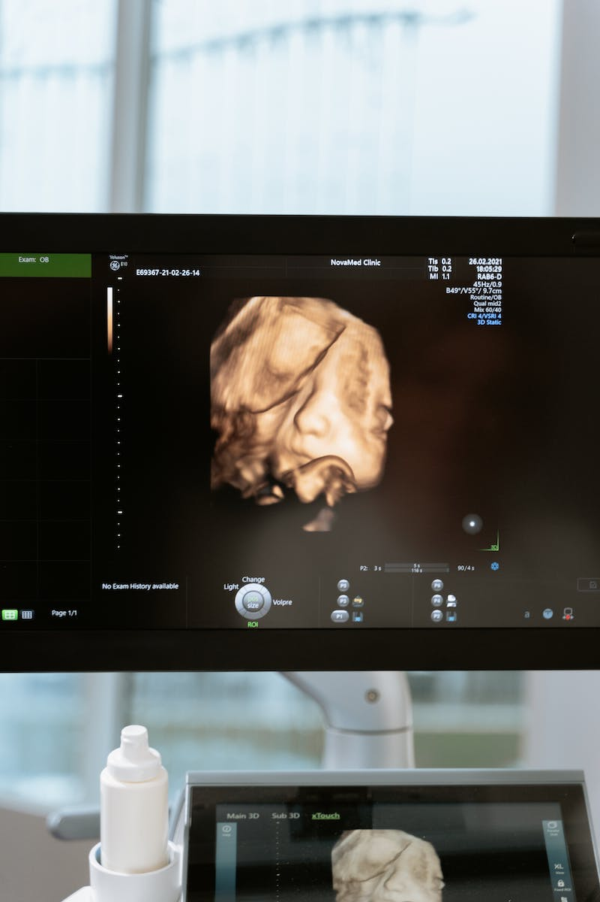
Conclusion
• Surgical treatment options for pediatric hydrocephalus include endoscopic third ventriculostomy (ETV) and shunting procedures
• ETV success depends on patient factors, etiology, and anatomical considerations
• Temporary measures may be necessary for small infants
• Long-term non-surgical treatment options are limited
Photo by Pexels

