Slide 1
The Mysterious Puzzle
Unraveling the Secrets of Ters' Puzzle Challenge

Slide 2
Introduction
• The challenge: Solve Ters' puzzle within 96 hours.
• The puzzle requires finding and purchasing specific items from the market.
• The task is difficult and expensive, with a reward of half a million gold.
• Failure to complete the challenge will result in losing gold and a soul achievement.
Photo by Pexels

Slide 3
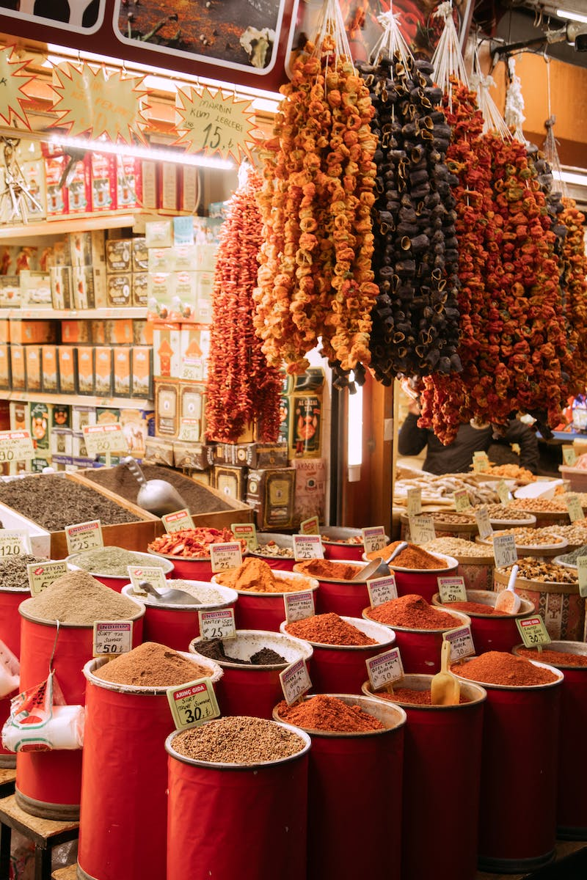
The Puzzle Market
• The puzzle items are hidden within a vast market.
• Numerous fake items are listed, making the search more challenging.
• Previous clues include the numbers 37, 50, and 55.
• Finding the correct item requires aligning the clues and deductions.
Photo by Pexels

Slide 4
Unraveling the Clues
• Exploring patterns and possibilities in the market listings.
• Connecting the numbers to potential items or item attributes.
• Considering Easter eggs and hidden references.
• Examining avatars, labels, and associated meanings.
Photo by Pexels

Slide 5
The Promising Discovery
• The potential solution: The 'Rush' sticker item.
• Correlation with the numbers and past clues.
• Symbolism and connection to Ters' avatar and messages.
• Justification for selecting 'Rush' as the most likely item.
Photo by Pexels

Slide 6
The Risky Purchase
• Purchasing 55 'Rush' stickers for 3750 gold each.
• Total expenditure of 260,000 gold.
• Uncertainty and doubts about the correctness of the choice.
• Hope for the return of the lost soul achievement.
Photo by Pexels

Slide 7
Awaiting Ters' Judgment
• Making a request to Ters for the final challenges.
• Implying the desire to reclaim the lost soul achievement.
• Expressing hope for a quick response and resolution.
• Gratitude for the audience's support during the journey.
Photo by Pexels

