Slide 1
Managing Anger and Respecting Others
Exploring the Importance of Self-Control and Mutual Respect

Slide 2
Introduction
• Music and Emotions
• Incident with Dika
• Feelings of Anger
• Importance of Self-Control and Respect
Photo by Pexels

Slide 3
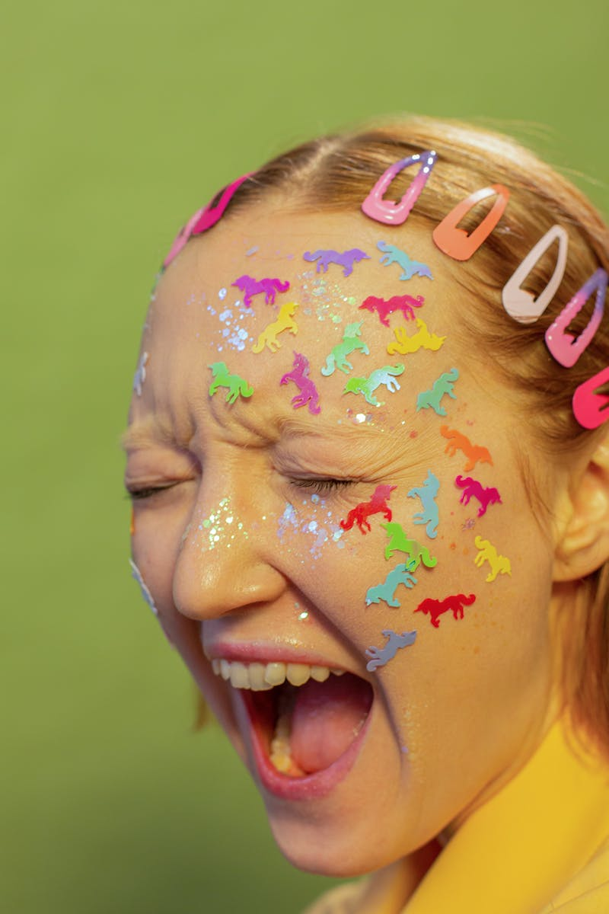
Expressing Anger
• Actions Towards Dika
• Impulsive Behavior
• Impact on Class Beliefs
Photo by Pexels

Slide 4
Reflecting on Class Beliefs
• The Importance of Respect
• Reasons for Feeling Angry
• Appropriate Behavior
Photo by Pexels

Slide 5
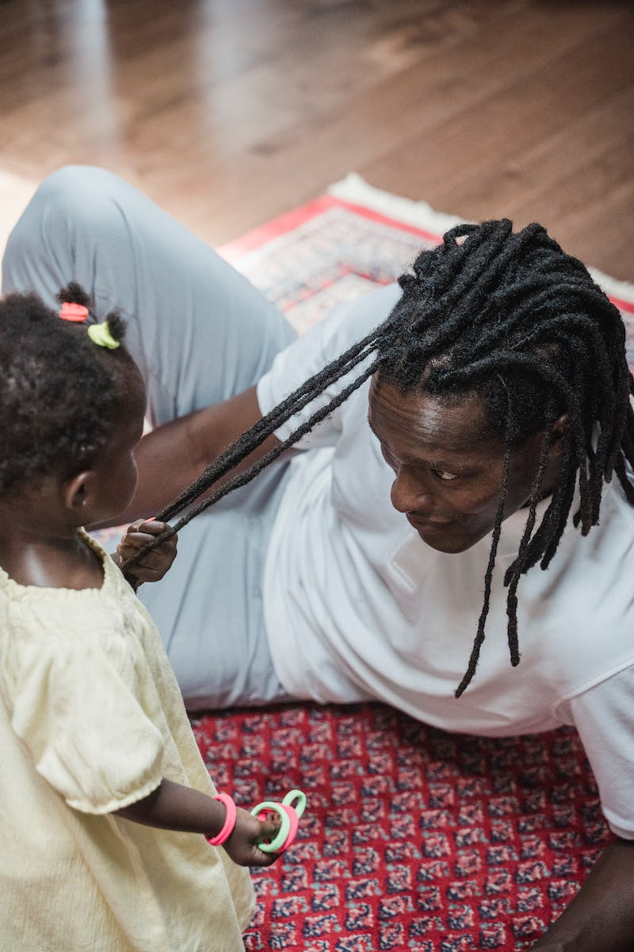
Channeling Anger Positively
• Practicing Patience
• Taking Responsible Actions
• Reporting Cheating Incidents
Photo by Pexels

Slide 6
Conclusion
• Wrap Up and Encouragement
• Reminder to Stay Positive
• Returning to Class
Photo by Pexels

