Slide 1
Psychological Safety: Creating an Environment of Reward and Growth
Why Psychological Safety is Essential for Team Success

Slide 2
Introduction
• Psychological safety is an environment of rewarded vulnerability
• Vulnerability refers to exposure to harm or loss
• Psychological safety allows acts of vulnerability to be rewarded
• Acting with vulnerability is essential for team success
Photo by Pexels

Slide 3
The Importance of Rewarding Vulnerability
• Rewarding vulnerability encourages individuals to be themselves
• It promotes learning, contribution, and challenging the status quo
• Without rewarding vulnerability, teams stagnate or break down
• Team members instinctively seek environments where vulnerability is rewarded
Photo by Pexels

Slide 4
The Impact of Punishing Vulnerability
• Punishing vulnerability activates the brain's pain centers
• It triggers self-censoring and defensive behavior
• Punished vulnerability hinders performance and creativity
• Individuals become preoccupied with personal risk avoidance
Photo by Pexels

Slide 5
Identifying Safe and Unsafe Environments
• Humans engage in threat detection to assess safety
• Observation and evaluation determine the perceived safety
• Safe environments elicit performance responses
• Unsafe environments trigger fear responses
Photo by Pexels

Slide 6
Specific Acts of Vulnerability
• Showing up and introducing oneself
• Sharing personal experiences or challenges
• Clarifying expectations and giving feedback
• Challenging the status quo and admitting mistakes
Photo by Pexels

Slide 7
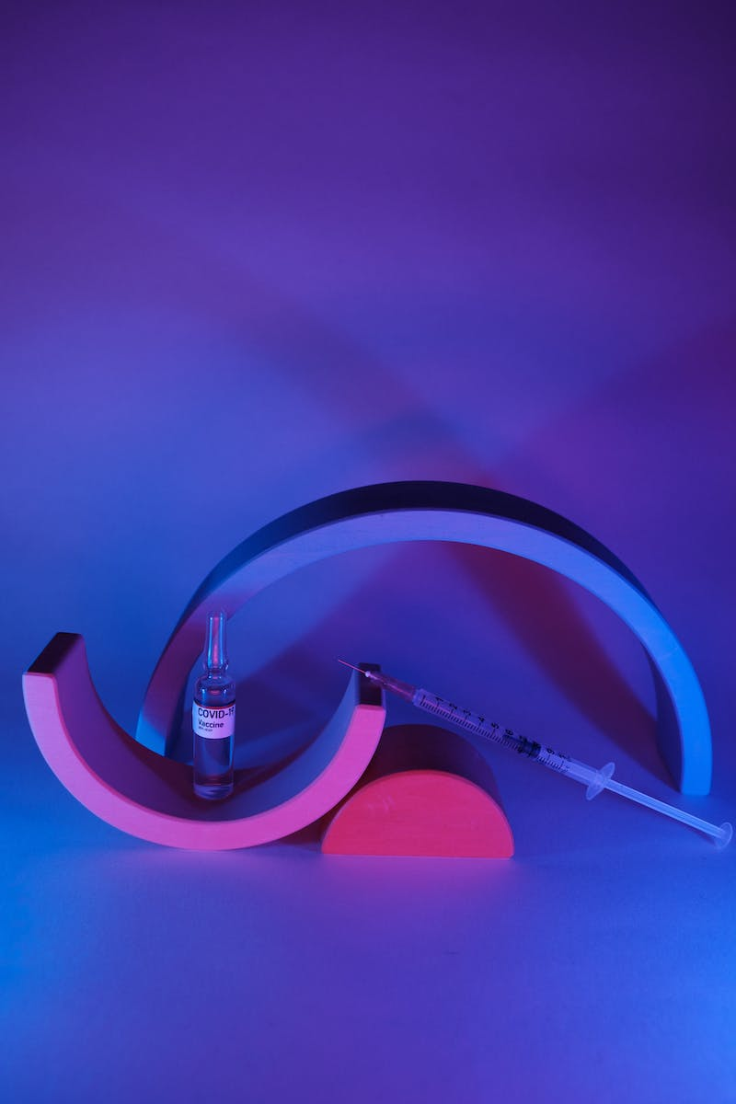
Creating a Blue Zone: High Psychological Safety
• A blue zone is an environment of rewarded vulnerability
• High psychological safety cultivates trust and open communication
• Teams thrive in blue zones by maximizing their potential
• Creating a blue zone requires continuous effort and prioritization
Photo by Pexels

Slide 8
The Perishable Nature of Psychological Safety
• Psychological safety is delicate and dynamic
• It requires constant attention and prioritization
• Similar to physical safety, psychological safety must be a daily focus
• Team members must be accountable for maintaining the blue zone
Photo by Pexels

